Slide 1
College Student Health Survey Report
St. Cloud State University
College Student Health Survey
Katherine Lust, PhD, MPH, RD
Director of Research: Boynton Health Service, University of Minnesota
Adjunct Assistant Professor,
Division of Epidemiology & Community Health, University of Minnesota
March 25, 2013

Slide 3
Methodology
Paper Work
FERPA
IRB
Logistics
List of students
IT
Test, Test. Test
Over sampled Veterans

Slide 4
Methodology
2,928 students were sent a survey (2008)
3,558 students (2009)
3,517 students (2010)
3,511 students (2011)
5,928 students (2012)
31.6% Response rate (2008)
33.4% (2009)
34.5% (2010)
35.7% (2011)
15.9% (2012)
Over the 5 years
19,442 students received a survey
and 5,520 completed a survey

Slide 5
Demographics
 | Survey participants
 | ‘08 | ‘09 | ‘10 | ‘11 | ‘12
Average age (years) | 23.5 | 23.1 | 23.3 | 24.4 | 24.6
Gender
Male | 39.0 | 40.1 | 38.6 | 39.9 | 40.0
Female | 60.7 | 59.7 | 61.1 | 59.4 | 59.7
Transgender/Other | 0.3 | 0.2 | 0.3 | 0.5 | 0.3
Race/Ethnicity
White-Non Hispanic | 85.9 | 86.6 | 85.7 | 85.7 | 85.7
Live Residence Hall or Fraternity/Sorority | 19.7 | 20.5 | 22.4 | 19.4 | 17.4

Slide 6
Analysis: Academic performance
Grade Point Average:
self report

Slide 7
Areas to be Examined
Tobacco Use
Alcohol/Other Drugs
Personal Safety
Financial

Slide 8
Current Tobacco Use
P <0.0001
Current Tobacco Use: Any use of tobacco within the past 30 days

Slide 9
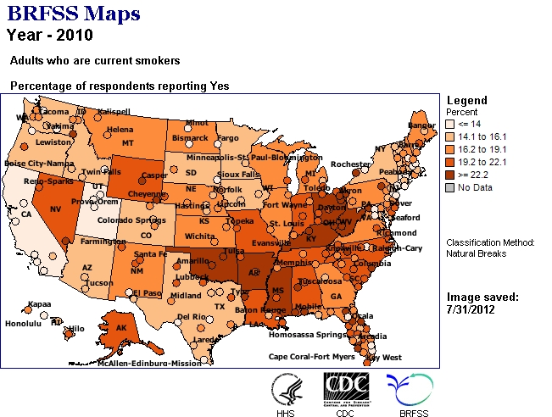
Current Tobacco Use
Minnesota: 14.9%

Slide 10
Daily Tobacco Use

Slide 11
Current Smokeless Tobacco Use
Current Smokeless Tobacco Use: Any use of smokeless tobacco within the past 30 days

Slide 12
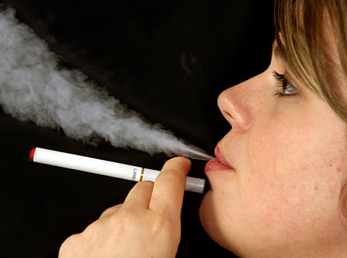
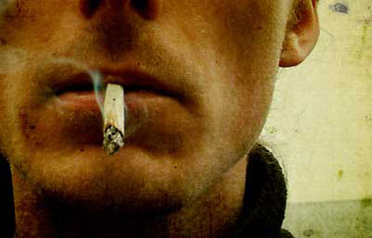
Consider Themselves Smokers Among Those Who Smoked Tobacco Within Past 30 days
51.2% attempted to quit
3.7= Average number of quit attempts
SCSU 20112 CSHS

Slide 13
Exposure to Secondhand Smoke
Location | Percent Who Indicate Exposure
 | Inside | Outside
On Campus | 3.5 | 53.4
Residence Halls | * | 9.3
Fraternity/Sorority | 0.4 | 1.5
Bars/Restaurants | * | 24.2
In a Car | 21.1 | *
Where I Live | 8.3 | 19.5
Private Parties | 10.5 | 19.0
Worksite | * | 10.2
Parking Ramp/Garage | 6.3 | *
Other | 6.4 | 14.8
*Location not included in question
SCSU 2012 CSHS

Slide 14
Current Alcohol Use
P <0.0001

Slide 15
Current Alcohol Use

Slide 16
Used Alcohol within past 30 days:
12th Grade
Male: 41.0%
Female: 39.0%
2010 MN Student Survey
E. Weitzman, 2006

Slide 17
High Risk Drinking
P<0.0001
Ages 21 to 23 are the peak years for engaging in high-risk drinking

Slide 18
High Risk Drinking
Ages 21 to 24 are the peak years for engaging in high-risk drinking

Slide 19
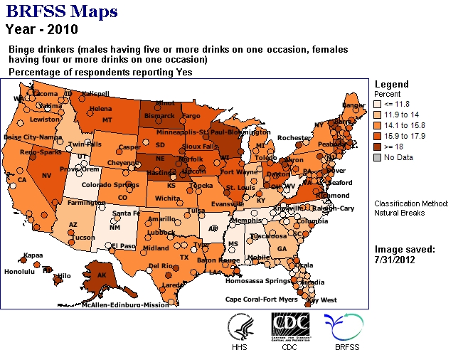
High Risk Drinking
Minnesota: 17.2%

Slide 20
Negative Consequence Due to Alcohol/Drug Use
Had a Hangover
Performed Poorly on a Test or Important Project
Been in Trouble with Police, Residence Hall, or Other College Authorities
Damaged Property, Pulled Fire Alarm, etc.
Got Into an Argument or Fight
Got Nauseated or Vomited
Driven a Car While Under the Influence
Missed a Class
Been Criticized by Someone I Know
Thought I Might Have a Drinking or Other Drug Problem
Had a Memory Loss
Done Something I Later Regretted
Been Arrested for DWI/DUI
Have Been Taken Advantage of Sexually
Have Taken Advantage of Another Sexually
Tried Unsuccessfully to Stop Using
Seriously Thought About Suicide
Seriously Tried to Commit Suicide
Been Hurt or Injured

Slide 21
Association High Risk Drinking and Negative Consequences
P < 0.0001
Aggregate 2010 CSHS

Slide 22
High Risk Drinking and Grade Point Average
Do not engage: Mean= 3.37
P< 0.0001
Engage in HRD: Mean= 3.21
Aggregate 2010 CSHS

Slide 23
High Risk Drinking and GPA
Aggregate 2010 CSHS

Slide 24
Current Marijuana Use
P= 0.002
U of M 2010 CSHS

Slide 25
Current Marijuana Use

Slide 26
Marijuana Use and GPA
P < 0.0001
Aggregate 2010 CSHS
Marijuana Use refers to use within the past 30 days

Slide 27
Other Illicit Drug Use-Past 12 Months
Survey Year | Most commonly used illicit drug | 2nd | 3rd | 4th
2008 | Cocaine 4.3% | Sedatives 3.8% | Ecstasy 2.4% | Hallucinogens 2.2%
2009 | Cocaine 3.7% | Sedatives 3.0% | Ecstasy 2.4% | Hallucinogens 2.4%
2010 | Sedatives 2.7% | Hallucinogens 2.1% | Ecstasy 2.1% | Cocaine 1.3%
2011 | Sedatives 2.8% | Hallucinogens 2.1% | Cocaine 1.5% | Ecstasy 1.4%
2012 | Sedatives 1.6% | Hallucinogens 1.4% | Cocaine 1.2% | Ecstasy 1.1%

Slide 28
Other Illicit Drug Use-Past 12 Months
5.9% report having used at least one of the nine illicit drugs
5.3% report having used another person’s prescription medication

Slide 29
Other Drug Use and GPA
P < 0.0001
Aggregate 2010 CSHS
Other drug use refers to use within the past 12 months

Slide 30
Sexual Assault: Lifetime

Slide 31
Sexual Assault: Lifetime

Slide 32
Sexual Assault: Past 12 Months

Slide 33
Sexual Assault: Past 12 Months

Slide 34
Domestic Violence: Lifetime

Slide 35
Domestic Violence: Lifetime

Slide 36
Domestic Violence: Past 12 Months
P<0.0001

Slide 37
Domestic Violence: Past 12 Months

Slide 38
Sexual Assault and GPA Females only
Not statistically significant
Aggregate 2010 CSHS

Slide 39
Domestic Violence and GPA Females only
Not statistically significant
P< 0.0001
Aggregate 2010 CSHS

Slide 40
Sexual Assault Reporting by Victims
Reported the Assault to | Percent
Health Care Provider | 30.0
Hall Director or Community Advisor | 6.0
Campus Sexual Violence Office | 8.0
Police | 32.0
Other | 50.0
Based on experiencing sexual assault within lifetime
SCSU 2012 CSHS

Slide 41
Depression Diagnosis-Lifetime All Students by sexual assault/domestic violence
SCSU 2012 CSHS

Slide 42
Questions?

