Slide 1
10 Ways To Promote Wellbeing In Your Class: Curriculum infusion ideas that address mental health

Slide 2
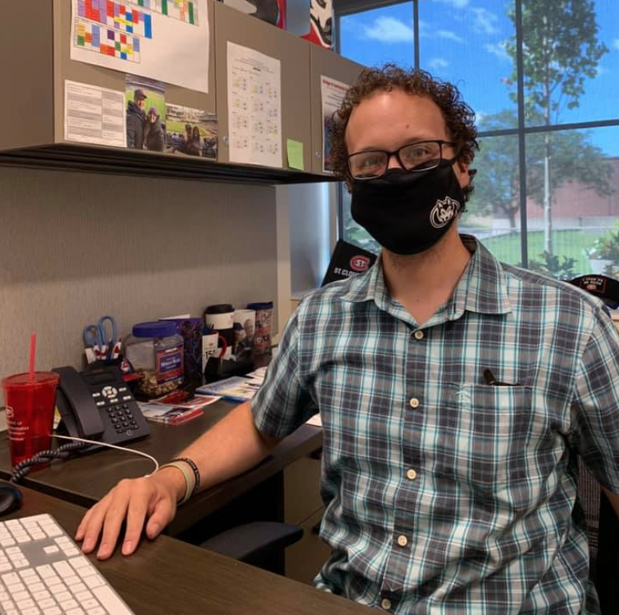
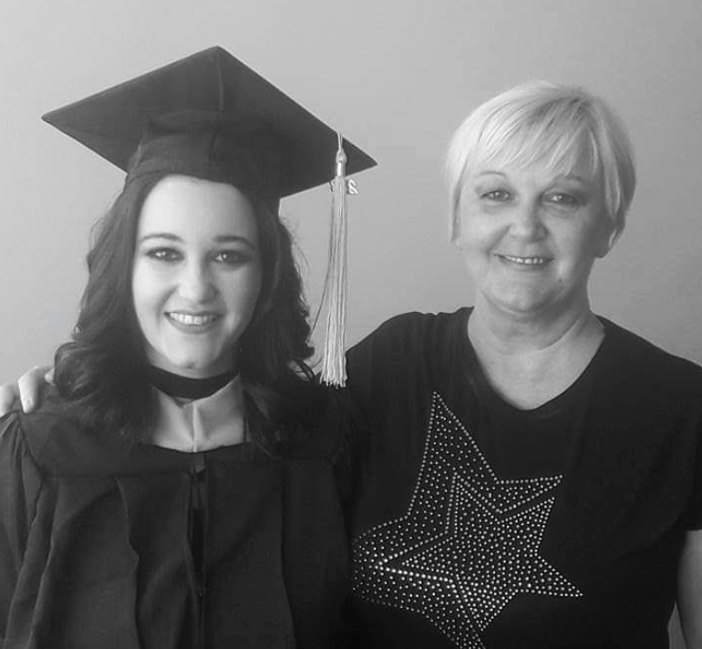
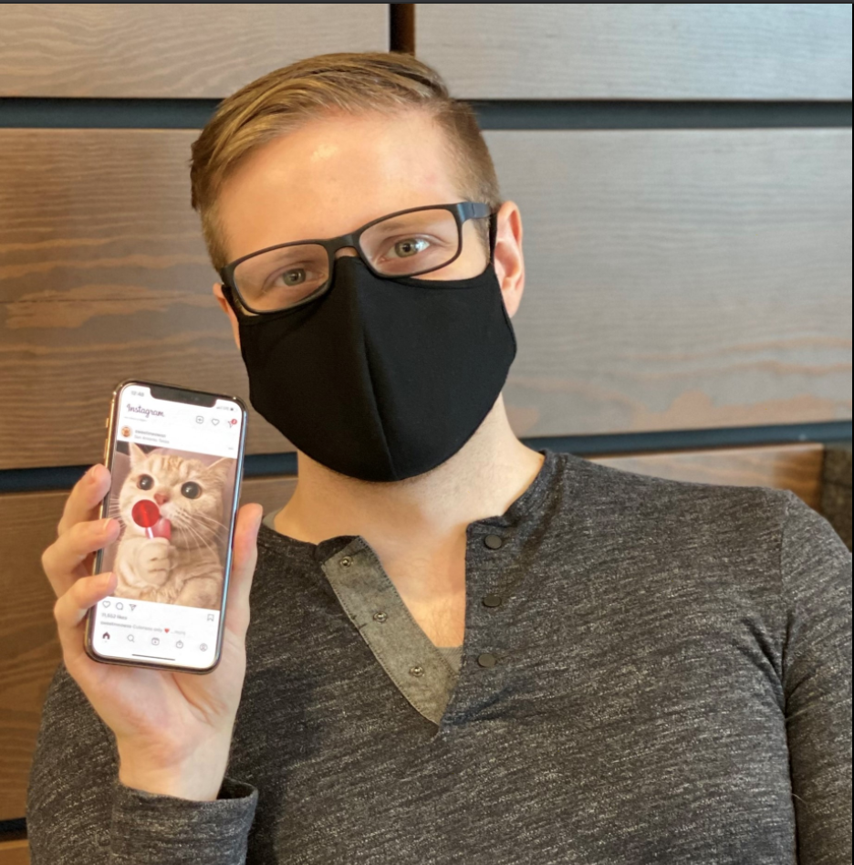
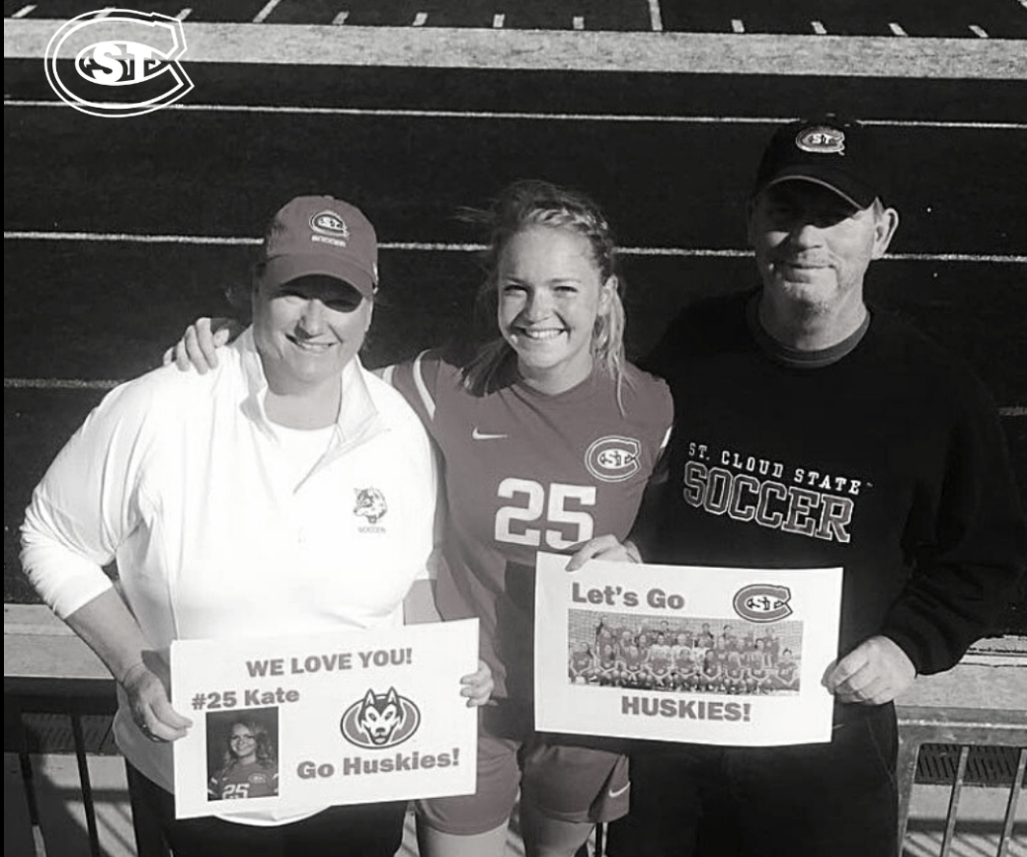
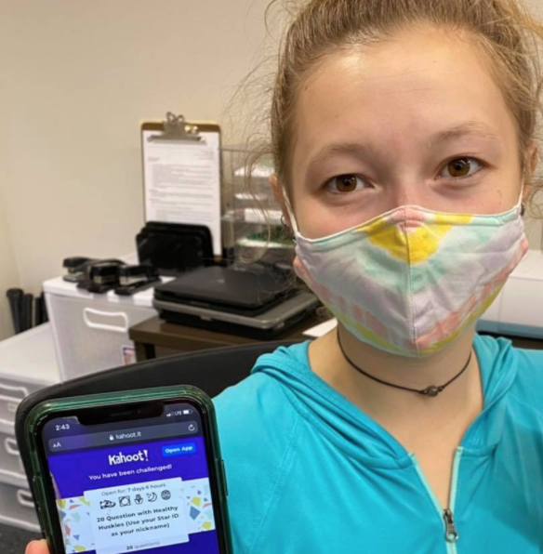
Jen Waletzko Johnson
Interim Director of AOD Prevention
Erica Karger-Gatzow LICSW
Asst Director of Health Promotion and Marketing
Samantha Yang
Mental Health Program Coordinator GA
1st year Masters College Counseling and Student Development

Slide 3
Let's Prioritize Health- right now!
Calm: Breathing Bubbles
https://www.youtube.com/watch?v=iaQed_Xdyvw

Slide 4
This session is being recorded

Slide 5
Agenda
Why this? Why now?
Model of Well-being
Current services supporting well-being at SCSU
10 ways to infuse well-being practices into your curriculum
Discussion

Slide 6
Why
Faculty care about their students and feel poorly equipped to help when it comes to mental health.
Students at St. Cloud State*:
39% report being diagnosed with a mental health condition in their lifetime
37% Report having unmanaged stress
Students are too stressed to attend additional workshops and groups
Fire prevention instead of fire fighting
*College Student Health Survey, 2020

Slide 7
SCSU Health Statistics *2020 College Student Health Survey
Average Number of Days/Month Affected by Illness
Poor Mental Health: M – 4.2 F – 7.2
Poor Physical Health: M – 2.6 F – 3.2
Poor Physical and/or Mental Health Affected Daily Activities: M – 2.3 F – 3.4
Top 4 Mental Health Stressors
Roommate/Housemate Conflict
Death of Someone Close to you
Serious Illness of someone close to you
Termination of Personal Relationship
Stress
71.4% of students reports having stress, with 52.9% indicating it impacts their academics
Notes:
I changed the numbers for the stress stat based on how I read the data in the CSHS, p. 11

Slide 8
Flourishing Model
Source: Keyes, C. (2007). Promoting and Protecting Mental Health and Flourishing. American Psychologist, 62 (2), 95-108.
Notes:
Flourishing has a combination of high levels of such as emotional well-being, psychological well-being, and social well-being. Only 23% of people in the United States are flourishing. According to Keyes, mental health exists on a continuum from flourishing (or positive mental health) to languishing (or negative mental health, but not necessarily having a mental illness). Keyes model of flourishing states that one can flourish or languish with or without a mental illness. The Flourishing Model -- see below -- identifies what aspects are needed in all three areas of emotional, social and psychological well-being to make up a flourishing life. Thus, in order to flourish, a person must have one of three traits from the emotional well-being area and six of the eleven traits from the psychological and social well-being areas.

Slide 9
Current State of Wellbeing services at St. Cloud State
CAPS: individual & dyad counseling, psychotherapy groups, crisis appointments (in-person), case management, faculty consultation
Medical Clinic: Mental health triage, medication management (general practice MD/NP & telepsychiatry), diagnostic evals
Wellness Coaching
SHHS Training School: individual counseling
Recovery Resource Center & UChoose
reductions in risky drinking & recovery is suicide prevention!
Student Accessibility Resources- Accommodations for students with disabilities
Active Minds SCSU
Hey, You Okay?
Safe Space and Bystander Trainings
QPR

Slide 10
Disclaimer
Everything we discuss is optional. We invite you to consider them.
Every option will not work for every class. Only you know what will work for your curriculum.
Everyone is on a different journey.
It’s okay to start small.
This is the beginning of the discussion.

Slide 11
Take Two
Dedicate 2 minutes at the beginning of class to wellbeing practices.
More doing, less talking (use this time to actually do the activity)
Two minutes over time becomes a habit.
Neuroplasticity, Office of Health Promotion, Carleton College: https://www.youtube.com/watch?v=jxeaWcpV6NQ

Slide 12
Let’s Practice an Affirmation Exercise
•I am becoming a better professor every day.
•The work I do matters.
•I believe in myself.
•I am amazing and am prepared to succeed.
•I trust my intuition.
•My ability to learn is improving every day.
•I am doing the best that I can.
•I am courageous.
•Anything is possible.
•I am grateful for all that I have.

Slide 13
Syllabus Statement
Include contact information and brief description of services to key services on campus (Student Accessibility Services, Counseling and Psychological Services, Medical Clinic, Recovery Resource Center, Wellness Coaching, etc)
Sample available on CETL website
Make it more than only a first day of class thing

Slide 14
Changing "Assignment Due" Times
Sleep and Mental Health have a bi-directional relationship- improving sleep improves mental health.
Default is 11:59pm
Center for College Sleep: Sleep and Mental Health https://www.youtube.com/embed/Jrr4aXe47vk/vq=highres/?rel=0
Consider 9pm or 10pm at the latest

Slide 15
SCSU Data on Student Sleep

Slide 16
Add a presentation on Health and Wellbeing
If you can’t be at class, you don't have to cancel. Consider utilizing that session for health and wellbeing.
Health and Wellness Resources at St. Cloud State
UChoose (reducing high risk drinking is suicide prevention!)
Recovery Ally Training
Hey, You Okay?
QPR

Slide 17
Share concerns
EAB’s Navigate : Simplifying processes for students and providing timely information on their academic progress can assist in reducing anxiety and promoting student persistence and retention.
Progress Reports
Advising Appointment Campaigns
Issuing Alerts
Financial concerns, Major academic concern, Major attendance/participation concern, Major life event.
Notes:
Progress Reports
· 1 – 2 times per semester, we request progress reports for specific populations of students and instructors identify students at risk for failure
· Professional advisors connect students to resources and strategize a return to success
· It’s important that students are first notified by their instructors, through current D2L grades, emails expressing concern and suggesting solutions.
Advising Appointment Campaigns
Students respond well to online appointment booking, which can reduce anxiety around contacting professionals directly and increase early attendance to advising meetings and encourage more timely registration.
Issuing Alerts
Instructors and faculty advisors can issue alerts through Navigate on individual students for whom they have significant concerns. Staff then connect the student with appropriate support services.

Slide 18
ASSIGNMENTS THAT PROMOTE WELLNESS
Introductory Assignment: share 3 things you are grateful for and 1 thing you are savoring.
Campus Engagement Assignment: Wellness, Cultural/Diversity, Spirit, Academic
Participate in Wellness Activity and write a reflection on the experience
Wellness Coaching
CAPS groups
Notes:
Wellness Coaching Feedback to share:
Wellness Coaching was something new for me, but I found it very helpful. I had heard about wellness coaching before but had never set a time for making an appointment. The sessions allowed me to reflect on the areas of my life that provided me an insight into how taking care of all aspects of health and wellness is so important. Wellness coaching overall was very helpful for me. I ended up scheduling 4 sessions with my wellness coach as I was finding it very helpful in coping with my problems and improving my health. My coach was a good listener and he helped me improve my health by guiding me and listening to what I had to say to solve my problems and behaviors.
Overall, this was an experience with my wellness coaches, I will take to not only my personal/professional development, but to my grave. I will bring this to my personal/professional development in also being able to care for myself, as I want to care for others. I learned I can accomplish anything I really set my mind to.
One thing I learned from my coach was the importance of truly listening to someone. It can change someone’s whole experience, day, or situation. I also plan to keep using the free resources I have through the universities as long as I am here
Wellness coaching was something I truly was not very open to when I showed up to my first Zoom session. In the matter of minutes, I realized why people do this. These few quick sessions not only gave me someone to vent to but gave me actionable goals to work towards. My coach was very helpful and welcoming. Having someone with an unbiased opinion on my life has been tremendous. They were able to ask insightful and thought-provoking questions that force me to really dive into my life.
Going forward I have a game plan for how I want to get the job of my dreams, maintain a healthy lifestyle, create my own chosen family, and truly make connections no matter where I go. I have actually continued wellness coaching and will meet once a month through graduation. This tool that we have on campus is something that more should take advantage of. This free resource is far better than any advisor I have had on campus. It has truly made the daunting concept of life after college much more feasible. Sometimes we all need an extra push to get the help and advice we need, and this assignment was enough. This semester and the following months would appear far more scary if I would not have been nudged to take this next step. I am grateful to have found this resource and would recommend more professors implement this into their courses.
It taught me that it is okay to talk about your physical and mental health and knowing that they are there to help you and support you. It also taught me that I am not alone and it is okay to reach out to others. This experience has helped me with my personal and professional development by allowing the client or whoever it may be to talk about their concerns no matter what it is and just being a good listener because sometimes that is all they need. I noticed that everyone isn’t looking for advice but the presence of those that are willing to just be there and support. It means a lot to help others express their concerns in a way that not only helps relieve themselves but also helps relieve yourself too in a sense that knowing that you made a difference just by being there for them. Also, it taught me personally that no matter what you’re going through, it’s always a good idea to reach out. Additionally, it has helped me to think differently in a way that I should put myself in their shoe or situation and try to comfort them
Going into the first session, I was hesitant because I actually am a wellness coach at my current job. With this in mind, I went into the appointments just wanting to get it over with because I already felt like I had the help and support that I needed. Boy, I was wrong. During the course of those three weeks, my coach and I set specific goals for myself; financial well-being, social well-being and time management. Overall, I did find that the Wellness Coaching sessions were very helpful. In my personal life, it has helped me to actually speak my goals into existence rather than keep them to myself. I find that it keeps me more accountable. In my professional life, I have found that these sessions have helped me to be a better coach for my clients and realizing what a big difference I can make for someone by just listening to them.

Slide 19
Assignments that promote wellness
ECheckupToGo – Alcohol & Cannabis
Evidence-based online prevention intervention. This tool provides personalized feedback that helps to show how your substance use habits, family history, and campus norms affect your life and future
Mental Health Assessments
Depression, Anxiety, Alcohol, Posttraumatic Stress, or Eating Disorders Self-Assessments. Screenings are confidential and free for SCSU students
https://screening.mentalhealthscreening.org/saintcloud

Slide 20
Adopt a universal design approach
Attendance: Remove or reduce it as a graded portion of the class
Sick notes: stop asking for them
SCSU Medical Clinic practice statement on excuse notes: https://www.stcloudstate.edu/medicalclinic/medical-clinic/default.aspx
Record classes, post slide deck
Consider utilizing a variety of modalities for assignments

Slide 21
Normalize meetings with faculty
Each student schedules a 1:1 meeting with professor (in-person or via Zoom)
Encourages persistence in the major
De-stigmatizes utilizing office hours
Creates a bond to department and school (Academic Belongingness)
Could be especially powerful for asynchronous classes

Slide 22
Model Wellbeing Practices
Talk about ways you manage stress, take breaks, pursue hobbies, enjoy life and recharge.
This demonstrates that we are all "human" and need to care for ourselves.
If/when you incorporate wellness practices into the class, participate with the class.
Not only important for them, but also for you.

Slide 23
Discussion: WHAT OTHER WAYS COULD WELLBEING BE INCORPORATED INTO A CURRICULUM?

Slide 24
Thank you!
Dr. Debra Japp, Dr. Monica Garcia-Perez, Mark Monn,
Dr. Kathryn Kloby, Sarah Meisinger, Dr. Brent Nielsen,
Dr. Christine Metzo, Jen Sell-Matzke, Corie Beckermann,
Jeanne Williamson (UofM Morris), Janet Lewis Muth (Carleton College)

Slide 25
Thank you!
Jen Waletzko Johnson - Jtjohnson@stcloudstate.edu
Erica Karger-Gatzow - Ehkargergatzow@stcloudstate.edu
Samantha Yang - Samantha.yang@stcloudstate.edu

