Slide 1
President’s Convocation
Spring 2020

Slide 2
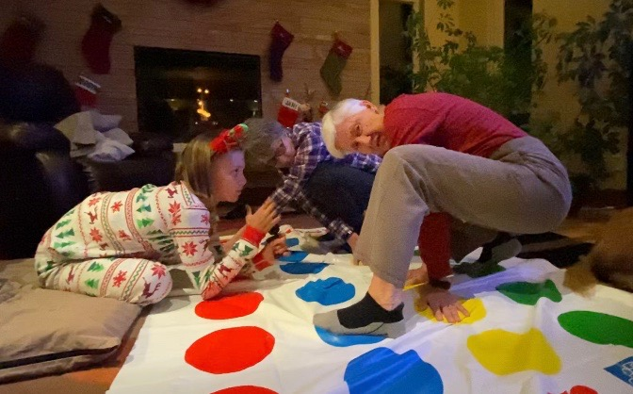

Slide 3


Slide 4
Fall 2019
Engage Campus
Why and what discussions
Summarize discussions & engage
Start

Slide 5
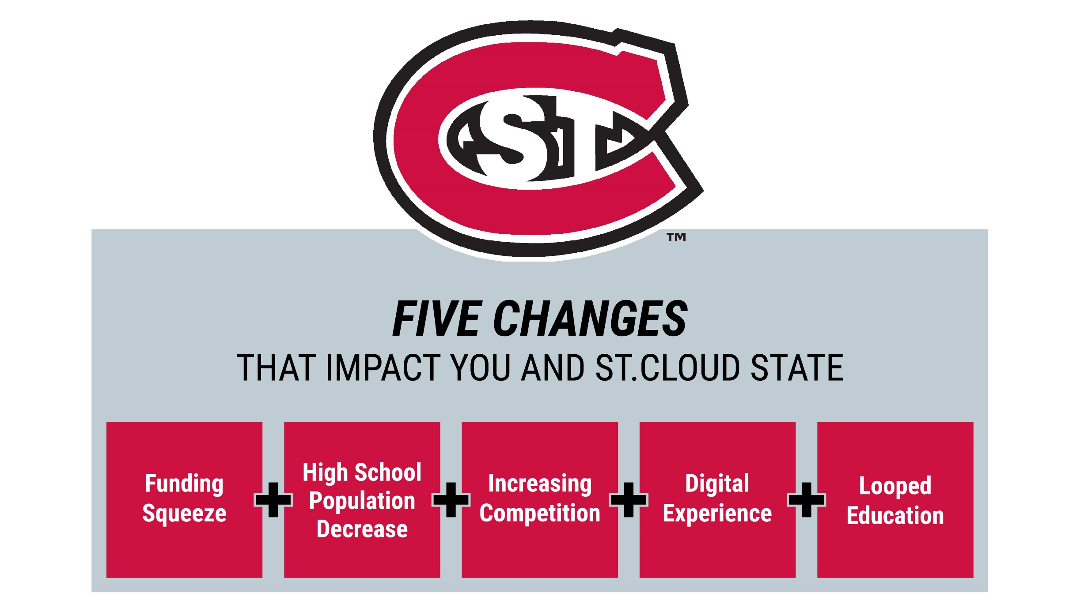

Slide 6
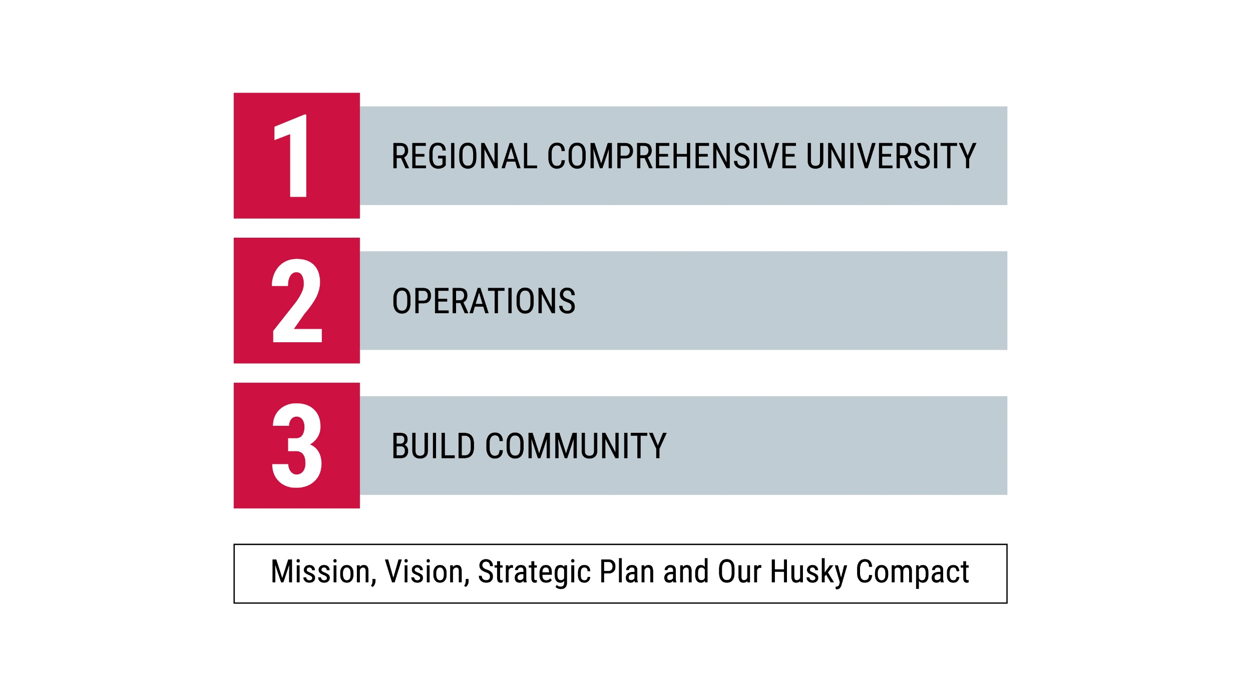

Slide 7

FEEDBACK

Slide 8
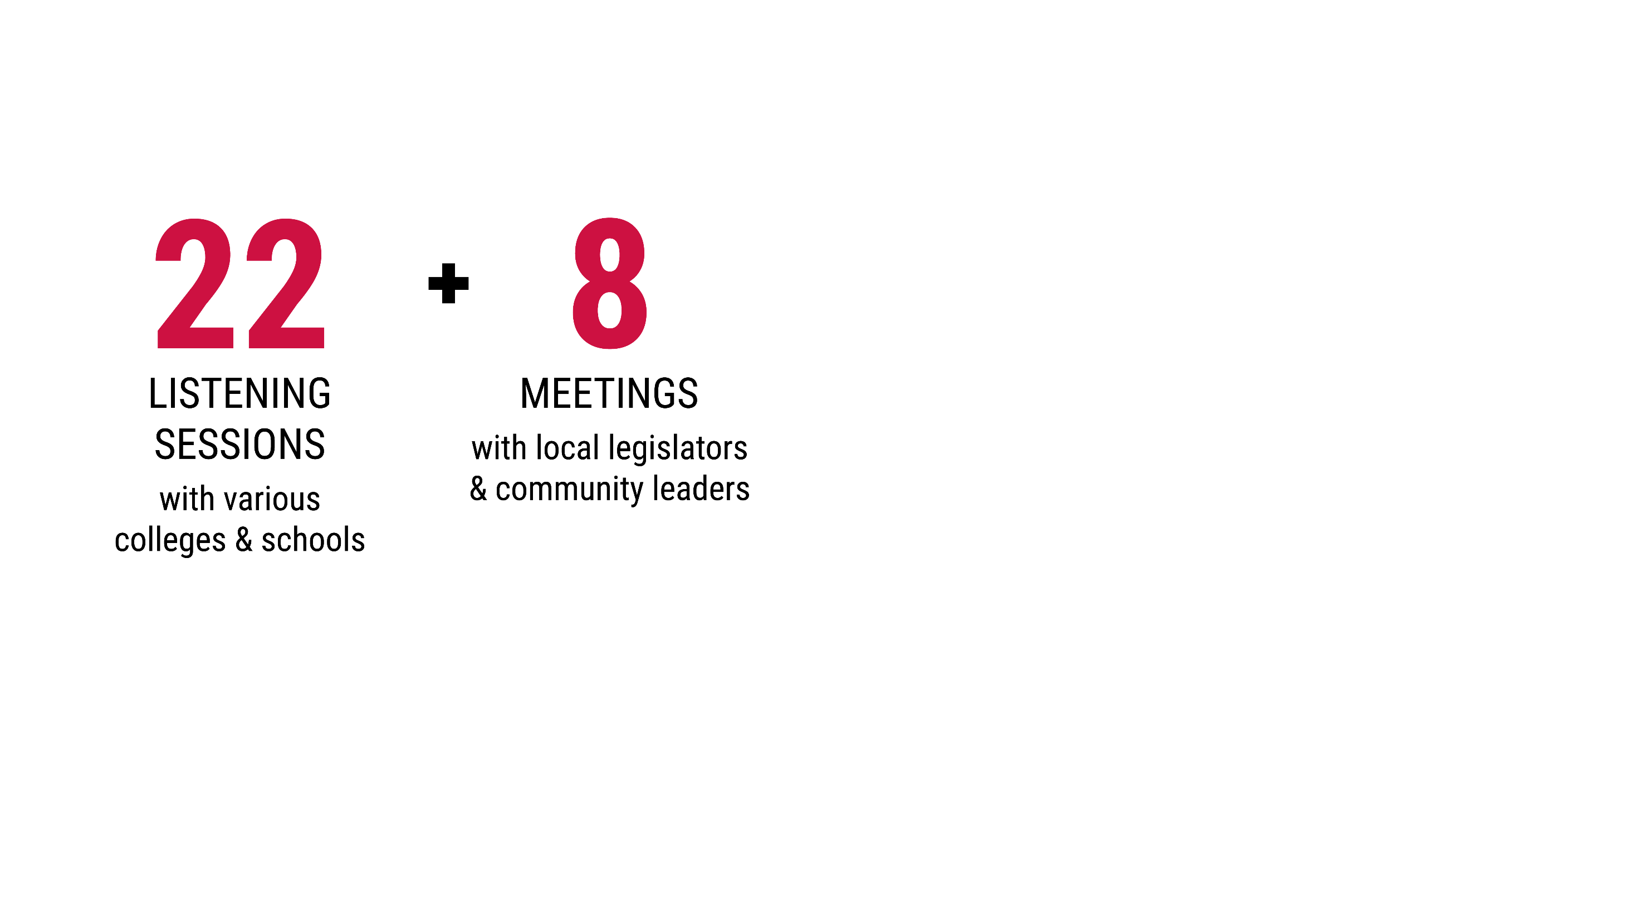
FEEDBACK

Slide 9
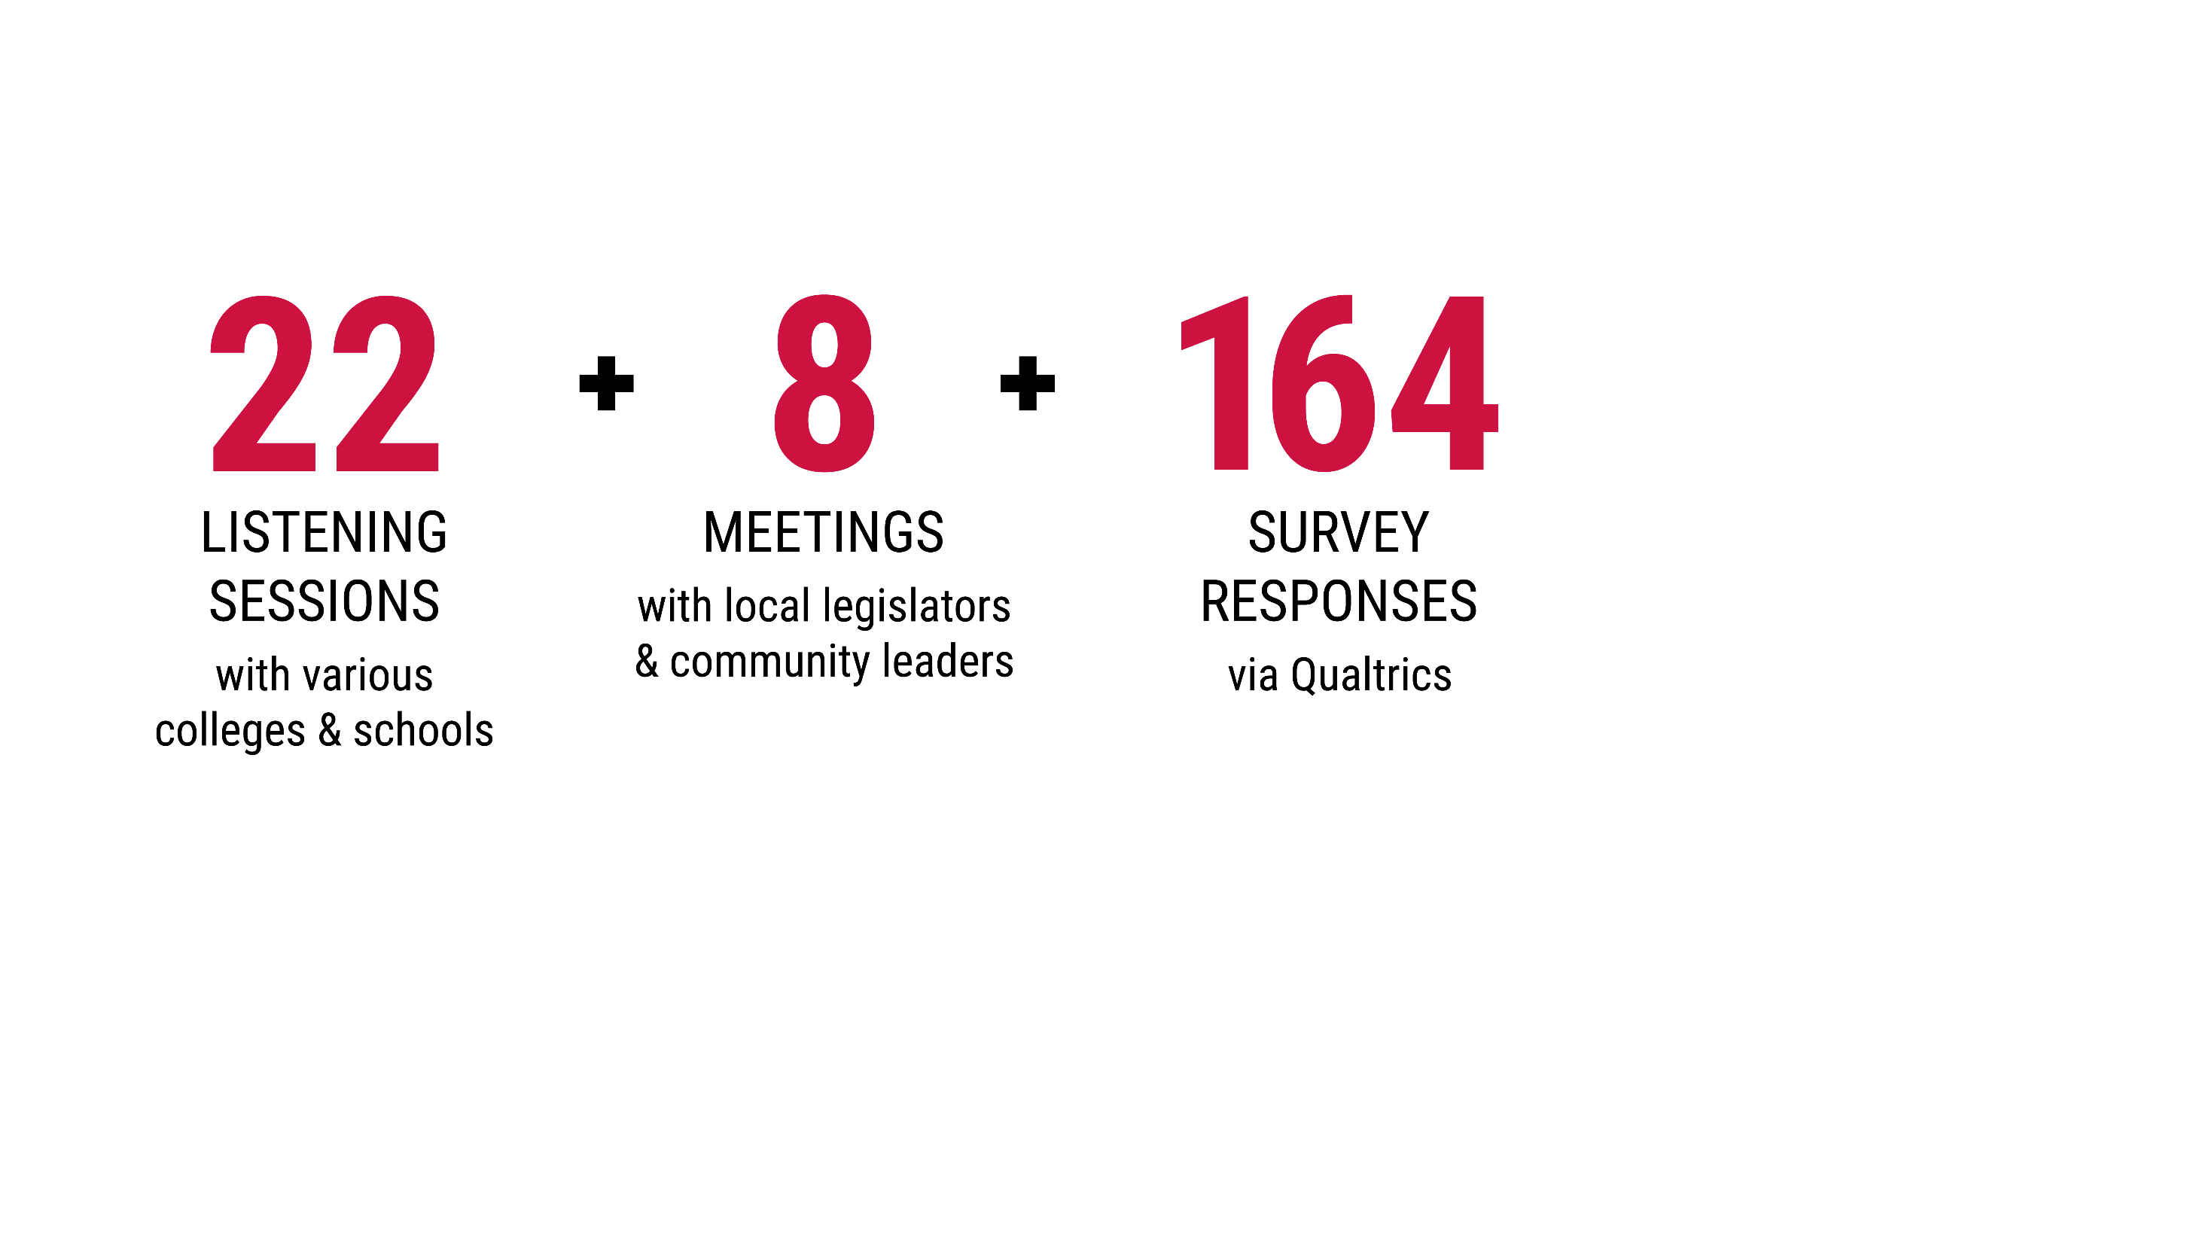
FEEDBACK

Slide 10
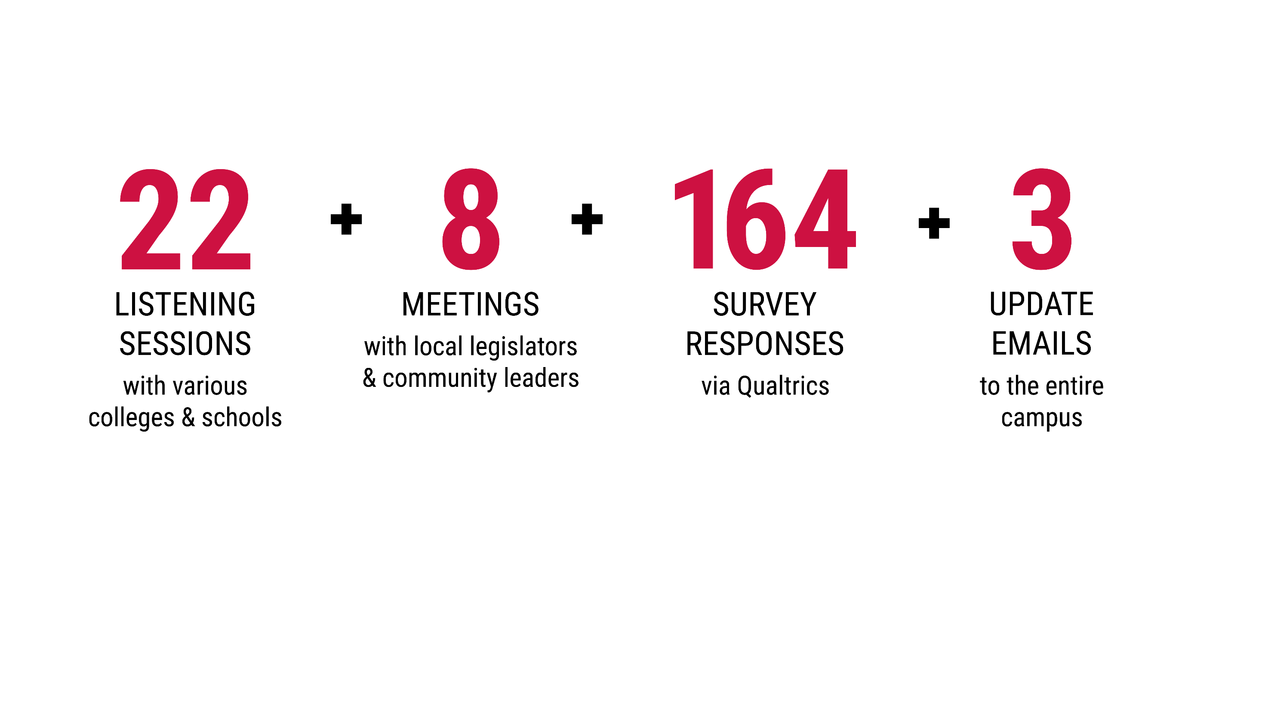
FEEDBACK

Slide 11
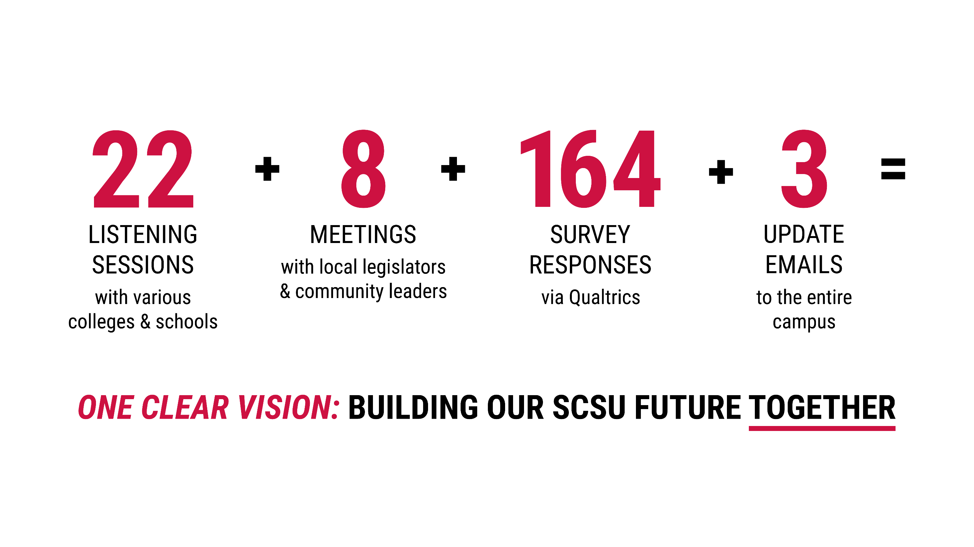
FEEDBACK

Slide 12
It’s Time.
Fall 2019
Engage Campus
Why and what discussions
Summarize discussions & engage
Start
3
Engage Campus
What SCSU will be
Begin “How” implementation
Spring 2020

Slide 14
1970-2000

Slide 15

REGIONAL COMPREHENSIVE

Slide 16

REGIONAL COMPREHENSIVE
REGIONAL COMPREHENSIVE
Regional - Limited Area
The university’s geographical location defined:
the student population and
university’s partnerships

Slide 17

REGIONAL COMPREHENSIVE
Comprehensive – Extensive Academic Options
Extensive portfolio of mostly undergraduate academic programs
Stand-alone general education courses lacking integration

Slide 18
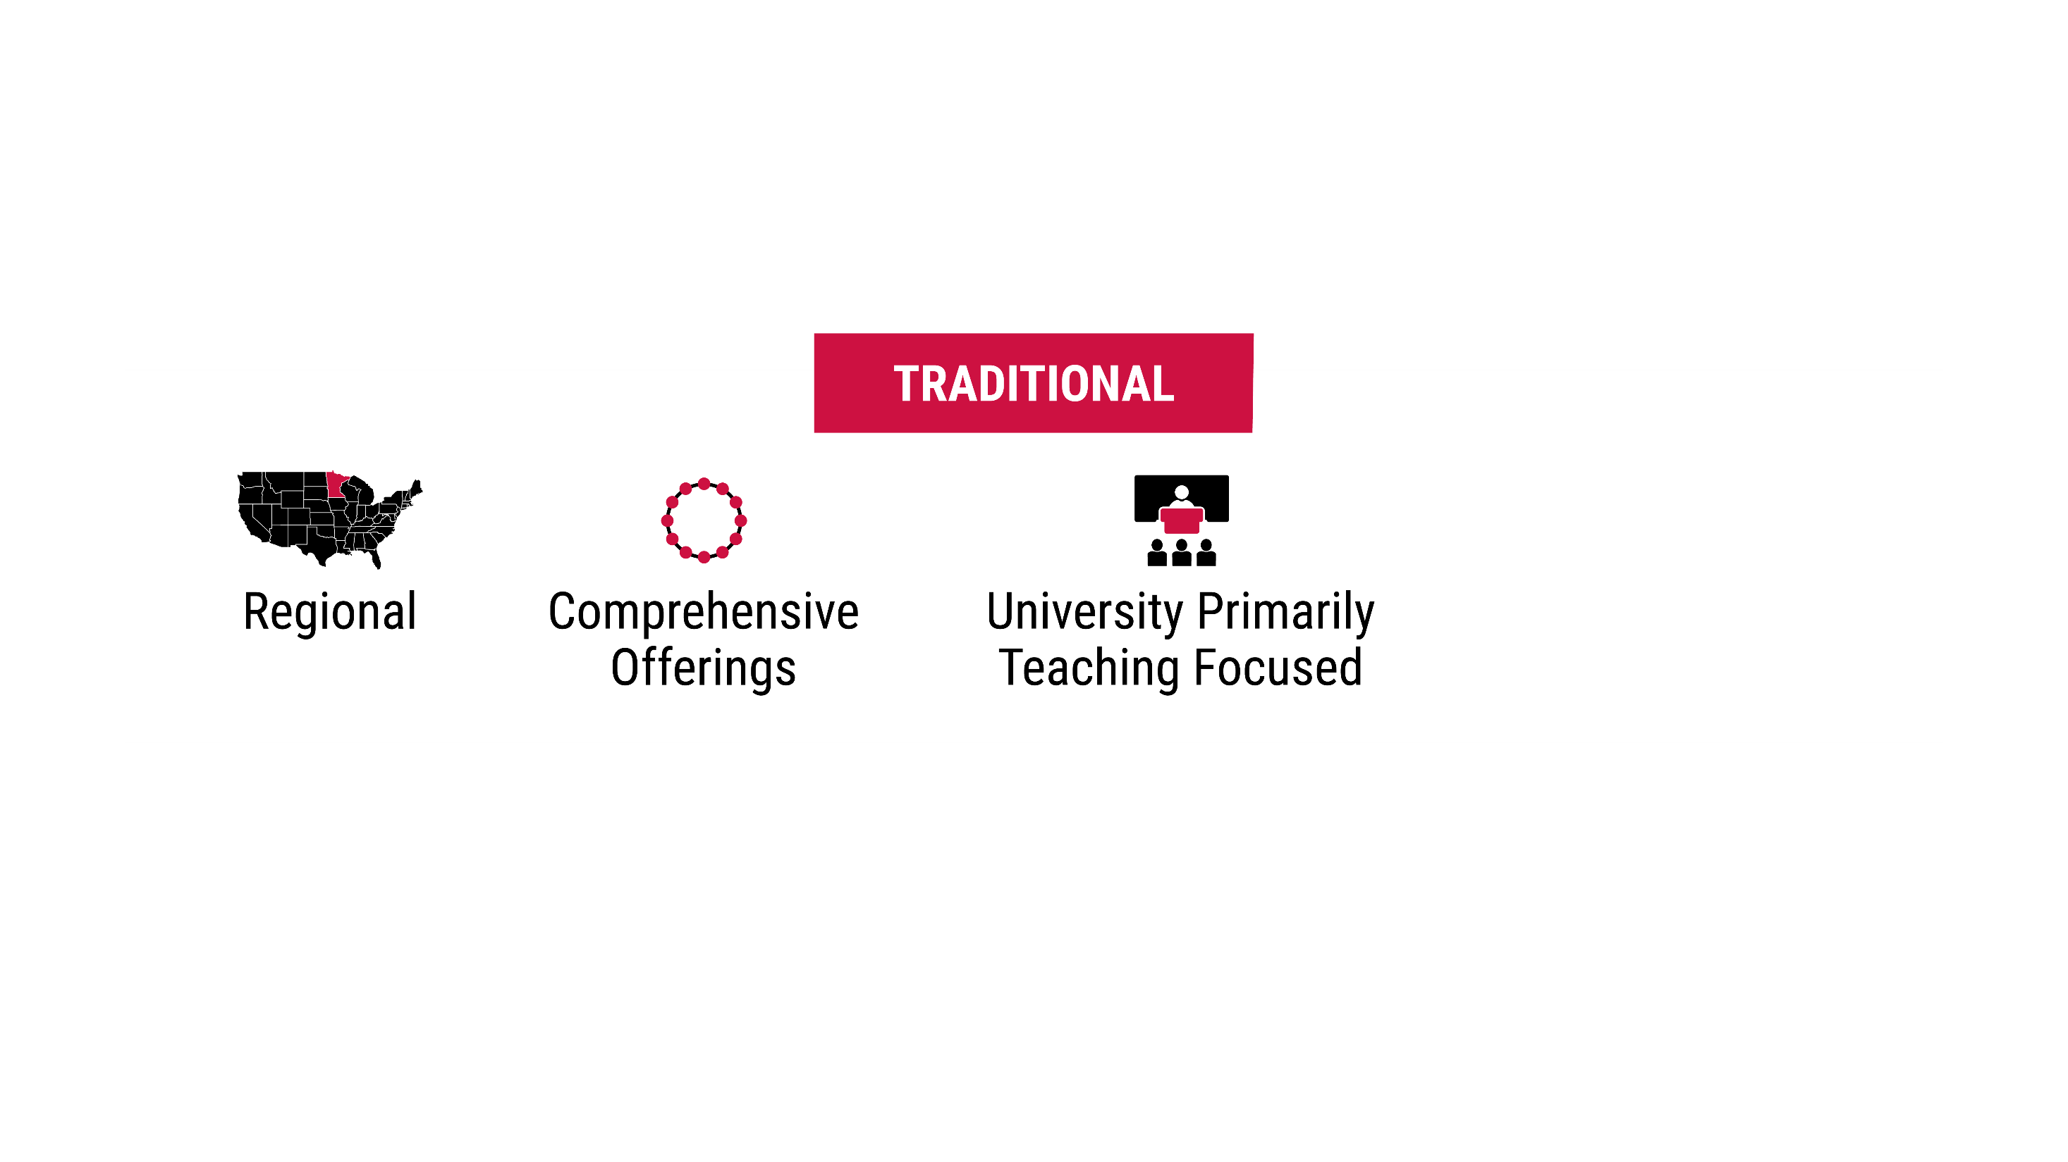
REGIONAL COMPREHENSIVE
University Predominately Teaching Focused
Substantial teaching loads for faculty similar to community colleges
Limited engagement in research, scholarship or creative works

Slide 19
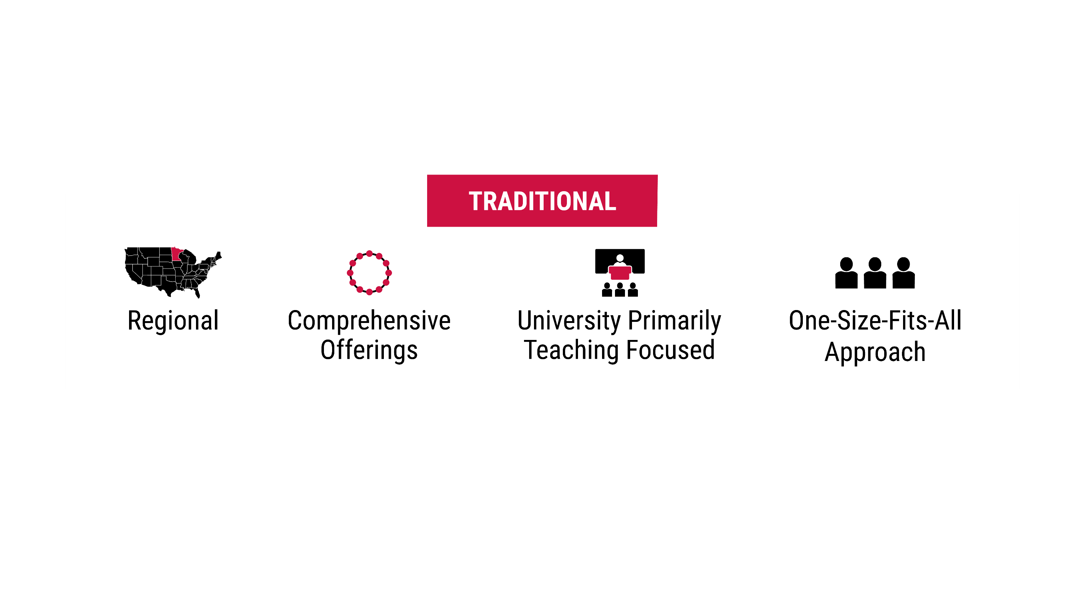
REGIONAL COMPREHENSIVE
One-Size Fits All Student Support
No differentiation in student advising support programs or structures

Slide 20
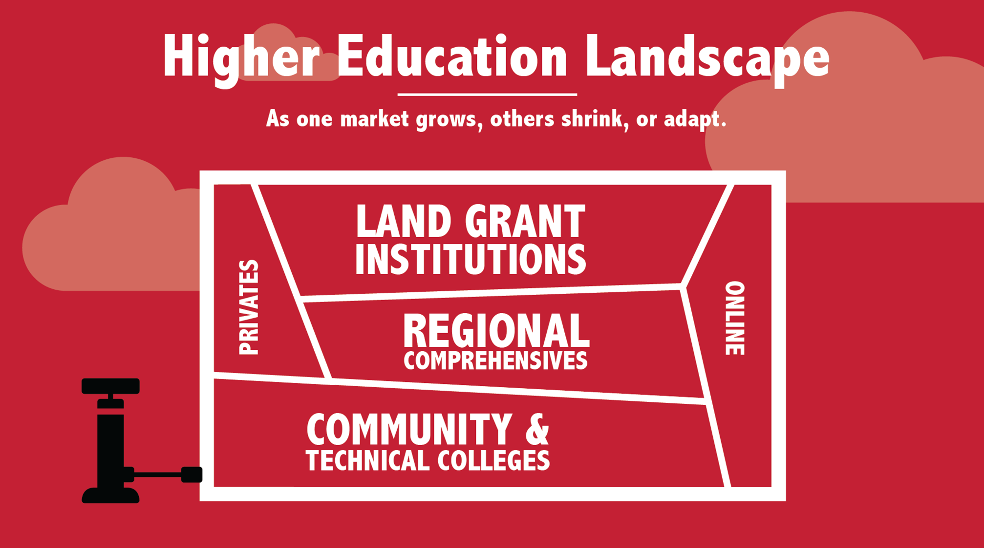
2000 - 2020

Slide 21
REGIONAL COMPREHENSIVES ARE STRUGGLING
West Virginia University
Eastern Washington University
Youngstown State University
Wright State University
Michigan - Central, Eastern, and Ferris State
Last fall, total enrollment at the 13 UW Colleges campuses dropped 22.3%
Pennsylvania (2010-2019)
East Stroudsburg – down 15.9%
Lock Haven University – down 42%
Shippensberg University – down 26.8%
Indiana – down 29.7%

Slide 22
1. New RCU @SCSU
To be competitive SCSU must create Distinctive Differences from other universities

Slide 23

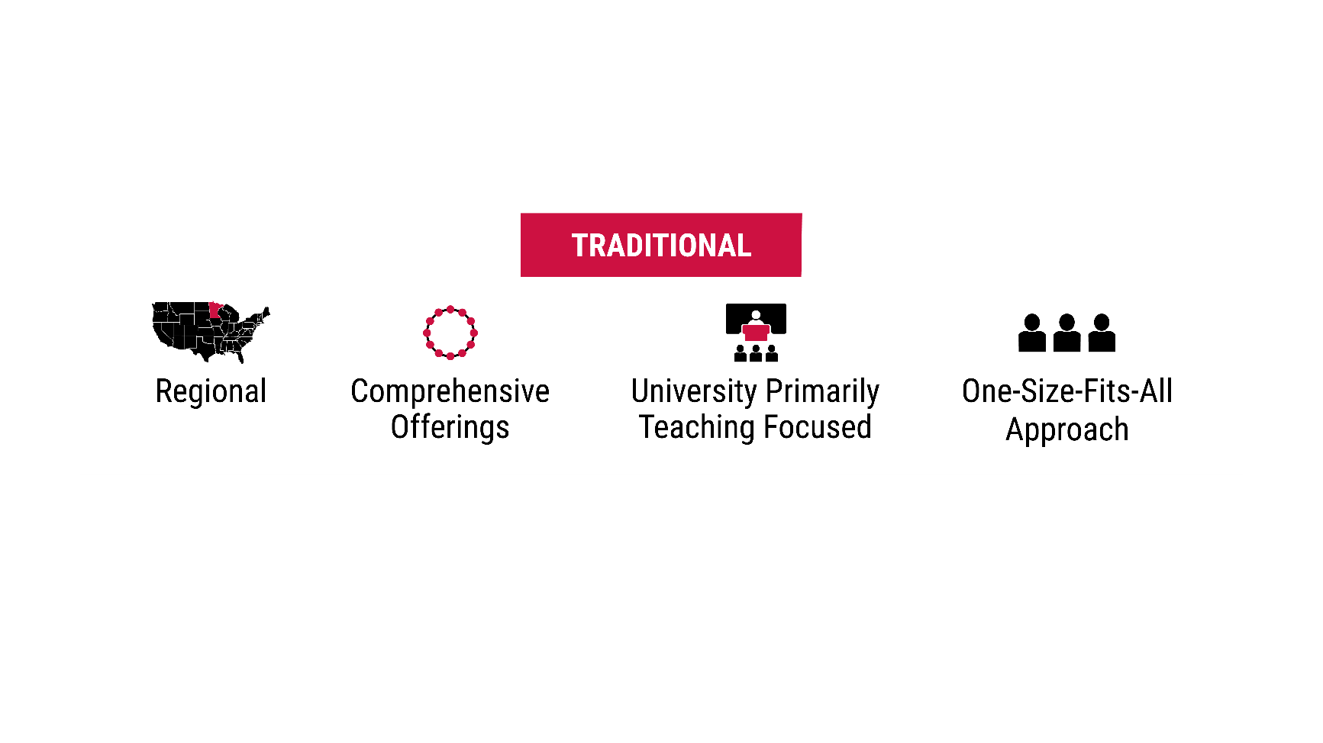
REGIONAL COMPREHENSIVE

Slide 24

REGIONAL COMPREHENSIVE
Expanded Regional
Student populations from MN, selected states and international;
Continue to address workforce needs in MN;
Partnerships that better leverages the assets of local, statewide and global partners;
Connects assets and expertise of our academic community to address local to global needs

Slide 25
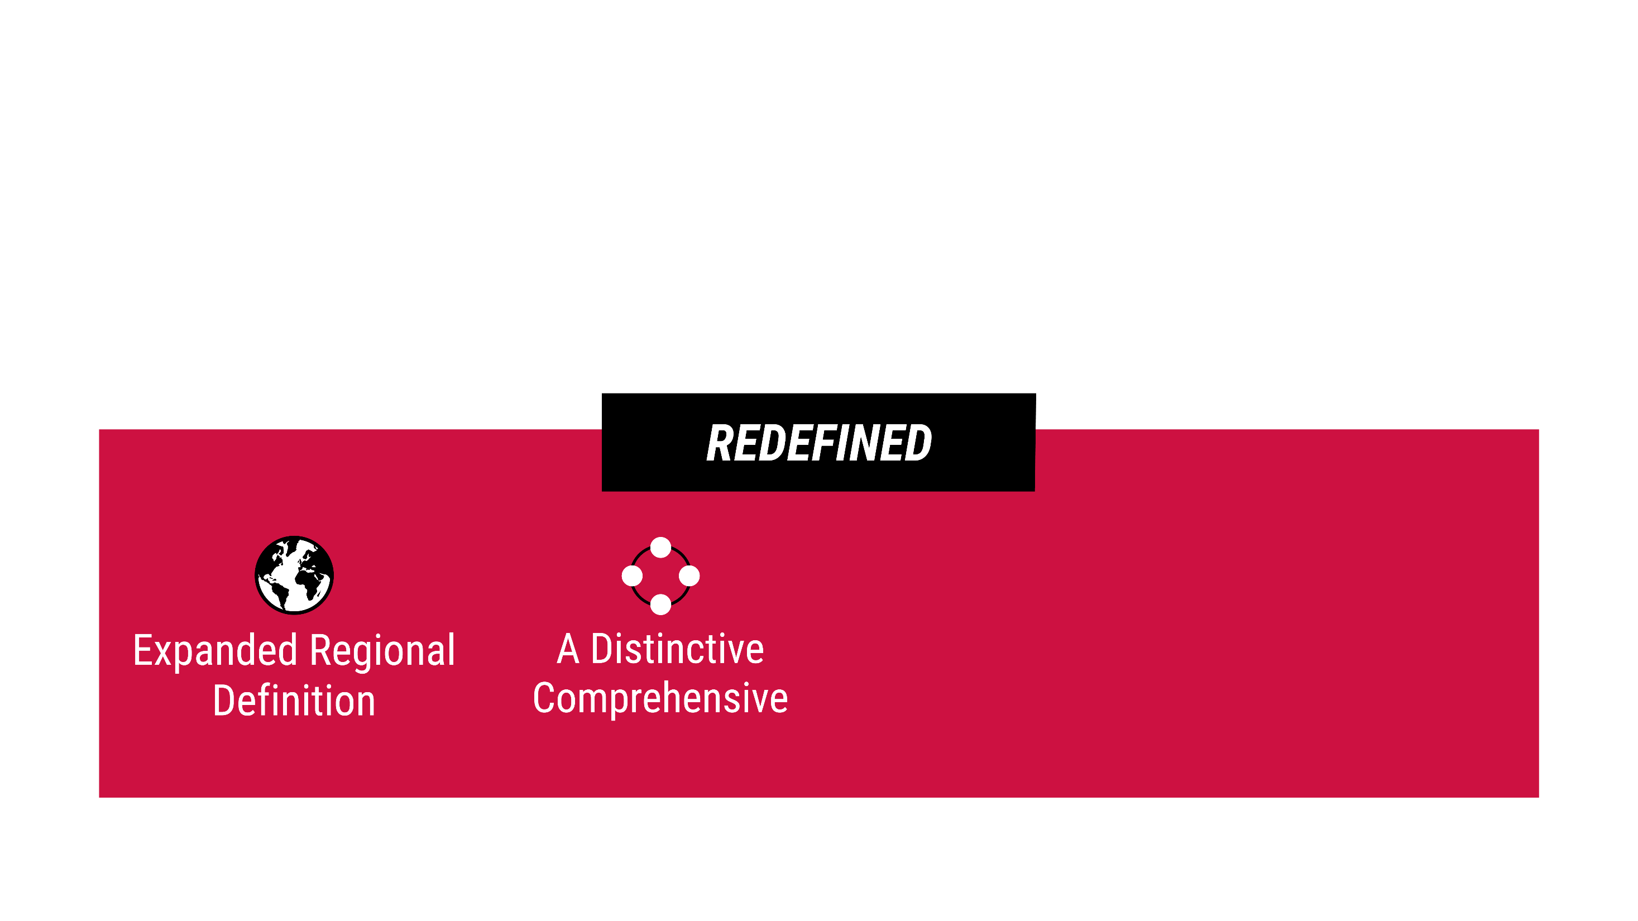
REGIONAL COMPREHENSIVE

Slide 26
REGIONAL COMPREHENSIVE
A Distinctive Comprehensive University
A university recognized as a leader in four academic areas;
A strengthened position in Humanities, Arts, and Social Sciences programs for the 21st century;
All programs will be distinctive by incorporating 6 characteristics that maximize student growth and success;
Has a designated number of top ranked and nationally recognized degree programs in each college and school;
Grow masters and doctoral programs;
Liberal education program is integrated and connected with student’s academic path and promotes personal and professional success;

Slide 27

UNIVERSITY LEADER IN 4 ACADEMIC FIELDS

Slide 28

UNIVERSITY LEADER IN 4 ACADEMIC FIELDS

Slide 29

UNIVERSITY LEADER IN 4 ACADEMIC FIELDS

Slide 30
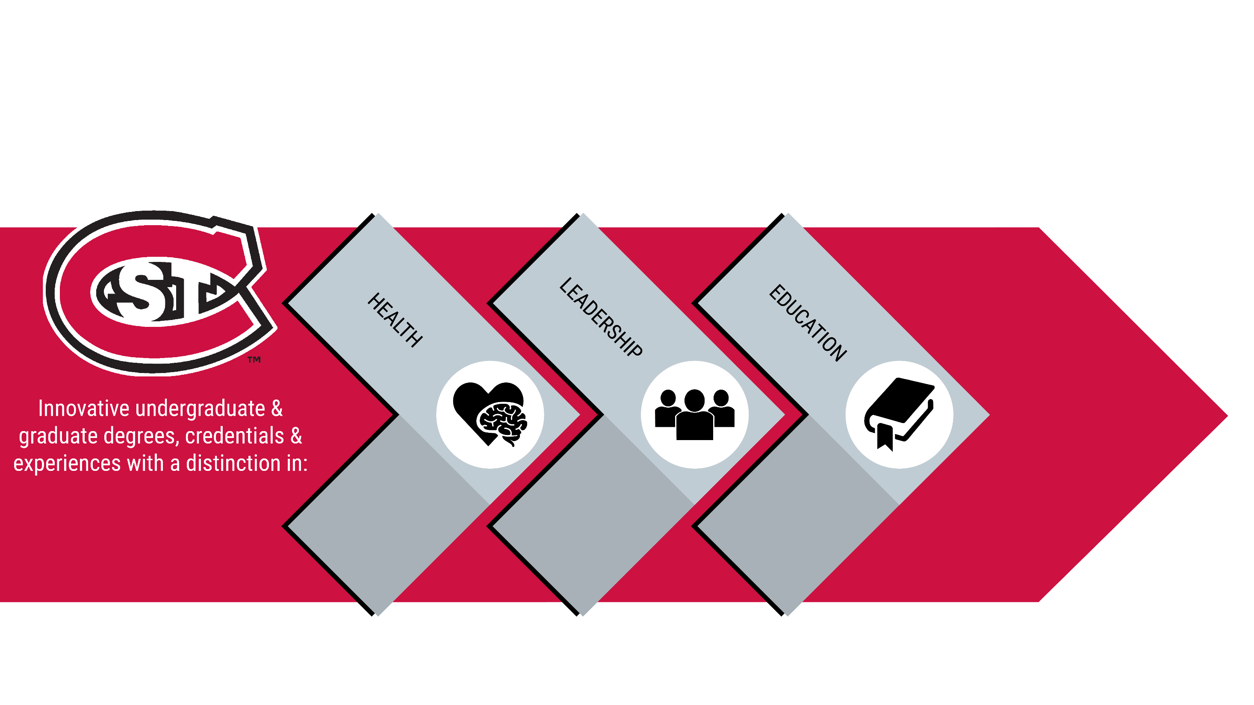
UNIVERSITY LEADER IN 4 ACADEMIC FIELDS

Slide 31
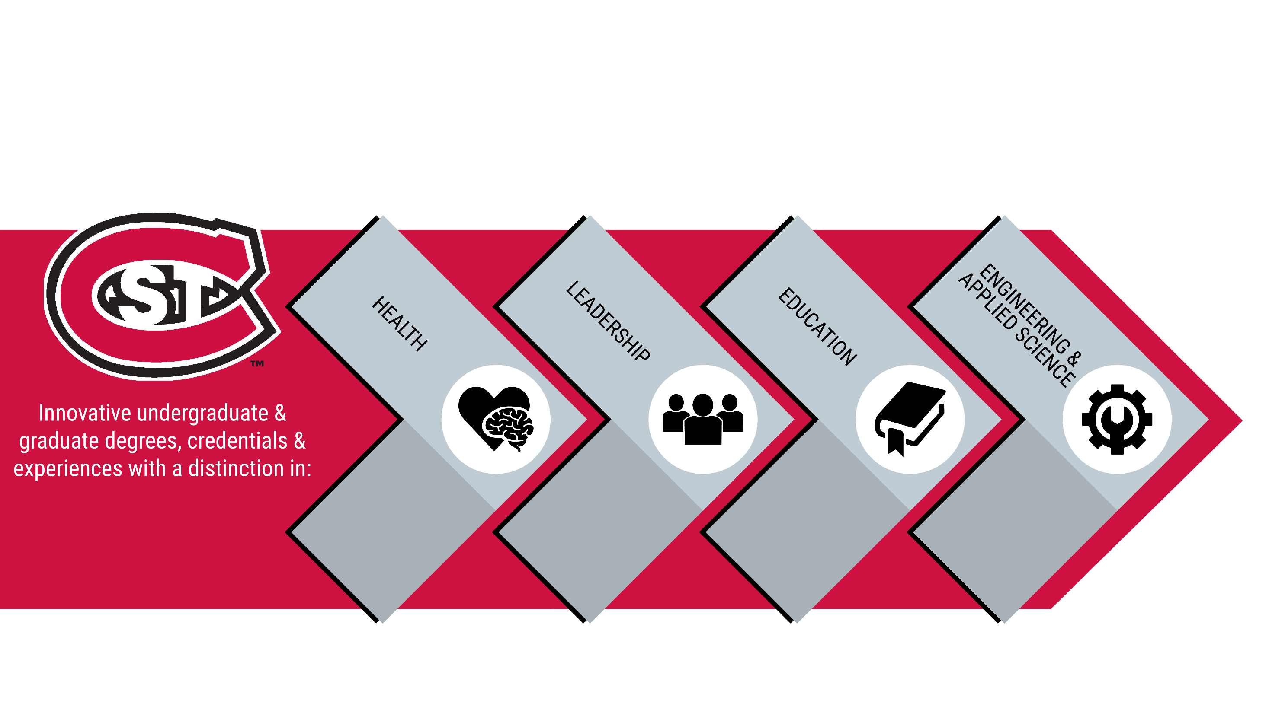
UNIVERSITY LEADER IN 4 ACADEMIC FIELDS

Slide 32
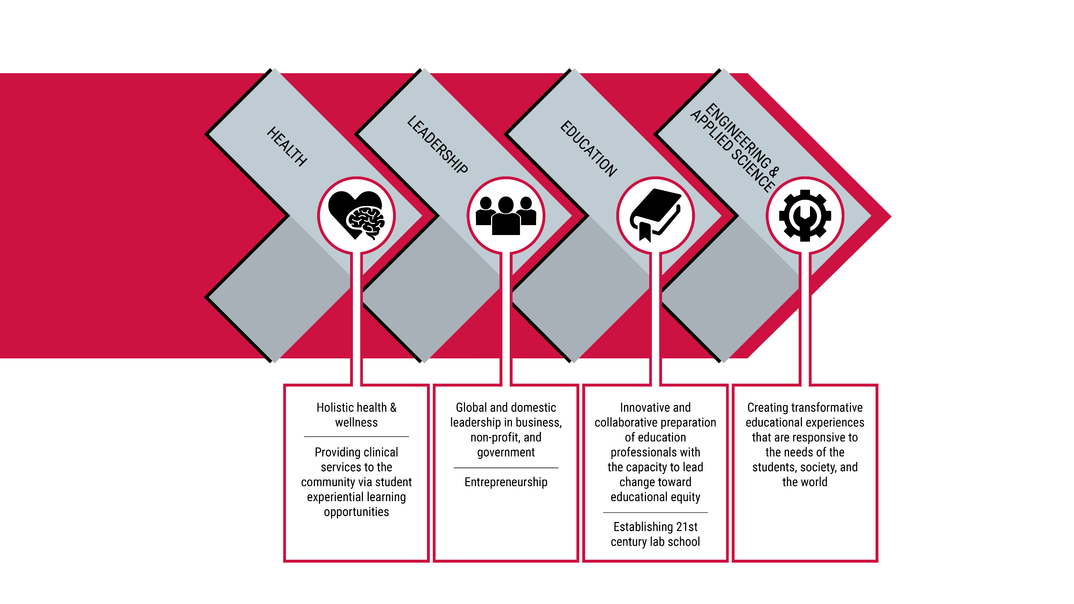
Transformative educational experiences that are responsive to the needs of the students, society, & the world ________________________
Utilizing robust partnerships with industry & community

Slide 33
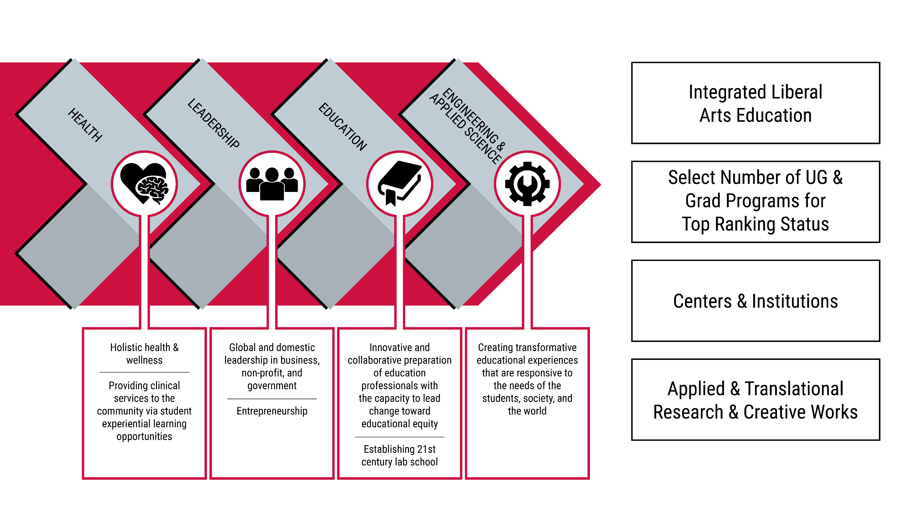
Integrated Liberal Educ Program
A strengthened position in Humanities, Arts, & Social Sciences programs
Clinical and Experiential Learning
Transformative educational experiences that are responsive to the needs of the students, society, & the world ________________________
Utilizing robust partnerships with industry & community
Centers & Institutes
Applied & Translational Research & Creative Works

Slide 34
Program Distinction Through 6 Unique Characteristics
Distinctive Programs Defined by:
Engaged Teacher/ Scholars
Life Long Learning Skills and Life Long Learning Strategy
Clearly Aligned with Career Options
Individualized Student Learning and Support
Robust External Partnerships
Experiential and Applied Learning Embedded in the Curriculum

Slide 35
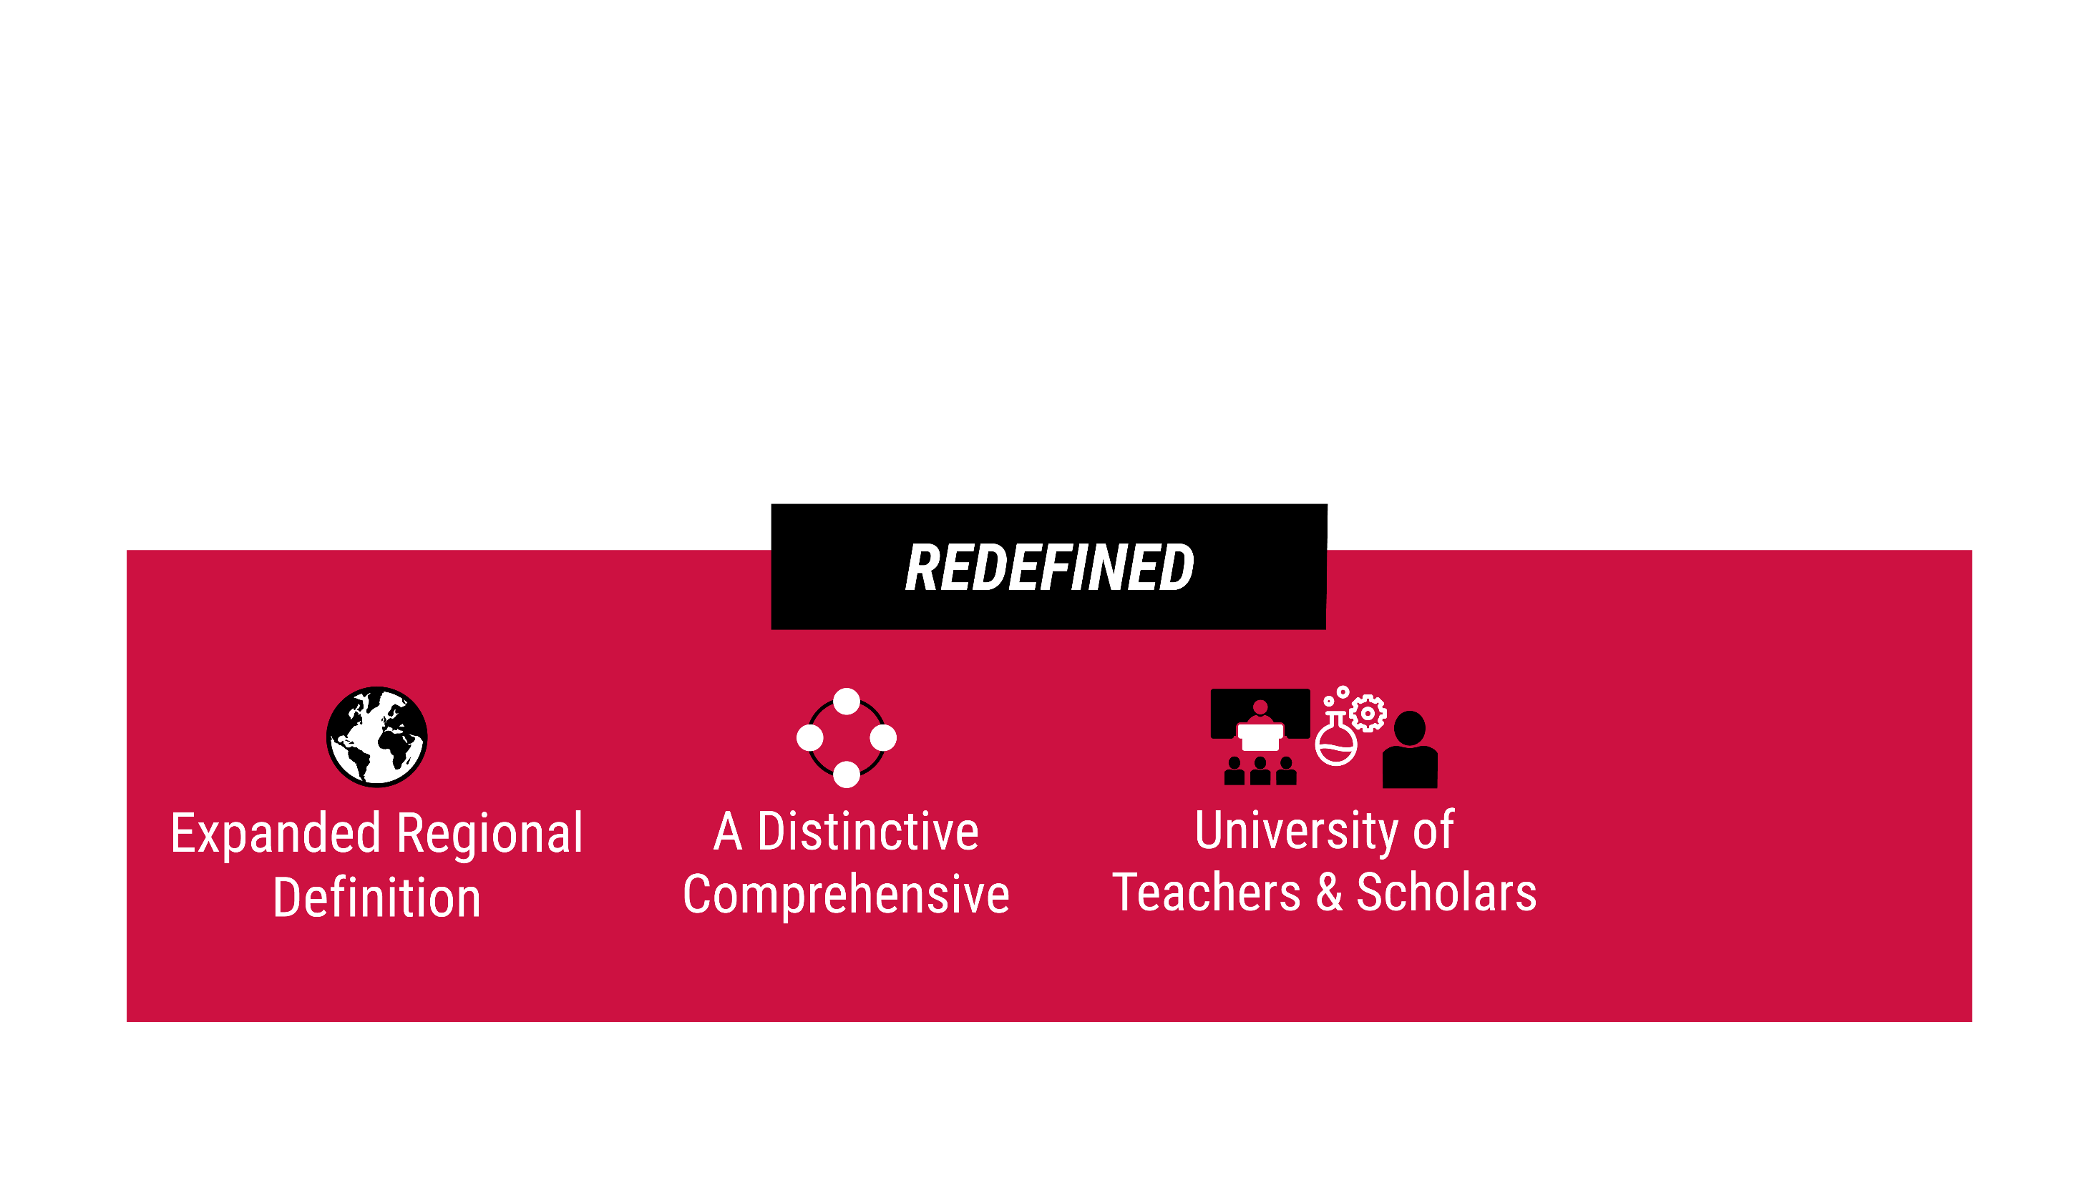
REGIONAL COMPREHENSIVE
University of Teacher-Scholars
Faculty are teacher scholars who integrate their research, scholarship and creative works with instruction and student experience;
Differentiated workload to promote scholarship and creative works;
Centers and Institutes are created to conduct applied research, scholarship, and creative work that aligns external needs with faculty expertise.

Slide 36
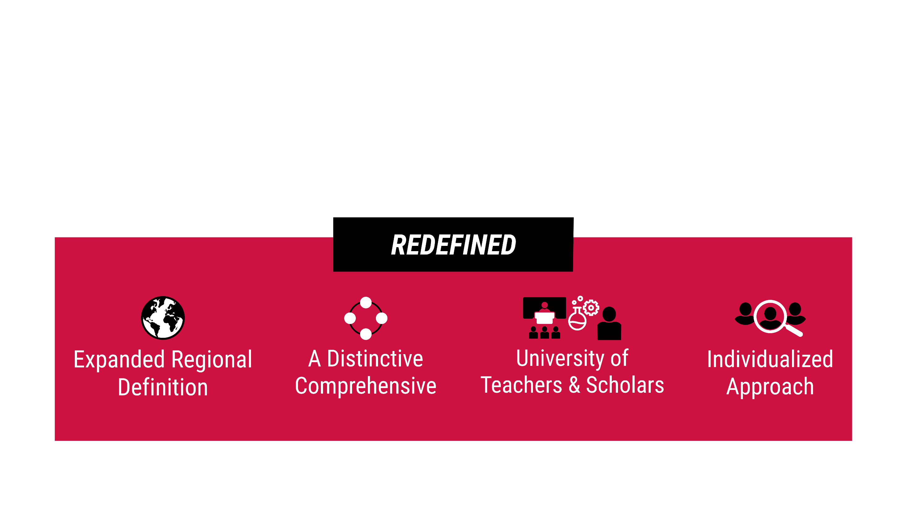
REGIONAL COMPREHENSIVE
Individualized Approach for Student Success
Individually based student support and guidance that reflects the diversity of our students and begins when admitted and continues through graduation;
Create opportunities for students to tailor their educational experiences to reflect their goals and personal mission;
Leverage data and technology to target support to specific student needs;
Stop out, looped learning and post-graduate connections are fostered.

Slide 37


Slide 38
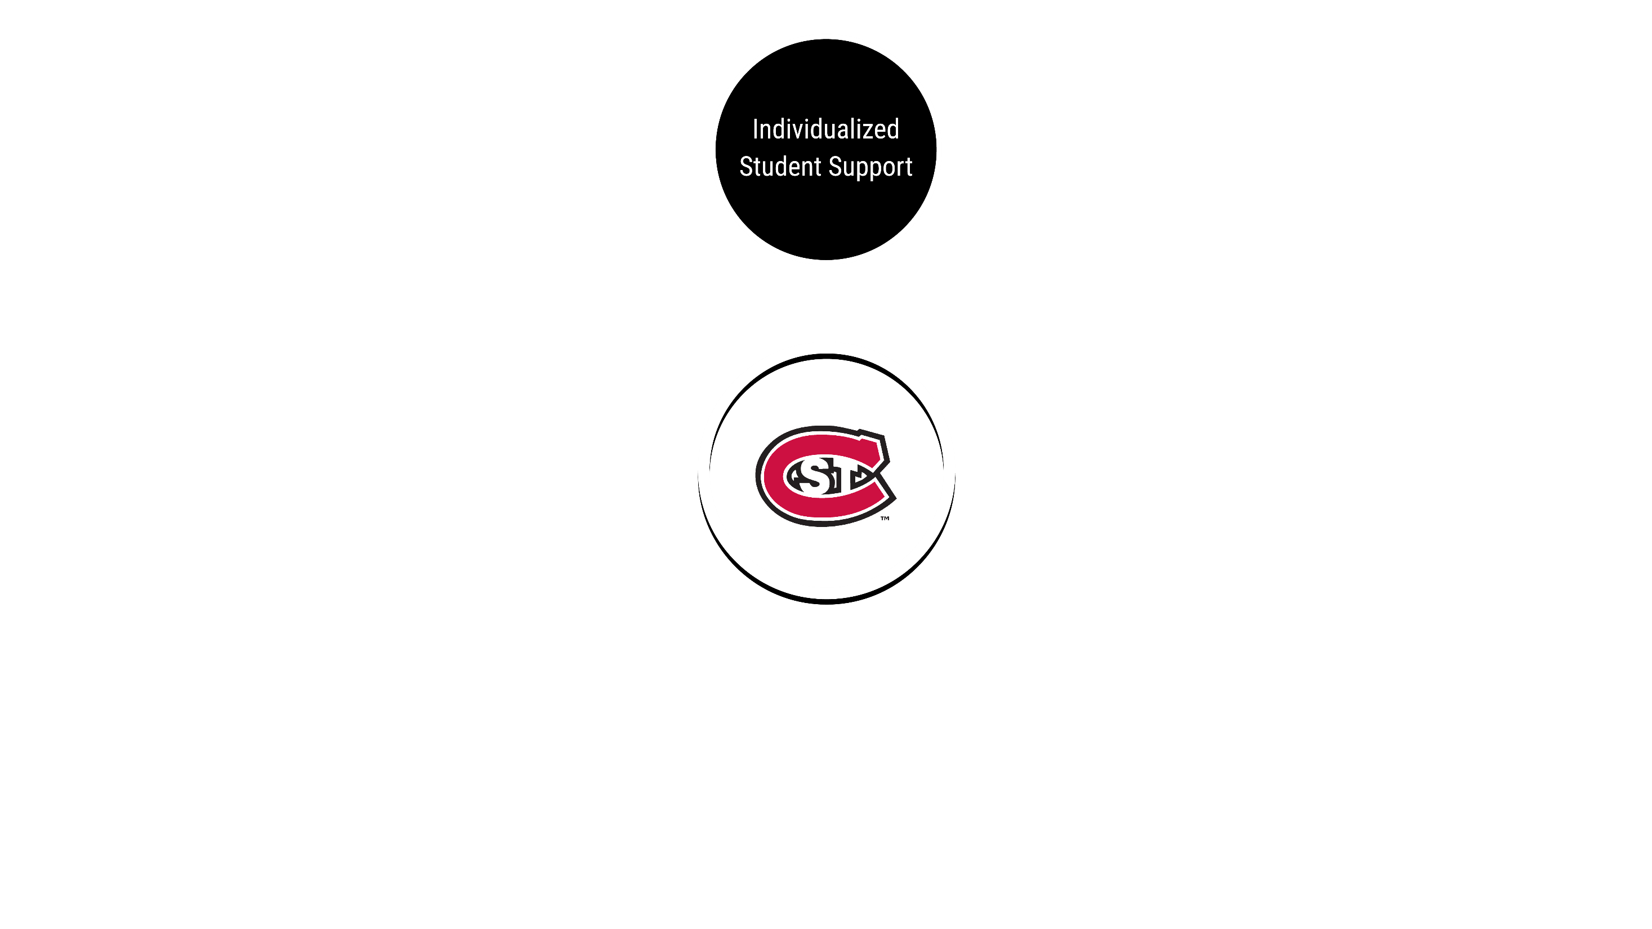

Slide 39
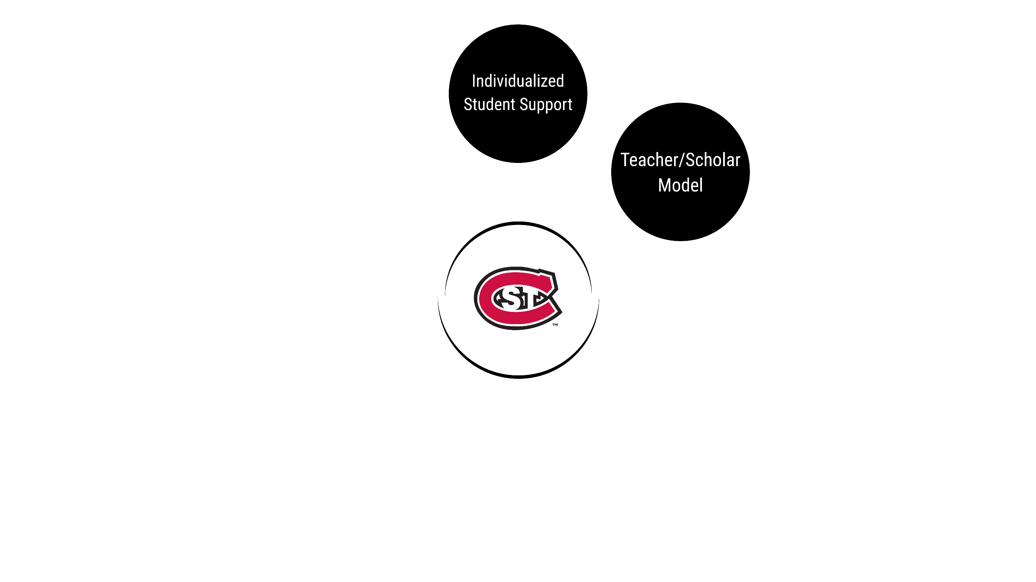

Slide 40
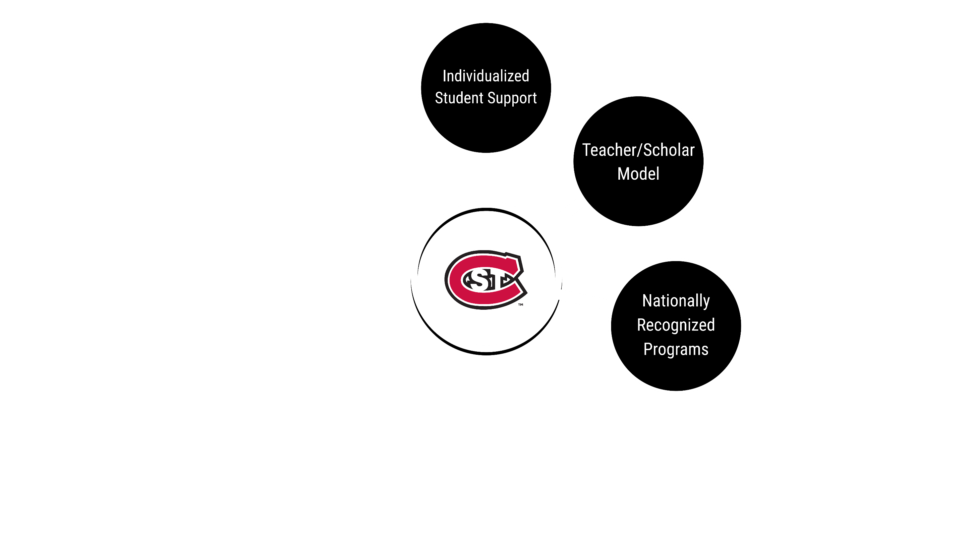

Slide 41
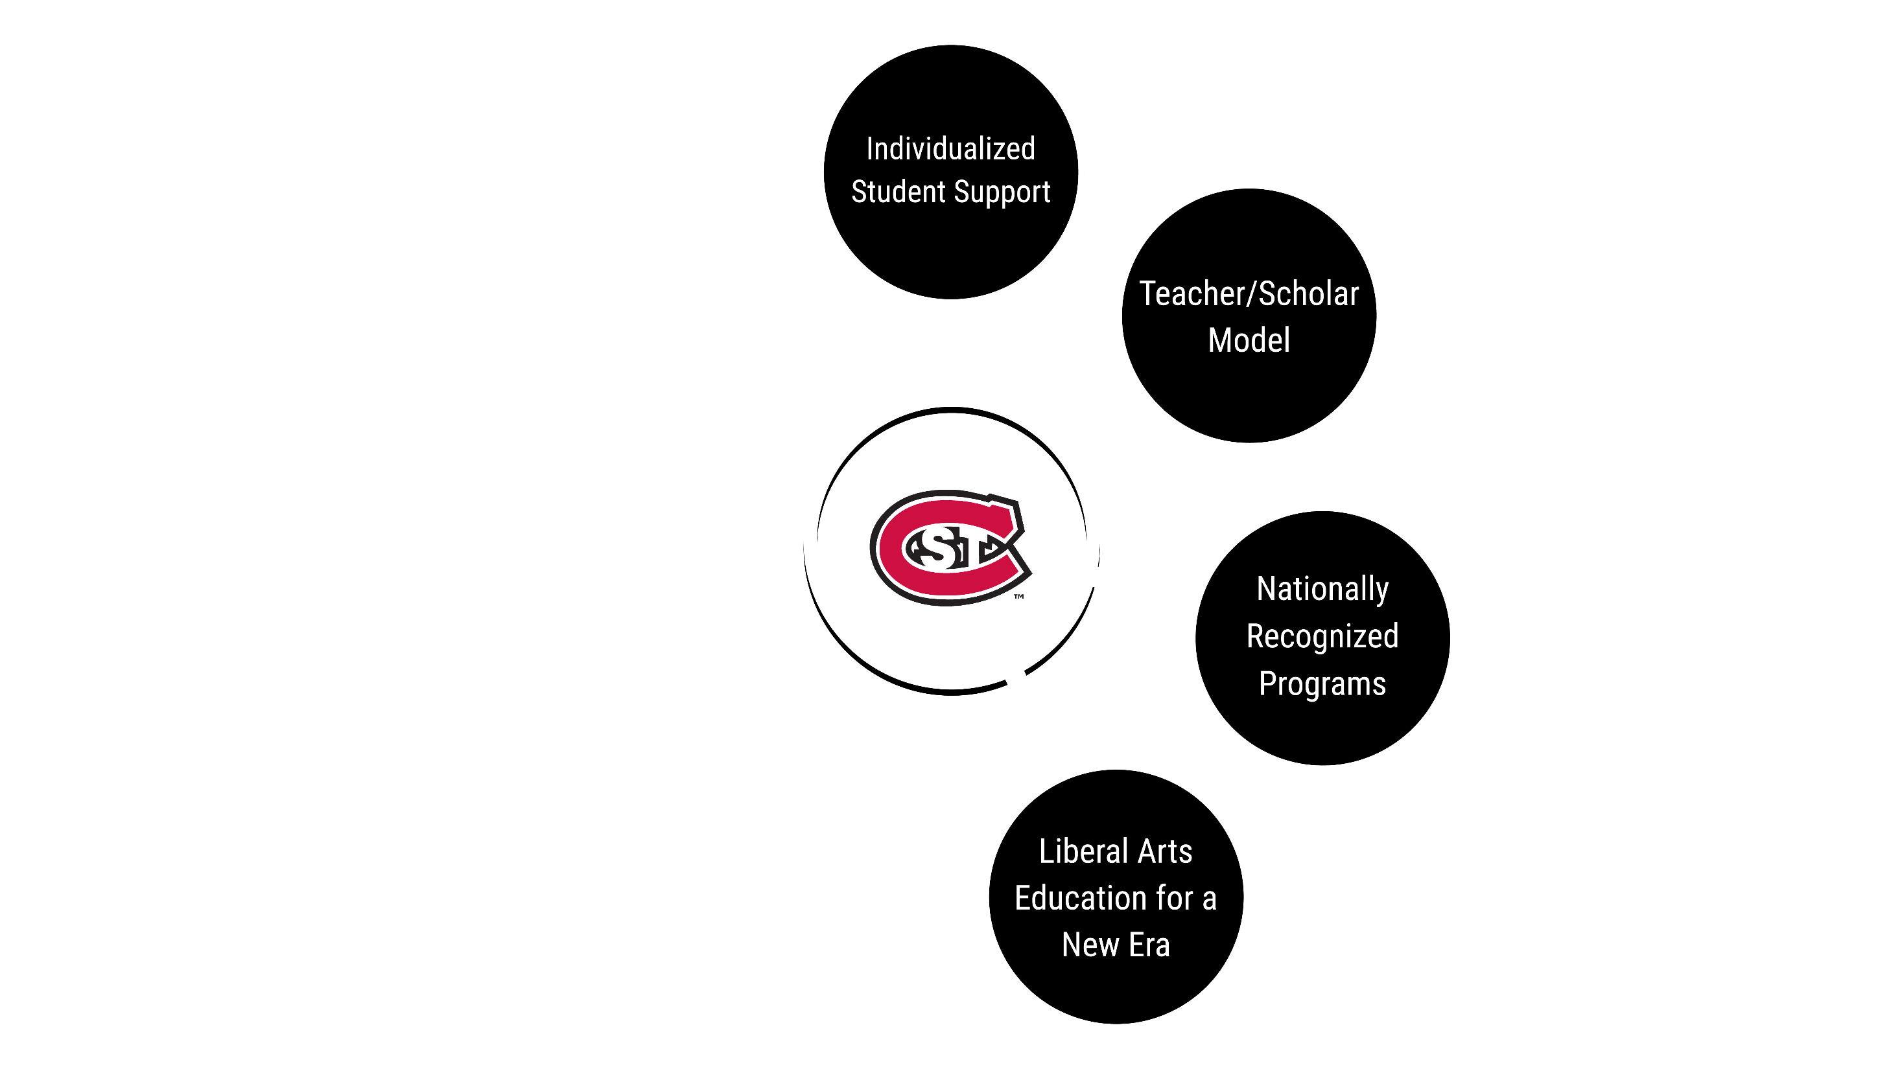

Slide 42
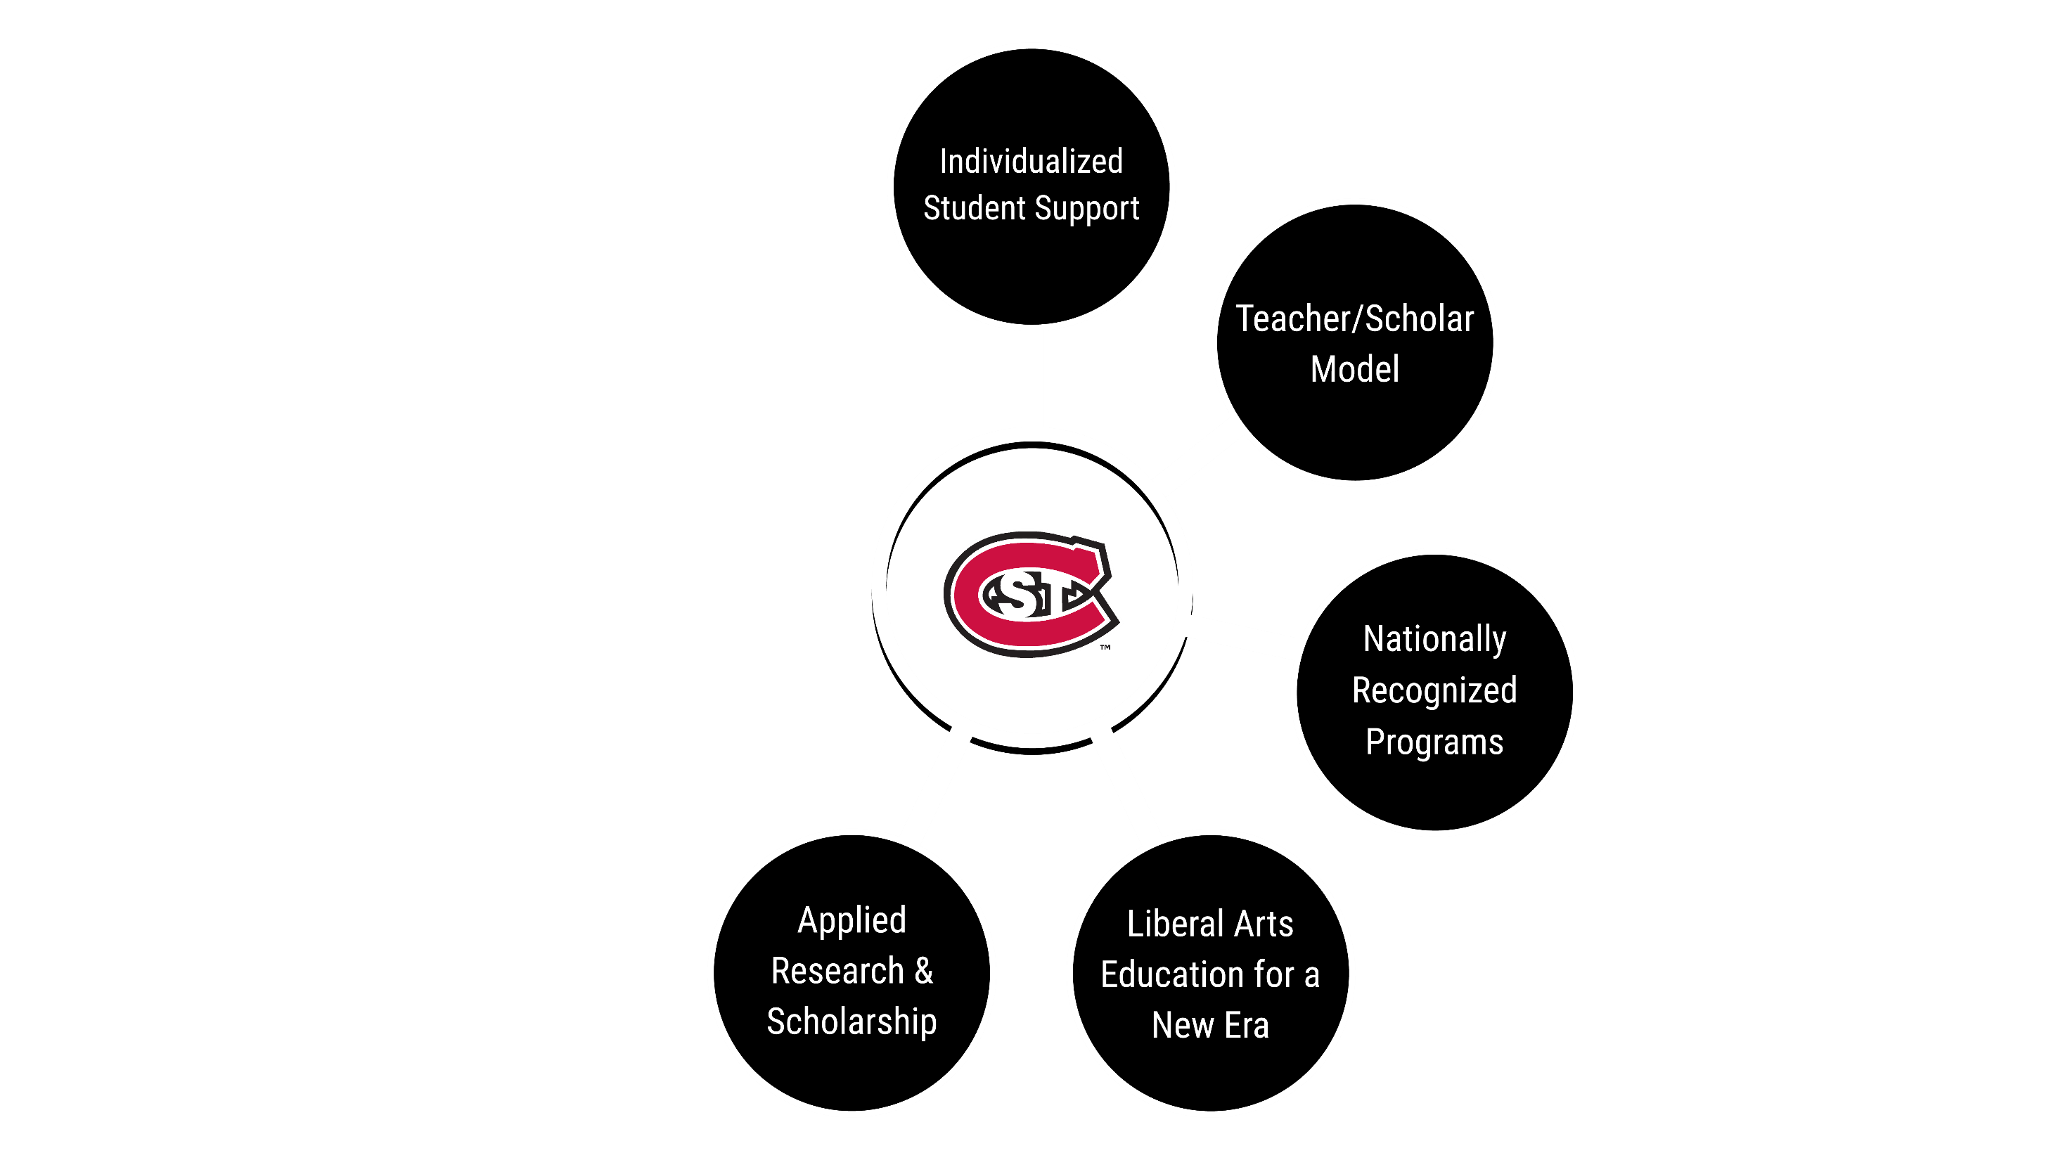

Slide 43
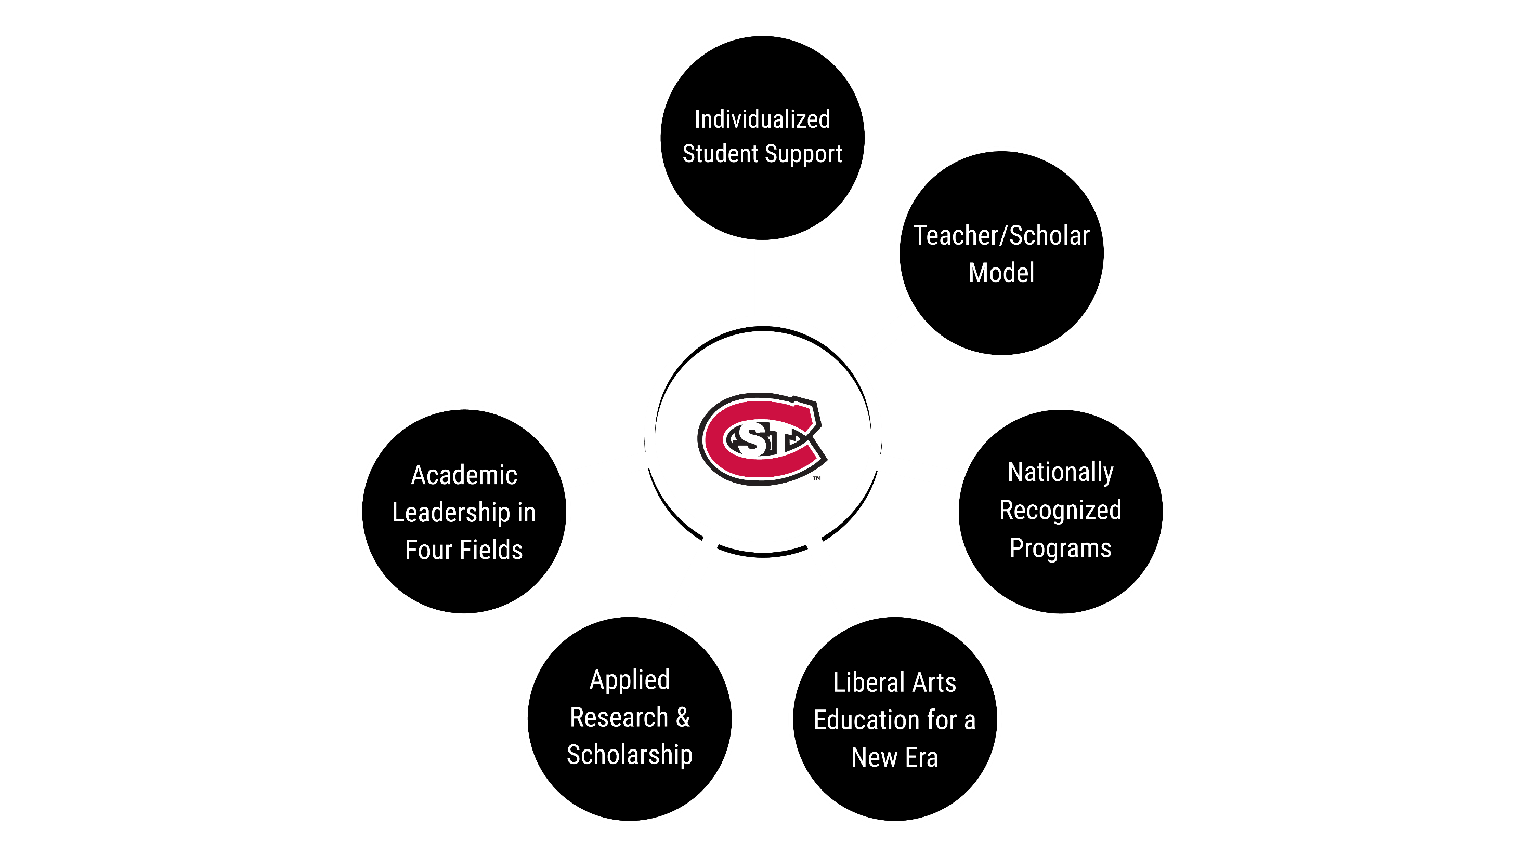

Slide 44
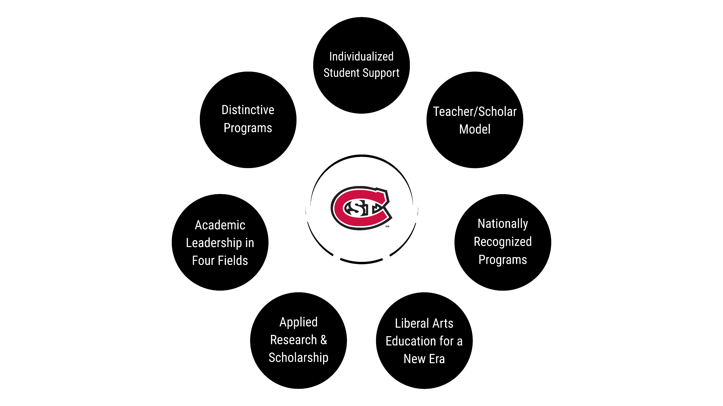

Slide 45
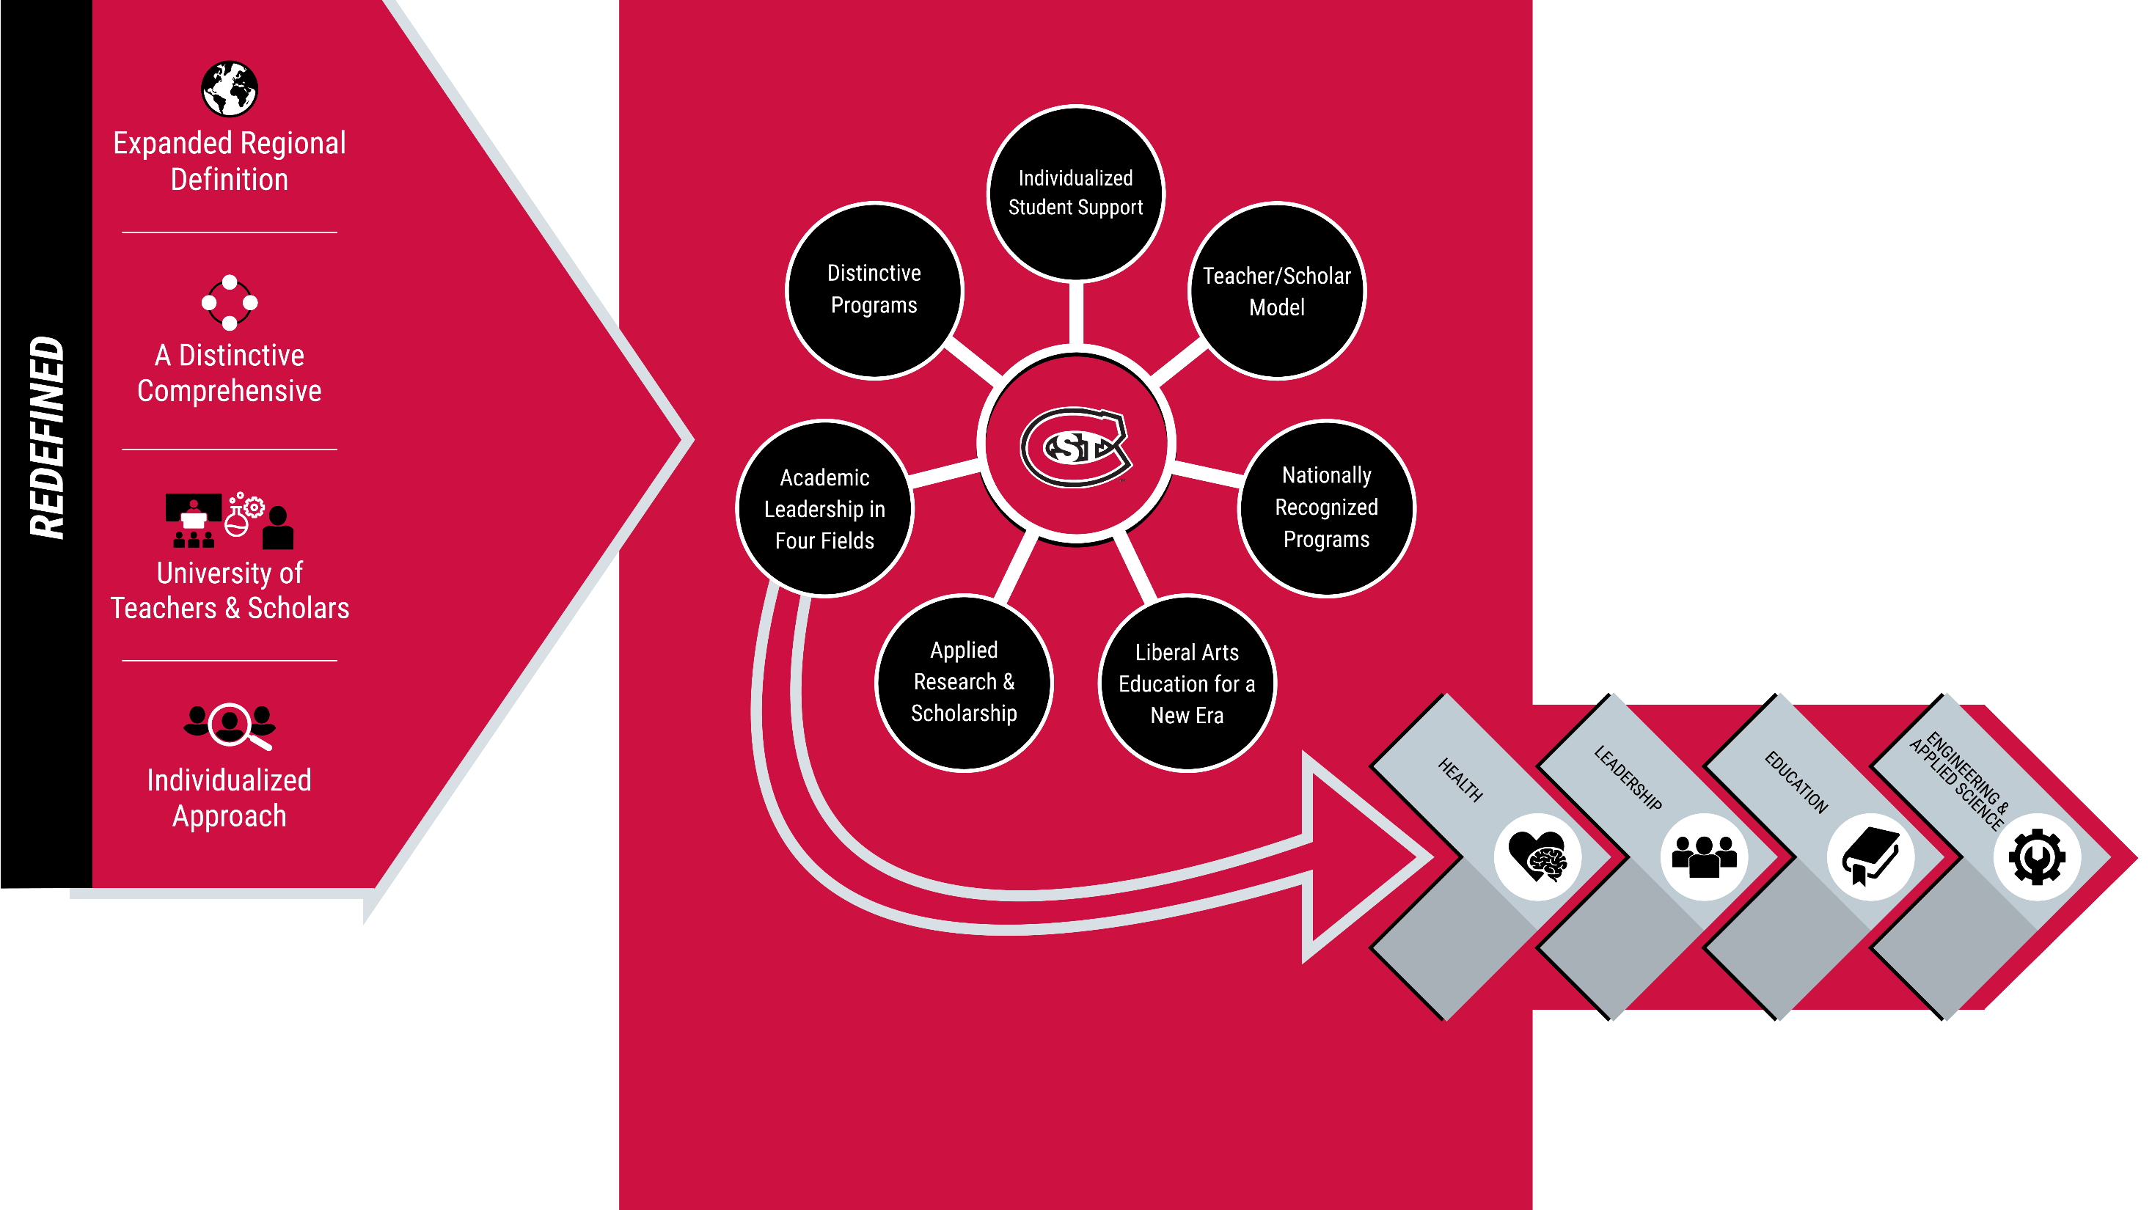

Slide 46

“Just as ripples spread out when a single pebble is dropped into water, the actions of individuals can have far-reaching effects”

Slide 47
Implement a New RCU – Let’s Go!
Building portfolio under each of the 4 areas
Top ranked programs
Program distinction characteristics
Centers and Institutes
LEP and strengthened position in Humanities, Arts, and Social Sciences programs for the 21st century
Huskies Advance Pathways
Husky Coaches

Slide 48
