Slide 1
MINNESOTA STATE
COLLEGES & UNIVERSITIES
BOARD OF TRUSTEES
APRIL 20, 2011
Campus Profile
Earl H. Potter III, President
St. Cloud State University

Slide 2
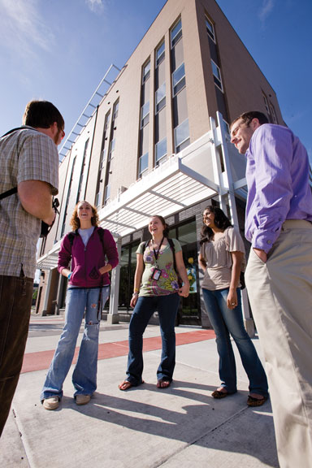
M ISSION:
We prepare our students for life, work and citizenship in the twenty-first century.
VISION:
Through active discovery, applied knowledge and creative interaction, we positively transform our students and the communities where they live and work.

Slide 3


Slide 4


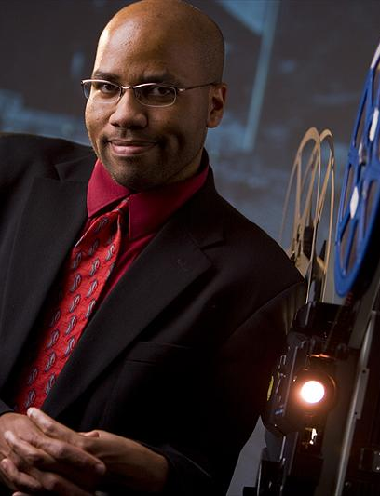

Slide 5
INVESTMENT IN
ACADEMIC REORGANIZATION
1,400 hours of committee meetings
46 Strategic Planning, ASAOPSA and Academic Reorganization Steering Group meetings
5 planning retreats
2 open forums
Plus
Survey
Listening session
Discussions

Slide 6


Slide 7
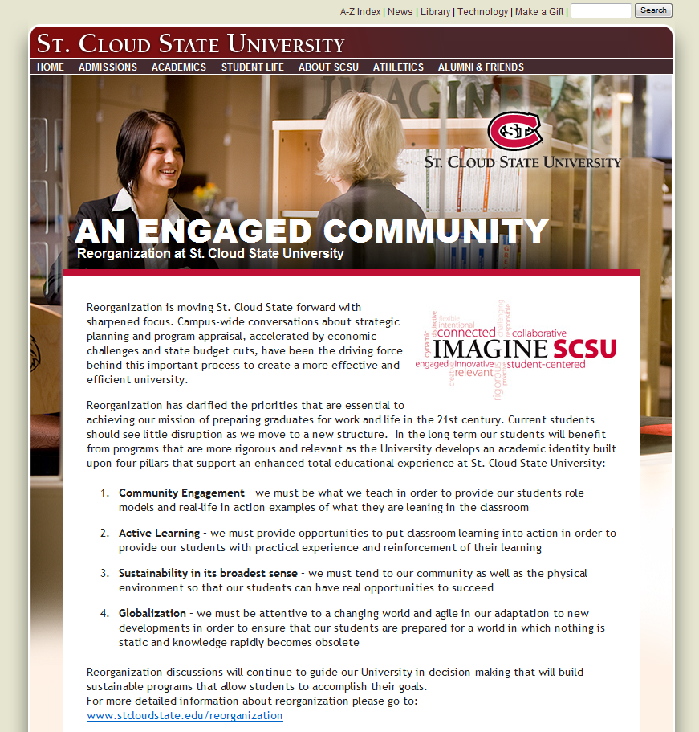

Slide 8
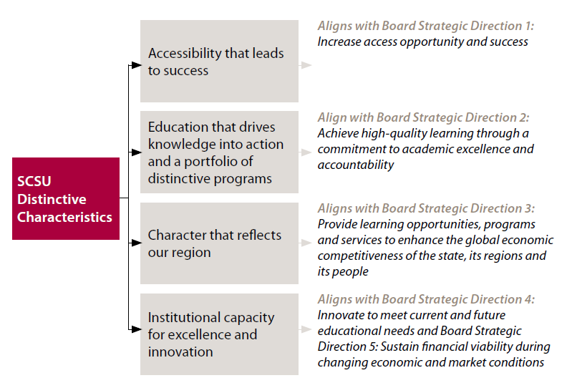
ALIGNING CHARACTERISTICS

Slide 9
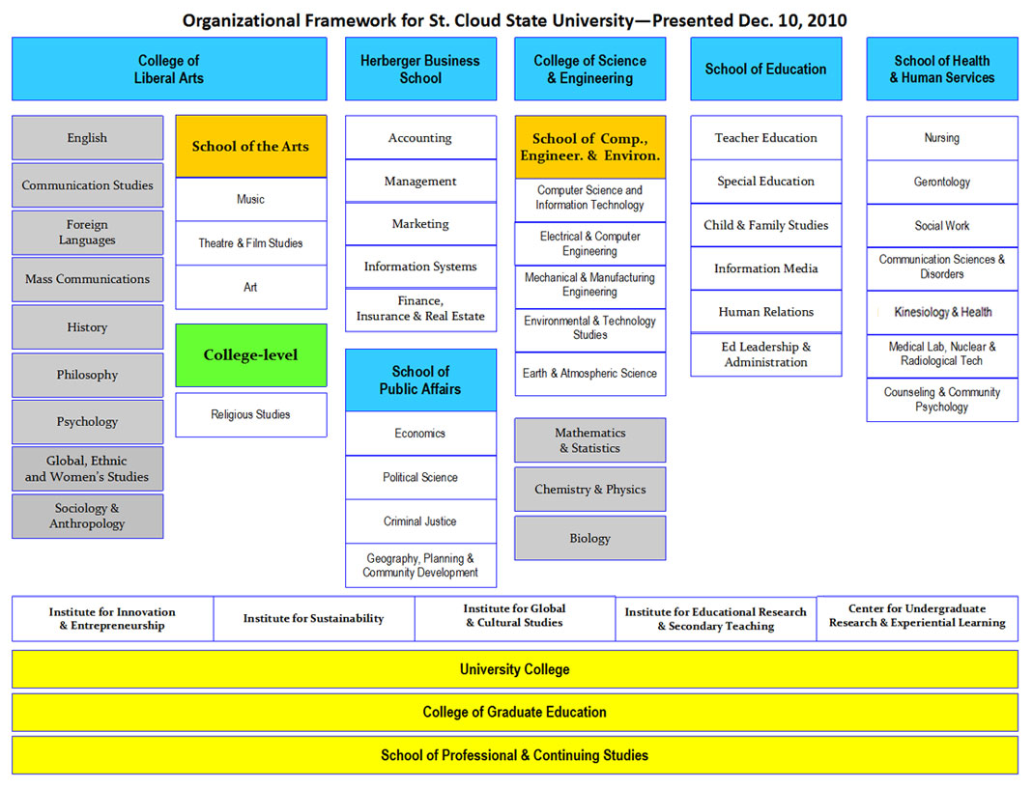

Slide 10
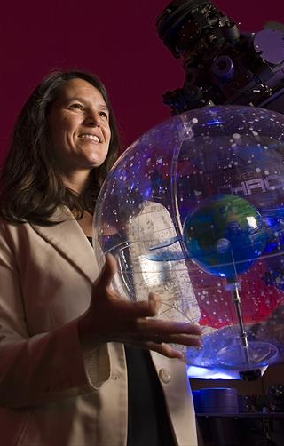
ORGANIZATIONAL FRAMEWORK
2 Colleges
  College of Liberal Arts
  College of Science & Engineering
4 Schools
  Herberger Business School
  School of Public Affairs
  School of Education
  School of Health & Human Services

Slide 11

LEARNING COMMITMENTS
Active and applied learning
Community engagement
Sustainability
Global and cultural understanding

Slide 12


Slide 13


Slide 14


Slide 15


Slide 16
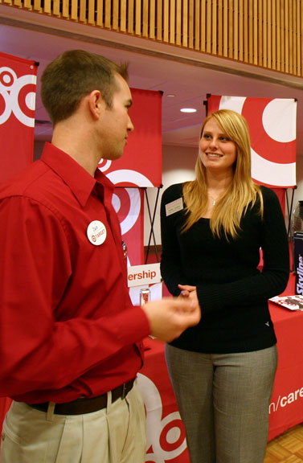
TOP 10 EMPLOYERS
OF OUR GRADUATES
(NUMBER EMPLOYED SINCE 2000)
Target – 218
Wells Fargo – 187
State of MN—185
St. Cloud Hospital – 183
Military – 171
St. Cloud State University – 147
ING Direct – 102
Enterprise Rentacar – 77
Menards – 68
US Bank – 68
TCF – 65
CH Robinson – 59
Larson Allen – 55
City of St. Cloud – 53

Slide 17


Slide 18
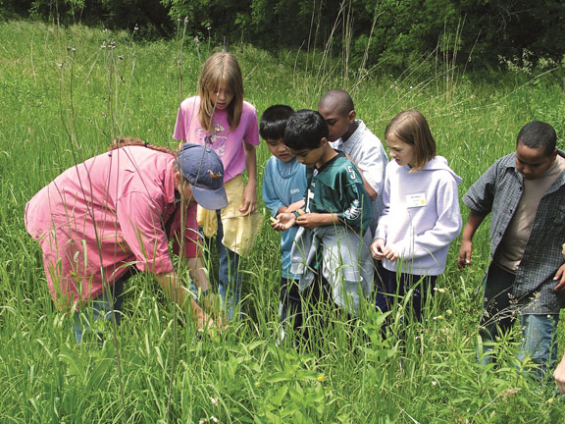
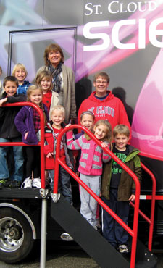
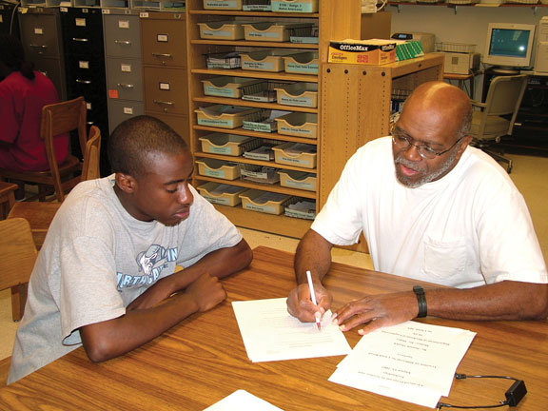
MATH SCIENCE CAMP

Slide 19

