Slide 1
Parking and Transportation
Annual Public Hearing
7-7-2015
9am-10:30am
Notes:
Topics to add:
Handicapped parking
Annual public hearing

Slide 2
What's the Problem?

Slide 3
Traits of a good parking program
Cost Effective and Sustainable
Community Focused (safe, transparent and convenient)
Fair and Equitable
Comprehensive and Green

Slide 4
State Statute 169.966
Board to Regulate Traffic on State Universities:
May establish rents, charges, or fees for the use of parking facilities
Money collected shall be deposited in the university activity fund
To maintain and operate parking lots and parking facilities

Slide 5
How Is Revenue Generated?
The sale of parking permits
Pay-as-you-go parking
Parking citations
SCTCC contract
Athletics parking fee
Revenues and expenditures are equal at approximately $1.3 million annually.

Slide 6
What does Parking pay for?
Salaries: 5 FTE salaries annually
Student workers
MTC Contract: Husky Shuttle & Sundowner
Equipment: front end loaders, vehicles, and pay machines
Maintenance contracts: striping, sealing, and technology applications
Rent: K-lot, in-direct costs to SCSU
Technology: hardware and software

Slide 7
Condition of Parking
Safety and security concerns
Poor or lack of lighting
Remote locations
Quality of area: trees, shrubs, etc.
Aging infrastructure:
30% of lots are 20 years or older
50% of these are 35+ years old
The life expectancy of a parking lot is 20-30 years.
Equipment life cycles:
Implementing cycles inventory greater than $20,000: front-end loaders, vehicles, machines and technology

Slide 8
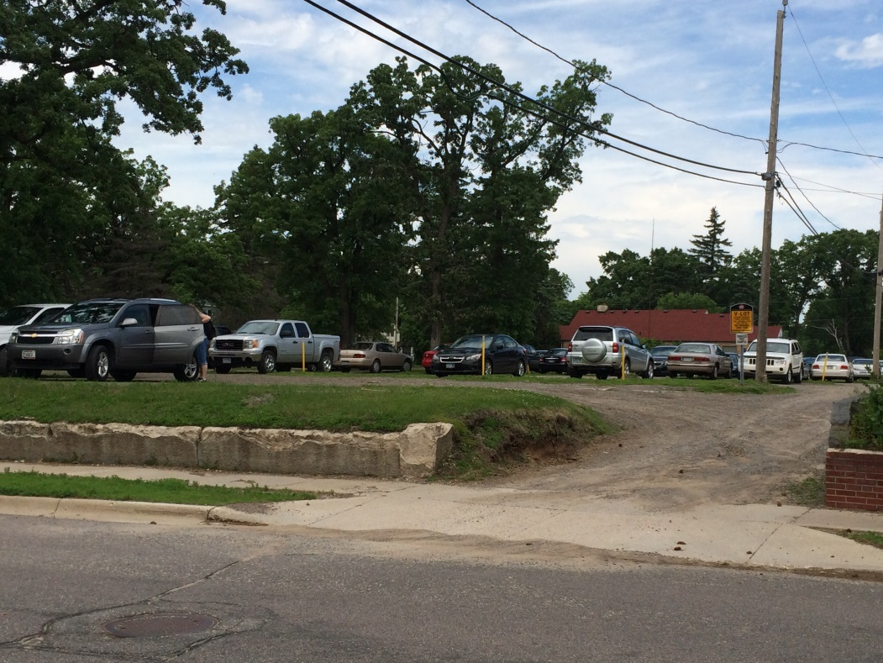
Safety and Security Concerns
V-Lot: Students suffer with very little lighting, trees in the lot, and deteriorating, washed out entrances.

Slide 9
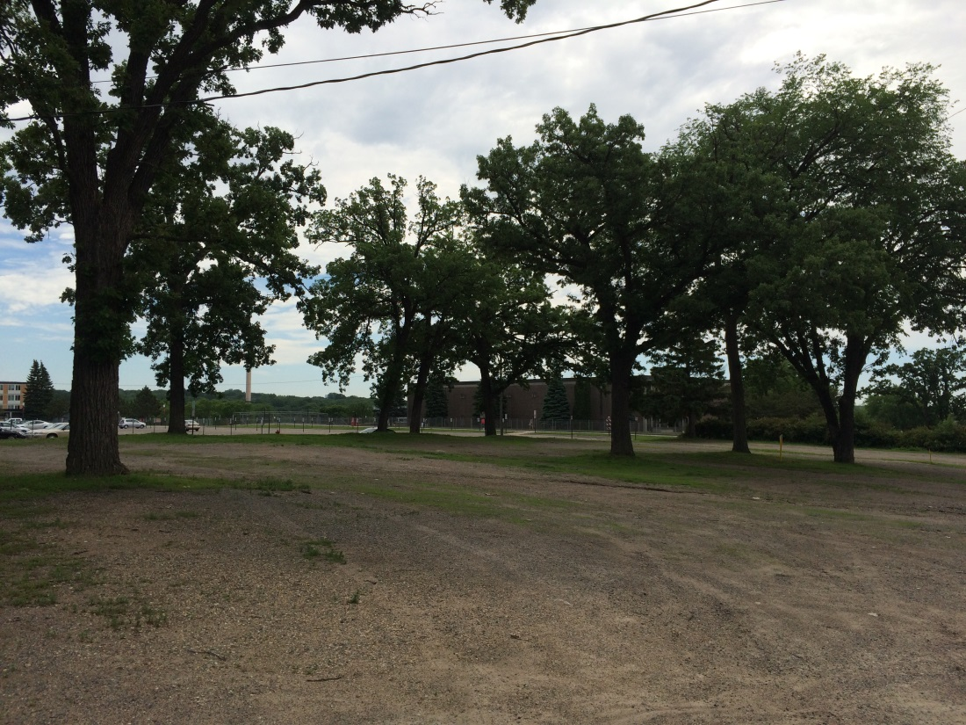
Safety and Security Concerns
E-Lot: Students park among the trees with no lighting

Slide 10
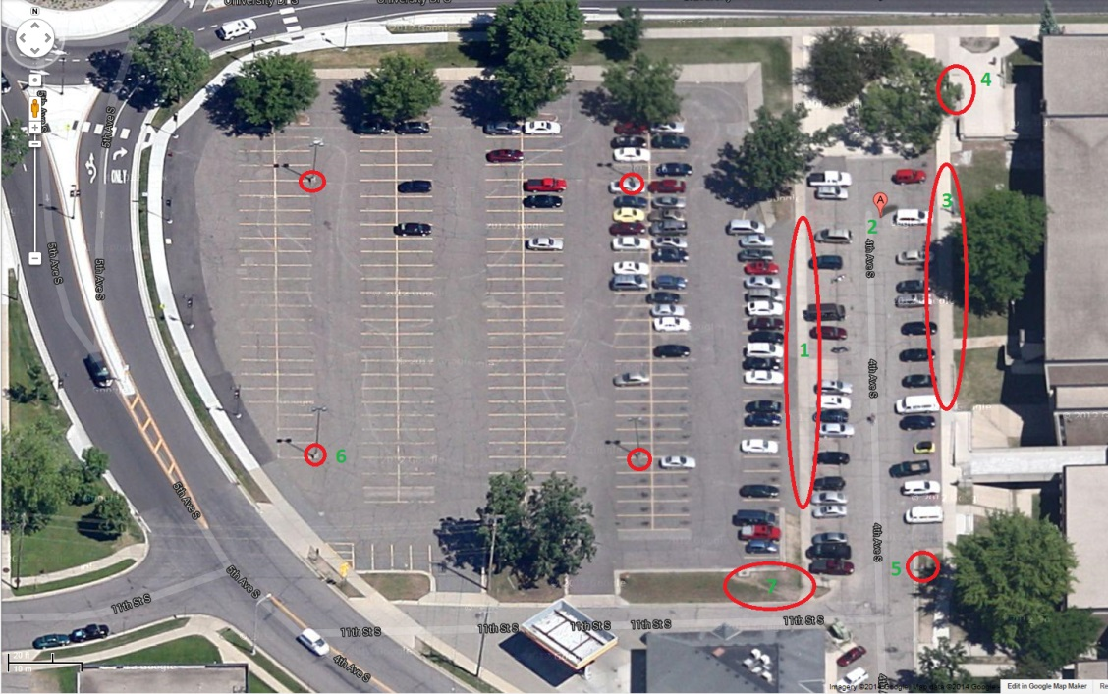
M & R Lots’ Safety and
Security Concerns
M & R Lots’ Redesign

Slide 11
Aging Infrastructure

Slide 12
What message are we sending?
Spring Commencement 2014

Slide 13
Estimated cost for repairs and improvements
Additional $150,000 Annually

Slide 14
Repairs and Improvements
Provide a better experience to all our parking customers (communication, signage and parking attendants)
Improve lot safety and security (lighting, call boxes and cameras)
Repair aging infrastructure (redesign, pave, strip)
Support equipment life cycles (plows, bobcats, patrol vehicles)

Slide 15
Option 1
Raise Parking Permit Rates
Permit Detail | # of Permits | Rate | % Increase | $ Increase | Proposed Rate | Revenue | Sales Tax | Revenue
Employee- Gated | 250 | 337 | 13.0% | 44 | 381 | 95,203 | 6,997 | 88,205
Student- Stateview | 65 | 337 | 13.0% | 44 | 381 | 24,753 | 1,819 | 22,933
Employee- Non-gated | 650 | 306 | 13.0% | 40 | 346 | 224,757 | 16,520 | 208,237
Student- A, E, M, & V | 715 | 306 | 13.0% | 40 | 346 | 247,233 | 18,172 | 229,061
Employee - K-lot | 100 | 189 | 13.0% | 25 | 214 | 21,357 | 1,570 | 19,787
Student- K&Q-lot | 1200 | 189 | 13.0% | 25 | 214 | 256,284 | 18,837 | 237,447
Emp/Stu- Evening | 170 | 66 | 13.0% | 9 | 75 | 12,679 | 932 | 11,747
Student Semester | 130 | 174 | 13.0% | 23 | 197 | 25,561 | 1,879 | 23,682
Student Semester | 400 | 107 | 13.0% | 14 | 121 | 48,364 | 3,555 | 44,809
Duplicate | 250 | 10 | 13.0% | 1 | 11 | 2,825 | 208 | 2,617
Total Revenue | 3930 |  |  |  |  |  |  | 888,527

Slide 16
Option 2
The cost for parking permits, pay-as-you-go parking, and citations all increased in FY14.
Athletics began contributing to the parking fund in FY14 also.
Distribute the financial responsibility to all users

Slide 17
Who are our Users
Commuter Students
Resident Students
Employees
Families, Guests & Visitors
Event Attendees

Slide 18
Improved Student Services
Students are now able to apply parking permit charges to their student account utilizing allocated financial aid for payment
The Public Safety Department will begin accepting payment for citations in addition to Business Services
Credit cards and Pay-By-Phone options are now available for use in surface pay lots

Slide 19
Commuter/Visitor Parking
Situation
Proposed Changes
Parking is abundant for commuters and pay/visitors
Commuter parking is located in less desirable or inconvenient locations
Advertisement of public parking is inadequate
Transition two parking lots or portions of, C Lot and one-third of N Lot
Price public parking at attractive rates
Advertise Public Parking through signage and web
Design a five year implementation plan

Slide 20
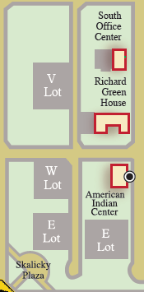
Commuter Student Parking
The Walker Parking Consultant study recommended, “Lot E and V are gravel lots judged to be in poor to unacceptable condition, but remain very desirable parking destinations. Grading, paving, lighting, security phones and other improvements are recommended.”
Lots E and V are being reviewed by engineers for lot improvements during FY16.

Slide 21
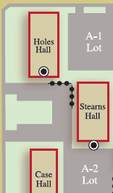
Resident Student Parking
The effective supply of parking is slightly below even for resident students on the north end of campus
While WW Holes Hall and Stearns Hall remain off line, covert 10 of the 13 15-minute spaces in the “horseshoe” to A Lot spaces. This will reduce the number of vehicles in Q Lot and provide a slight increase in revenue.

Slide 22
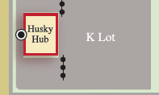
Resident Student Parking, Cont’d
The parking study identified that Q Lot is only minimally occupied and is in poor to unacceptable condition
Eliminate Q Lot re-purposing the space as overflow parking to K Lot, expected to be limited to athletic and other large community events
Establish K Lot East as overnight parking for the resident students currently in Q Lot

Slide 23
Students’ & Employees’ Safety and Convenience after 3:00 pm
The parking capacity of our current surface parking lots can be increased during non-peak hours by better advertising the parking options after 3:00 pm for all permit holders on campus.
This advantage of being able to park closer to many of the academic buildings after 3:00 pm will also improve safety for our commuting students and faculty.

Slide 24
Students’ & Employees’ Monday- Thursday After 7:00 pm
Continue with current parking permit requirements until 7:00 pm.
After 7:00 pm:
Continue to require SCSU parking permits in all lots allowing permit holders access to parking
Pay lots and the 4th Avenue Parking Ramp will offer a reduced rate of $3 for the evening effective from 7:00 pm until 3:00 am.
Lots C & V will become “Free Parking”
“Free Parking” provides an option to students coming to utilize evening services and supports smaller community meetings or events being held after 7:00pm every night of the week.

Slide 25
Weekend Parking
Continue to require SCSU parking permits in all lots
Lots C & V will become “Free Parking”
Pay lots and the 4th Avenue Parking Ramp will offer a reduced daily rate of $5.
Pay lots and the 4th Avenue Parking Ramp will offer a reduced rate of $3 for the evening effective from 7:00 pm until 3:00 am.

Slide 26
Miller Center 24 Hour Computer Lab
Offer parking available in Miller Pay Lot from 3:00 am-7:00 am.
Our students currently do not have available on campus parking from 3:00 am-7:00 am while utilizing the 24 hour computer lab with exception to the 4th Avenue Parking Ramp.

Slide 27
Families, Guests and Visitors:
Support Corbin Design’s Wayfinding Study by implementing directional signage to the Pay Lots and 4th Avenue Parking Ramp.
Improved webpage content including lot addresses and GPS coordinates for all pay-as-you-go parking.

Slide 28
Events & Our Community Parking is the first and last impression of a venue
Benefits of the event parking program with a fee structure:
Identify parking locations on campus for each specific event allowing departments to provide specific parking directions.
Fund improved parking directional signage
Provide a coordinated approach to minimize frustrations for those unfamiliar with campus
Fund better lighting and safety measures, including parking attendants, in parking lots.
Improved internal signage and opportunities for advertising within the 4th Avenue Parking Ramp
Fund additional employment opportunities for students

Slide 29
Financial Plans
Establish a replacement cycle for equipment to include but not limited to: patrol vehicles, Facilities equipment (front-end loaders and attachments, dump trucks, etc.), pay stations, permit and enforcement software.
Establish five, ten and fifteen year projections for significant lot repairs and improvements.
Provide an annual report regarding the condition of Parking.

Slide 30
Review of Policies and Practices
Changes or improvements will be made to the parking policies and practices to better serve our community:
A University policy will be drafted to include the principles and procedures of parking.
Develop an ongoing relationship with University Communications to create parking messages to be utilized in various forms of media.
A job analysis will be completed on the customer service representative position servicing the front office for the Public Safety Department.

Slide 31
Comprehensive Planning (Big Picture)

Slide 32
Planning and Possibilities
https://www.youtube.com/watch?v=tPLyipKxyMw

Slide 33
2015-16 Metro Transit Commission Contract
Parking pays 283K for the Shuttle and Sundowner
Student Government pays 150k for Late night and a portion of the Sundowner
Free rides for all SCSU community members (Valid SCSU ID)
Majority of University Express Routes will remain in operation
North Star Link

Slide 34
Summary of Improvements:
Community Focused
Expanded and improve lighting and other safety features
More desirable student parking (Commuter and Residential)
Improved student services: financial aid option, pay lot payment options
Affordable/desirable permitted/visitor spaces near academic buildings nights and weekends
Improved wayfinding for guests and visitors
Cost Effective and Sustainable
Equipment life cycles
Improved physical infrastructure of lots
Greater transparency of the parking program
5 year planning cycles

Slide 35
Summary of Improvements Con’t
Equitable and Fair
Equitable distribution of cost to all parking lot users
Daily users
Visitors
Event users
Parking facilities maintained and operated through parking revenue
Continue to offer affordable (Free) parking options
Comprehensive and Green
support transportation patterns of the community
Improve the pedestrian environment
Collaborate/integrate with City and Campus comprehensive plans

