Slide 1
STUDENT TEACHING ORIENTATION TEACHER LICNESURE
Sampada Lehman
Assistant Registrar Teacher Licensure Certifying Officer

Slide 2
Graduation Information
Applied for graduation?
Must have degree and completed state approved program
Visit Office of Records and Registration site for graduation application.
Graduation date / Commencement
December 15, 2017
Grades are submitted after Commencement
December 20, 2017
Degrees are posted

Slide 3
Licensure Information
Need degree
Completed state approved program
Completed MTLEs – please remember to name SCSU as a score recipient. EVERY time you register.
edTPA completed
When to submit your application:
Grades are recorded
Degree is posted
MTLE scores are official

Slide 4
Teacher Licensure Application Process
Directions are on Office of Records and Registration website: https://www.stcloudstate.edu/registrar/teaching-licensure/default.aspx
Finger Print Card – Complete all information on it. Incomplete cards will take longer time to process.
Planning to get licensed out of state?
Strongly recommend obtaining Minnesota Licensure
Get a folder to keep all information and documents together.
Call/email/visit me

Slide 5
Check List
Apply for graduation
Check your Degree Audit Report to make sure everything is in order and if not, then please contact your advisor and/or visit me
Plan to take Minnesota Teacher Licensure Examinations (MTLE)
Keep the time line in mind
Submit edTPA
And the most important – Check the SCSU Teacher Licensure website before you start the process: https://www.stcloudstate.edu/registrar/teaching-licensure/default.aspx
Do not RUSH! Review it thoroughly! Plan ahead!

Slide 6
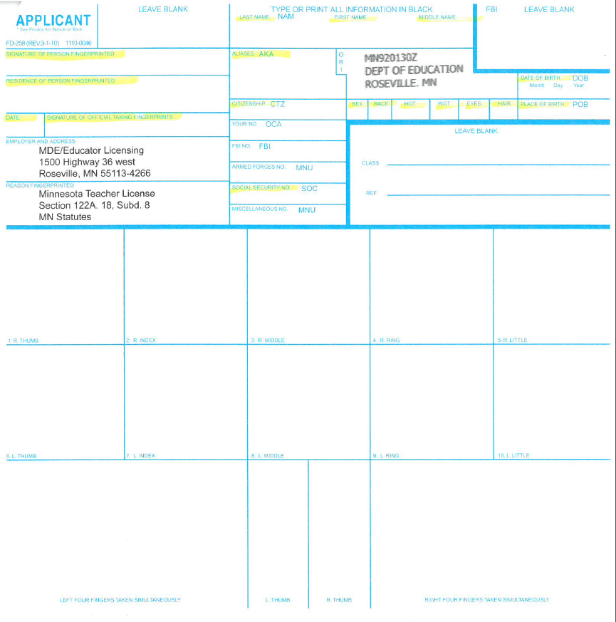
Finger Print Card Sample

Slide 7
Question?
Sampada Lehman
Assistant Registrar Office of Records and Registration St. Cloud State University sslehman@stcloudstate.edu
T 320.308.4037
Kyle Dirkes
Assistant Registrar Office of Records and Registration St. Cloud State University
kdirkes@stcloudstate.edu T 320.308.6416

