Slide 1
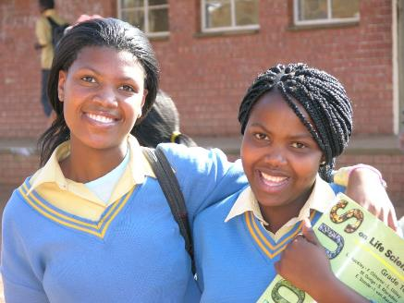
Education IN South Africa August 2008 KAthy Johnson, Fran Umerski & Kyle Ward (Additional InformAtion added June 2013)

Slide 2
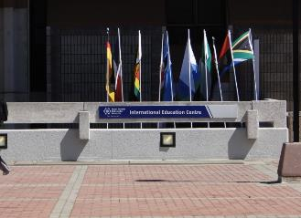
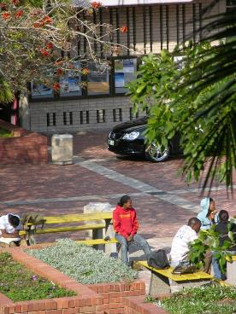
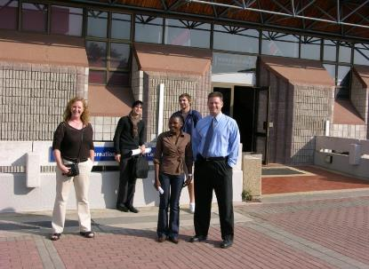
Nelson Mandela Metropolitan University

Slide 3
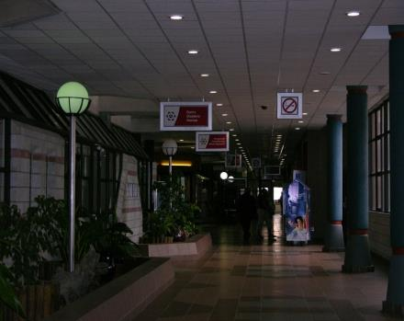
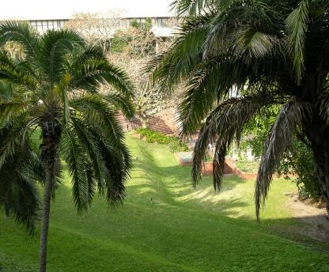
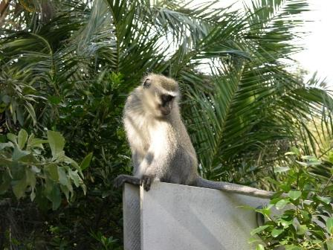

Slide 4
Nelson Mandela Metropolitan University
NMMU is the largest higher education institution in the Eastern and Southern Cape
20,000 students enrolled at seven different campuses
(five located in the Nelson Mandela Metropole, and two in the beautiful city of George)
The multi-campus structure enables NMMU to be closely involved with, and geographically closer to, the communities it serves.
The main campus of NMMU is situated in Summerstrand, Port Elizabeth.
The faculty are spread across the seven campuses, and in some cases programs are duplicated on more than one campus.

Slide 5
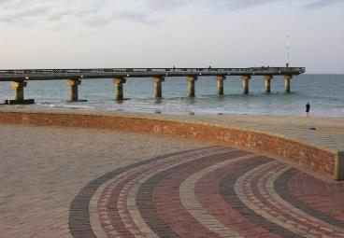
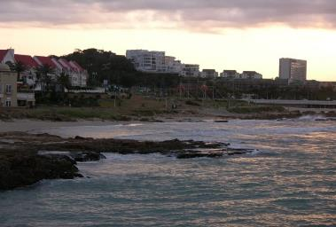
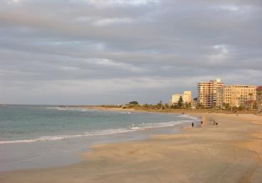
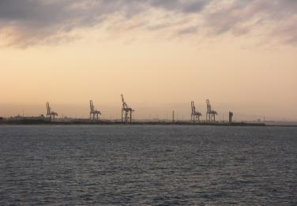
Port Elizabeth, South Africa
SE Coast
1.2 million
Tourism
Motor Industry
Warm Summer
Mild Winter
34% unemployed

Slide 6
Port Elizabeth, South Africa
Located on the South Eastern coast of Africa, this major sea port and tourist destination is set along the beautiful shores of Algoa Bay, and is fondly referred to as the Friendly Eco-City.
The city is the second largest city in terms of area and the fifth largest in terms of population in South Africa (1.2 million). The city is also an important center for the South African motor industry.
Temperatures are moderate all year round with rain scattered throughout the year. The summers are warm with a very temperate humidity level. Winters are mild and pleasant, and it is significant that water sports, even surfing, boardsailing and diving, are practiced year-round. In all, the visitor soon discovers that the climate is one major contributor to the reputation of the area as offering an outstanding quality of life.
Port Elizabeth has many historical attractions.

Slide 7
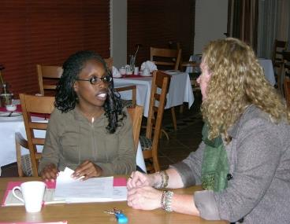
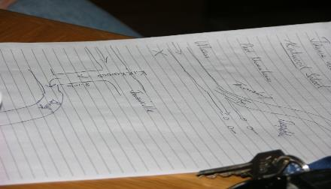
Meetings with Teacher Candidates
Students, Prof. Patrick Bean, NMMU, Shahzad Ahmad, Kathy Johnson, Kyle Ward, Fran Umerski, Vousi
Driving directions to Kirkwood

Slide 8
Indian Ocean

Slide 9
Education in South Africa
National curriculum; written in 1996 & 2005; 4 terms; schools rated on 200 criteria; receive A-E quintile ratings
Tuition/fees; school uniforms; Primary = grades R-7; HS= 8-12

Slide 10
Education in South Africa
Foundation Phase (R-3); Literacy, numeracy, Life Skills
Intermediate Phase (4-6); Language, Social Science, Math, Science (Life & Physical), Life Orientation (careers) Phy Ed, HIV, Technology, Economics, Arts & Culture

Slide 11
Education in South Africa
Senior Phase (7-9): must finish 9th; same as intermediate phase
High School: Grade 10-12 is further education & training; fees required; up to 25 subjects offered, 10 subjects designated

Slide 12
Vice Chancellor Dr. Linda Baer Dr. Nicco Jost, NMMU Dr. Kathy Johnson, SCSU
Shahzad Ahmad, SCSU Director Multicultural Student Services and SCSU students

Slide 13
Special Education Schools
Segregated
Categorical
20 year integration plan, now in year 8
May close down the special educ. schools

Slide 14
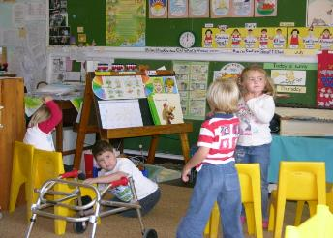
Cape Recife
Special Education school for children with physical disabilities, learning disabled, and students with ADHD
Pre-K through grade 12
ECSE: Pre-primary group of 13 students, physical disabilities and at risk students
Segregated school for children with disabilities

Slide 15
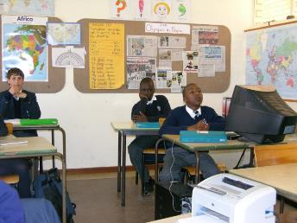
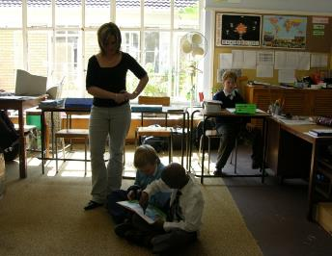
Mode of instruction: English
Provide OP/PT therapy direct, with specific, well equipped areas
Each student has an IEP, with annual IEP and comprehensive assessment

Slide 16
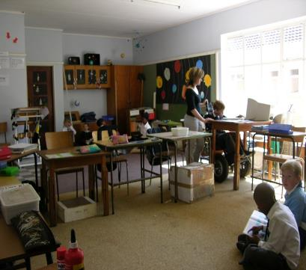
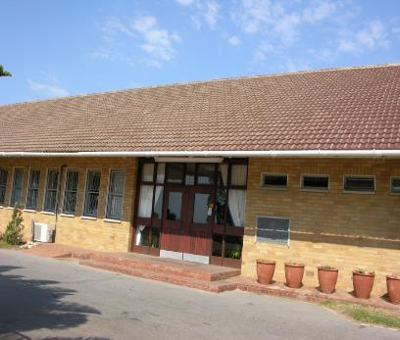
All certified teachers
Diverse student body
National curriculum,
with adaptations

Slide 17
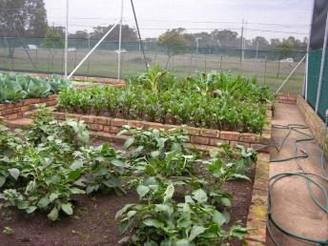
Merryvale Special Education School
300 Students
1 OT, 1 PT and 1 SLP

Slide 18
A great deal of functional skills are focused on
White teachers

Slide 19
Very integrated school, balanced student body of white, colored and black students (these are terms/classifications used by South Africans to denote White, Black and People of other Ethnicities).
IEP’s for each student; just learning how to incorporate these into the student program

Slide 20
Westview High School
660 students
Academics and skill based education

Slide 21
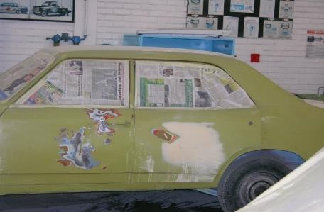
No IEP’s; programs are offered for all students
students receive both the basic academic skills of reading, writing, math, and the technical trainings

Slide 22
Serves students with an IQ, as measured by a psychologist in Port Elizabeth, that ranges from 70-85
Students attend school through grade 10
Students receive a certificate of their trained “skills” in order to seek a job

Slide 23
Different technical trainings such as hair design, cooking, automotive, welding and sewing are offered

Slide 24
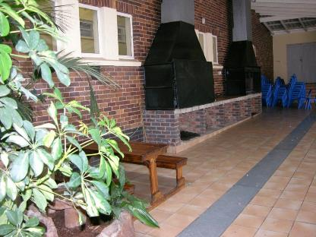
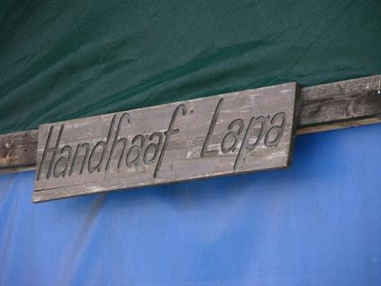
The school earns funds through renting two Brie (BBQ) areas: one with a pool, one with a dance area

Slide 25
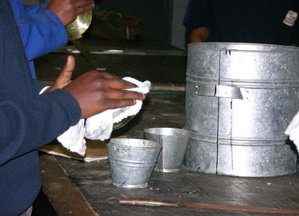
Sheet metal work

Slide 26
Township Schools
Black and colored students
Very large class size
Some doing very poor, some doing well
Some have adequate supplies

Slide 27
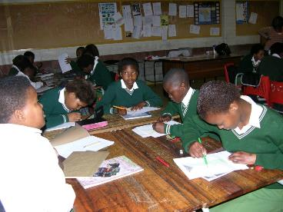
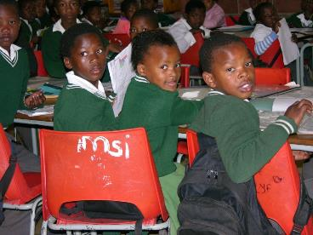
Township School: Waldren Area
Grades 1-7
40-50 students per class
Minimal community or NGO support
All black school
Every Friday children clean the school

Slide 28
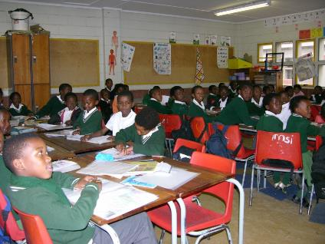
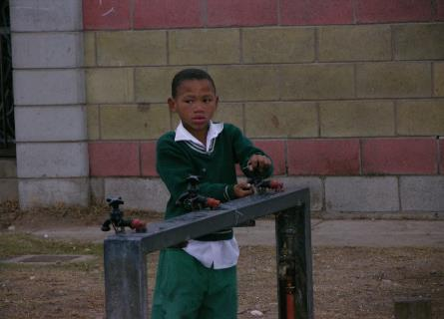
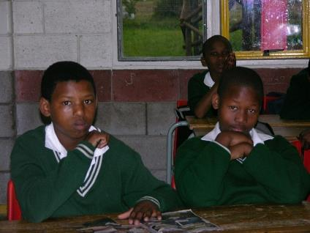
Families of poverty from the township
All black teachers

Slide 29
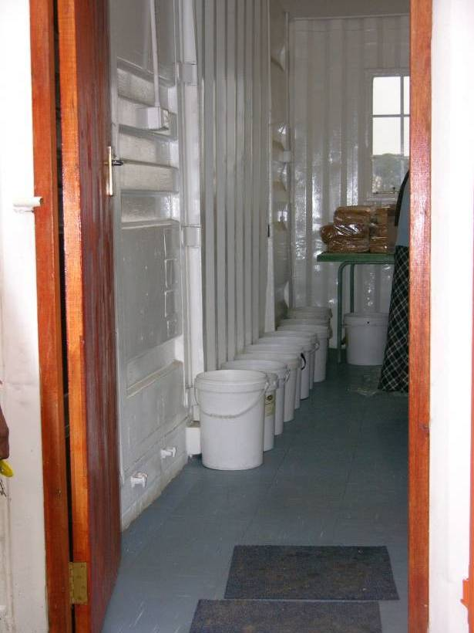
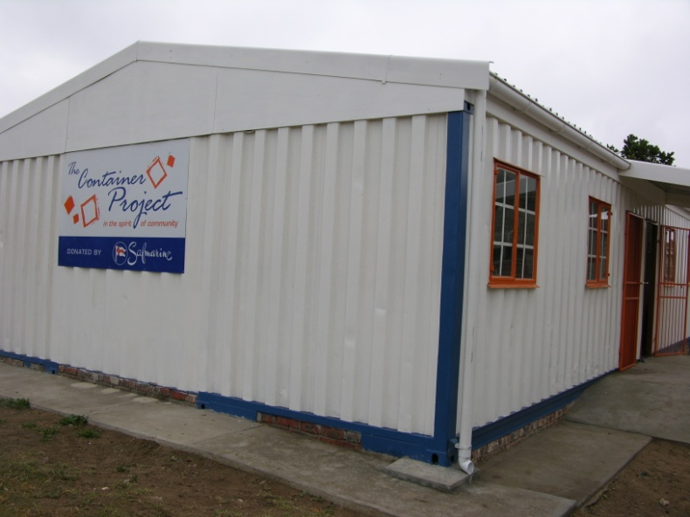
Bread and butter supplied daily to K-7; no lunch
R-grade 3 Xhosa language (Khosa tribe) mode of instruction; shift to English grade 3
Faculty from NMMU have been supporting

Slide 30
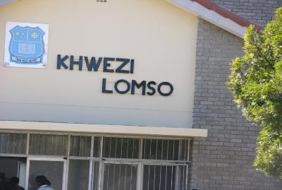
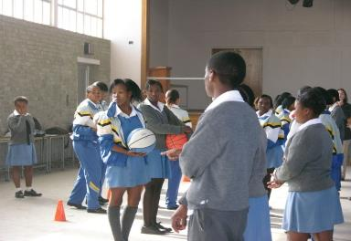
Khwezi Lomso:Township School
Grades 1-9
Math & Science focus
1,700 students

Slide 31
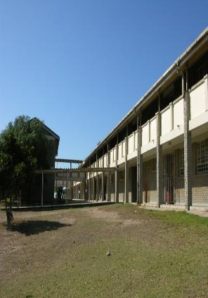
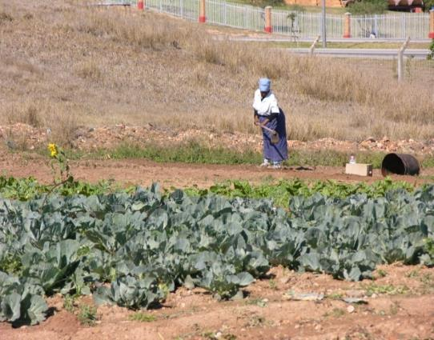
Two large community gardens for the local families on the grounds of the school

Slide 32
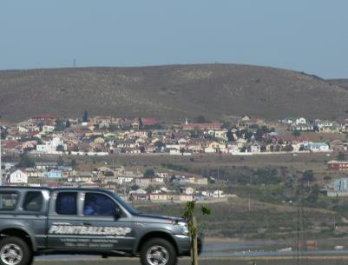
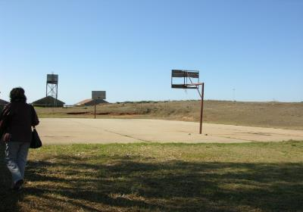
Township across the highway from school
Basketball offered as after school sport; only township school to offer
School built their own BB court

Slide 33
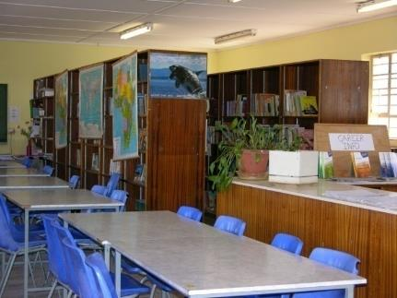
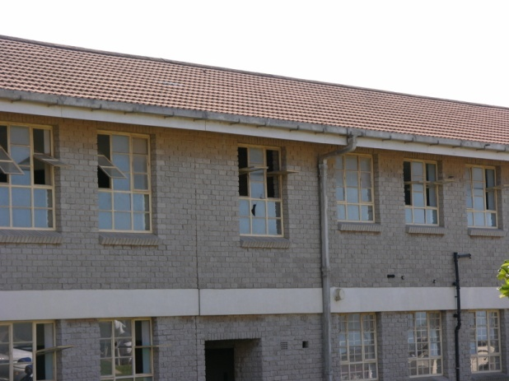
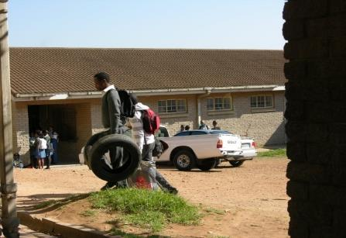
Library: very small area,
very few, old materials

Slide 34
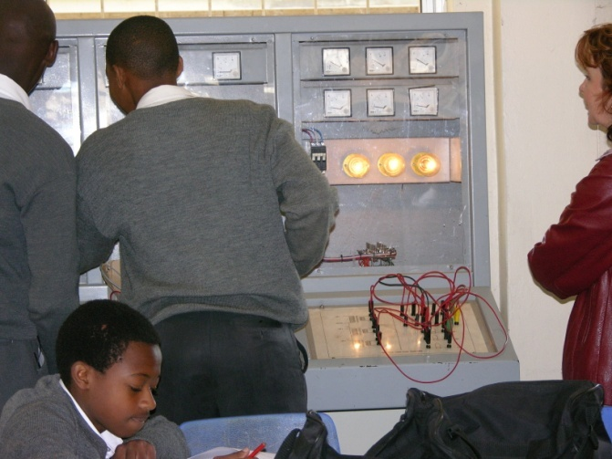
All black student body
Black and white teachers
Tech Ed options: electrical, drafting, auto maintenance
Chess club for students

Slide 35
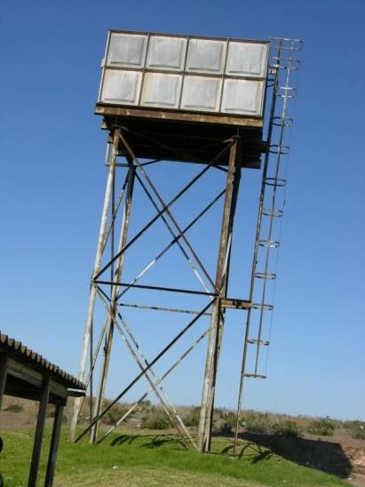
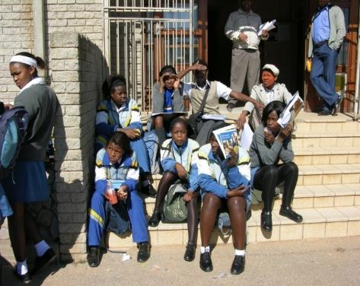
Well funded by government
High student success rate

Slide 36
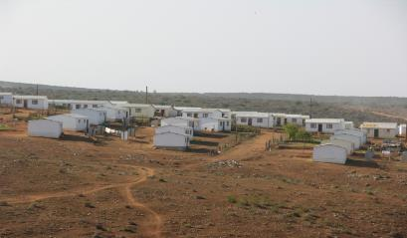
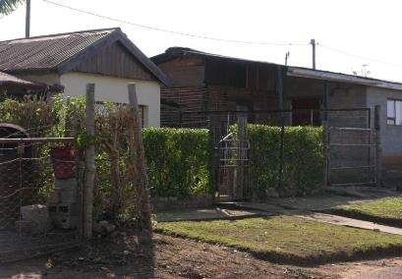
Moses Madiba: Township School
About 570 Students
Moses Madiba was a freedom fighter
School is right in the middle of the township
Very limited teaching due to attitude of teachers

Slide 37
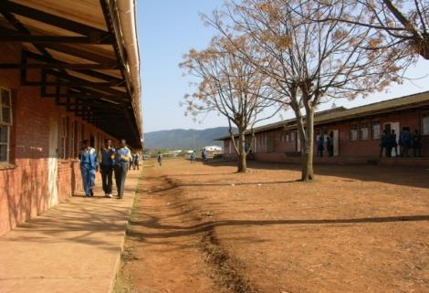
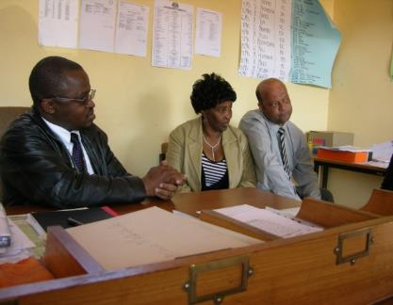
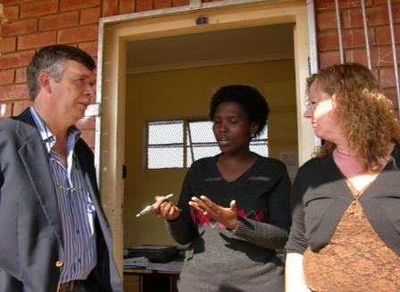
All teachers are certified
Teachers drive in from Port Elizabeth
Acting principal for past 2 years

Slide 38
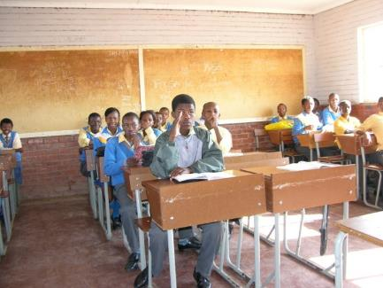
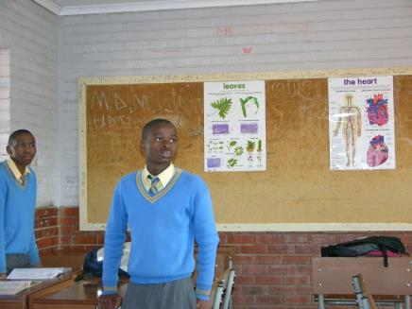
All black students from the townships
Very limited supplies and materials for students
Have enough textbooks…but these do not align with the national curriculum

Slide 39
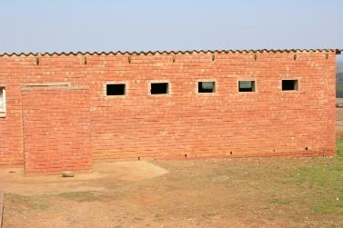
Toilets and Water Access
Bathrooms were in dire conditions, due to no money to update and fix the plumbing

Slide 40
Regular Education Schools
Tuition: 4000-7000 R ($600 -860 USD)
School Pop.: No longer all white
Schools must raise $ for funds
Some schools perform below standards & some above

Slide 41
Settlerspark Elementary
Pre-K (R) to 7th grade
425 students, 40% white and 60% black

Slide 42
School shifted in the last 10 years from all white to now majority black

Slide 43
Majority of white teachers
Performing below standards; struggling with shift in student body

Slide 44
Mode of instruction: English
Adequate materials and resources
Very clean
Very large school and grounds

Slide 45
Linkside High school
Grades 8-12
Excellent sports facilities
Extracurricular activities for students

Slide 46
670 students
Three computer technology labs, leveled for students’ ability

Slide 47
Remedial classes offered
About 5% go to university upon graduation
National curriculum is followed

Slide 48
Kirkwood School
350 students
R – 12 grades
Language of instruction: Afrikaans
Principal teaches classes in two other schools; black township and colored area school

Slide 49
Teacher Candidates (Special Educ.) Adrienna, Diana and Mike
Majority of student body is white, but more integrated with some black and colored now coming
Teacher Candidates stay in school dorm/hostel

Slide 50
Community village school about 1.5 hours from Port Elizabeth

Slide 51
Community Sponsors
Student hostels available
Some live on orange grove farms far away

Slide 52
Pearson High School; CAL Teacher Candidate Sarah M.

Slide 53
Pearson High School

Slide 54
Student Teaching Options
Current Majors: Secondary; (Special Education may offer this opportunity again in the future. Option not available for SPED at this time. June 2013)
Potentially open to all K-12 & 5-12 majors
Schedule for CFS and Elem. Ed. does not coincide with methods/student teaching schedule at SCSU
Schedule: Fall- Mid July to Late September
Schedule: Spring- Late January to Late March

Slide 55
Thank you to OCE student workers Amanda, Lewis, Meggin, Nicholas and Erica for their work on this power point.
Moon rise on Safari, South Africa
Contact information
kejohnson@stcloudstate.edu; fwumerski@stcloudstate.edu;
krward@stcloudstate.edu

