Slide 1
Workplace Bullying: What it is and what you can do
Holly J. Schoenherr, Ph.D.
Director of Human Resources
St. Cloud State University

Slide 2
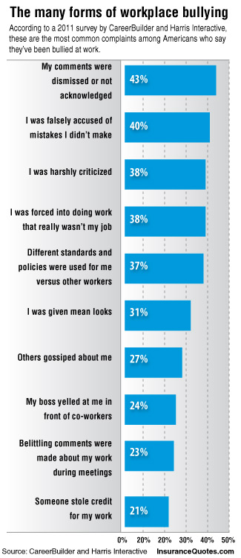
Examples of Bullying Behaviors:
Yelling, screaming
Constant criticism
Inconsistent compliance with rules
Threatening job loss
Insults and put-downs
Discounting/denial of accomplishments
Exclusion from a group

Slide 3
Bullying Defined
Workplace Bullying is repeated, health-harming mistreatment of one or more persons (the targets) by one or more perpetrators that takes one or more of the following forms:
Verbal abuse
Conduct which is threatening, humiliating, or intimidating
Work interference, sabotage, which prevents work from getting done
Exploitation of a known psychological or physical vulnerability
--The Workplace Bullying Institute

Slide 4
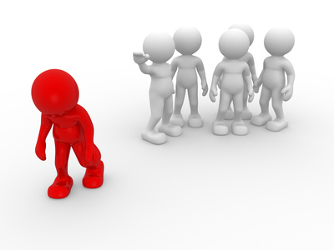
How is Bullying different from…
Harassment?
Sexual harassment includes unwelcome sexual advances, requests for sexual favors, sexually motivated physical conduct, and other verbal or physical conduct of a sexual nature when:
Submission to such conduct is made either explicitly or implicitly a term or condition of an individual's employment or education, evaluation of a student's academic performance, or term or condition of participation in student activities or in other events or activities sanctioned by the college or university; or
Submission to or rejection of such conduct by an individual is used as the basis for employment or academic decisions or other decisions about participation in student activities or other events or activities sanctioned by the college or university; or
Such conduct has the purpose or effect of threatening an individual's employment; interfering with an individual's work or academic performance; or creating an intimidating, hostile, or offensive work or educational environment.

Slide 5
How is Bullying different from…
Harassment?
Discrimination?
Discrimination means conduct that is directed at an individual because of his or her protected class and that subjects the individual to different treatment by agents or employees so as to interfere with or limit the ability of the individual to participate in, or benefit from, the services, activities, or privileges provided by the system or colleges and universities or otherwise adversely affects the individual's employment or education.

Slide 6
How is Bullying different from…
Harassment?
Discrimination?
Healthy Conflict?
Healthy conflict occurs when individuals of diverse backgrounds and personalities are able to speak candidly about matters of interest to them, ask difficult questions, challenge ideas and propositions that do not seem right to them, and work together to achieve optimal solutions in a mutually respectful manner.
Video

Slide 7
Behaviors in Healthy Conflict
Focus on substance or problem not person or the other party. Understand that the situation is not about you or me, it’s about the problem.
Assume good intentions. It’s easy to make stuff up if you think the other party is out to get you. Both parties should assume good intentions. Assume that the other party means well, that he or she is seeking optimal solution.
Be open and willing to consider the merits of alternative arguments. In doing so, you acknowledge the possibility that the other person might have an idea or perspective that you did not consider. This behavior signifies openness, humility and respect for the other party.
Have enough awareness to understand when emotions are rising (e.g., changes in tone of voice and body language) and know when to stop a conversation to prevent a counterproductive event from occurring.

Slide 8
Legal
Illegal
Appropriate
Inappropriate
Sexual Harassment??

Slide 9
Legal
Illegal
 | Sexual Harassment
Appropriate
Inappropriate
Discrimination??

Slide 10
Legal
Illegal
 | Sexual Harassment Discrimination
Appropriate
Inappropriate
Healthy Conflict??

Slide 11
Legal
Illegal
Healthy Conflict
 | Sexual Harassment Discrimination
Appropriate
Inappropriate
Bullying??

Slide 12
Legal
Illegal
Healthy Conflict
Bullying | Sexual Harassment Discrimination
Appropriate
Inappropriate

Slide 13
Test your knowledge…
Scenario 1: Adam is a hard-working and responsible employee with autism. Adam has a difficult time dealing with certain sounds. These sounds make him feel very anxious, and he cannot focus on anything else when he hears these sounds. Two of Adam’s co-workers have figured out that he is very sensitive to certain sounds. Whenever they go past Adam’s work area, they make “shhhhhh” and “buzzzz” noises.
Is this bullying?

Slide 14
Test your knowledge…
Scenario 2: James works at a computer repair store. He sometimes forgets to record and file the service reports after he fixes a computer. His co-worker has to do it for him 2 or 3 times per week. He often reminds James to record and file the reports and he asks him things like, “Did you file the service report?”
Is this bullying?

Slide 15
Test your knowledge…
Scenario 3: Derrick works in an office setting. All of the other office assistants go to lunch together every day. Derrick packs his lunch and stays at the office to eat it. However, Derrick would like to go to lunch with them once in a while, but he doesn’t know how to invite himself. The others have not invited him to go with them.
Is this bullying?

Slide 16
Test your knowledge…
Scenario 4: Marcus is a smart, hardworking employee. Marcus is not very comfortable in social situations at work, and he tends to work alone. Marcus sometimes struggles to know what to say in conversations. He might say things that others view as strange or different. Marcus works near a guy named Ben. Almost every day, Ben asks Marcus lots of questions about his special interests and hobbies, and he won’t stop asking. When Ben asks Marcus these questions, he is usually smirking or laughing.
Is this bullying?

Slide 17
Is it possible to prevent or stop bullying?

Slide 18
Is it possible to prevent or stop bullying?
YES!!

Slide 19
What you can do…
When the bully is a co-worker

Slide 20
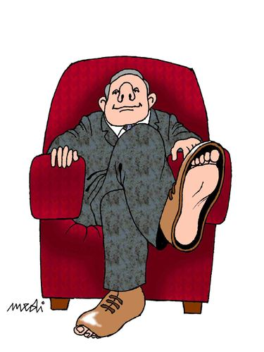
What you can do…
When the bully is a co-worker
When the bully is a boss
Video

Slide 21
What you can do…
When the bully is a co-worker
When the bully is a boss
When the bully is you

Slide 22
Who can help?
Supervisor
Human Resources
Employee Assistance Program

Slide 23
Homework assignment…
What can you do immediately to be a part of the solution?
Start doing
Stop doing
Do better

