Slide 1
Telework Policy Supervisor Town Hall

Slide 2
Agenda
SCSU Telework Policy & MMB Telework Policy
https://www5.stcloudstate.edu/Policies/SCSU/Viewer.aspx?id=157&v=1
https://mn.gov/mmb-stat/policies/1422-telework.pdf
SCSU Short Term Telework Policy
https://www5.stcloudstate.edu/Policies/SCSU/Viewer.aspx?id=148
Considerations for Approving Telework Requests
Tips for Managing Telework Employees
FAQs
Speaker Panel – Amy Simon & Phil Thorson

Slide 3
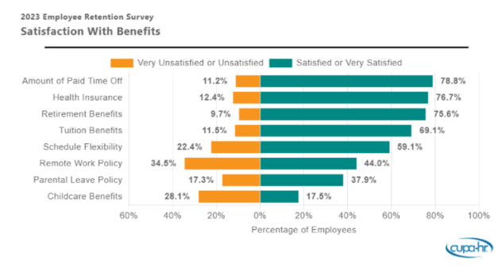
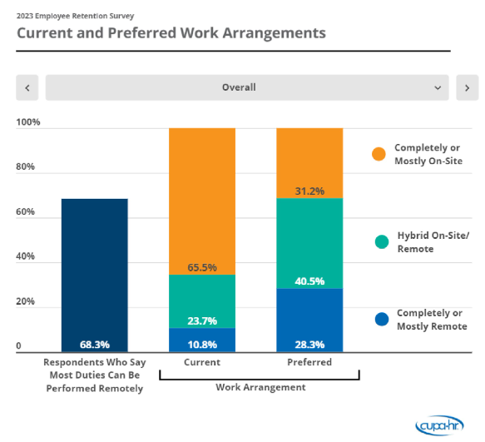
SCSU Rationale
St. Cloud State University (SCSU) recognizes the strategic value and benefits of accommodating flexible work arrangements. The benefits of a flexible work environment must be balanced with the need to provide an engaging residential campus experience for students and to ensure adequate staff on campus to support effective university operations.

Slide 4
SCSU Policy
In accordance with the MMB Telework Policy, employees may have the option to telework.
May be fully teleworking or hybrid.
Requires approval by supervisor and can be altered as necessary*.
Telework may not be feasible or appropriate for all positions.
Factors considered include, but are not limited to:
impact or perceived impact on student experience, access, or success
business needs of the unit, department, and the university
impact on job performance & duties
necessary SCSU resources
SCSU adopts the general standards and expectations as found in the MMB Telework Policy.
All employees must sign the Telework Form

Slide 5
SCSU Procedure
Step 1: Employee and Supervisor review the employee assessment flow chart.
Step 2: The employee completes the telework form.
Step 3: The supervisor completes the supervisor portion of the form, will evaluate the request and will consult Human Resources if there are questions.
Step 4: If the decision is to deny the request, then see step 5. If the decision is to approve the request, skip to step 6.
Step 5: Supervisor denies the request, supervisor & employee should meet to discuss the decision and explore alternatives. If no alternatives exist, HR may review the decision, upon request. If the supervisor revises the original initial determination, continue to Step 6. If the decision is upheld, telework will not be approved.

Slide 6
SCSU Procedure - Continued
Step 6: Employee will be provided with a copy of MMB’s HR/LR Policy #1422 Telework Policy. The MMB telework policy should be reviewed and discussed. A mutual understanding of the standards and expectations should be established and accountability measures determined.
Step 7: Supervisor and employee sign the telework form and document the expectations and needs, including, but not limited to:
Plans regarding how the Employee's performance will be evaluated
Equipment and supplies needed
Workers’ compensation availability – Must notify HR if outside the State of MN
Data privacy and security practices that will be expected
Communication and availability expectations and logistics
Where to find emergency contacts (i.e. IT help, reporting an injury, etc.)
Step 8: The original, signed telework form is provided to HR and a copy is retained by the employee and supervisor.
Step 9: The supervisor should work with the employee on receiving the necessary equipment and supplies.
Step 10: The supervisor communicates with other team members about telework arrangements.

Slide 7
Telework Form
The Telework form is linked in the policy.
The form is mostly completed by the employee, but there is a "Supervisor Considerations For Telework Eligibility" section that the supervisor will need to complete.
This section will ask questions to help you determine whether the employee and their position is eligible for telework, and works through the employee & supervisor flowcharts.
The answers to this section are color-coded.
-If you check a green box, then there is no concern on that point with allowing telework.
-If you check an orange box, then mitigation measures are required to address the concern. The more orange boxes you check, the more you should reconsider whether or not to allow an employee to telework.
-If you check a red box, then either the employee or their position are not eligible for telework per the policy.

Slide 8
Short-Term Telework Policy
SCSU's new Telework Policy does not replace or diminish the Short Term Telework policy which empowers supervisors to approve telework on an as needed basis.
This new Telework Policy pertains only to regularly scheduled hybrid or fully teleworking positions.

Slide 9
Considerations for Approving Telework
Supervisor Assessment Flowchart
Employee Assessment Flowchart
Supervisor Telework Considerations – found in Telework Form
*Links to all documents can be found on the Policy Hub and HR Telework webpage

Slide 10
Tips for Managing Teleworking/Hybrid Employees
Notes:
Managing teleworkers is not radically different than managing in person employees. The same basic principles apply. However, there is a need for at least some review of the position and supervisory expectations.
-Review current goals for the position and see if they need to be adjusted as a result of telework. If there are no goals for the position (the form reviews this too), then you need to create goals and objectives to help measure the effectiveness of the telework arrangement.
-Set expectations for employees in relation to telework, evaluate whether expectations will change or not as a result of telework. Make sure you communicate clearly around expectations, as clear expectation setting and communication around expectations can be an issue with telework if they are not properly set ahead of time and on an ongoing basis if challenges arise.
-Keep a focus on results with telework.
-Documentation is very important with telework. If results aren't getting accomplished, then make sure to document the gaps, and document the communication you have with employees regarding that. Having documented expectations and goals—and documenting times that they aren't met (and corrective communication around that) is v. important in any supervisory relationship, but especially with telework.

Slide 11
Notes:
-Frequent communication is vital when teleworking. Otherwise, disconnection with the rest of the team and the supervisor can occur.
-Telework requires trust and delegation. While you should schedule and have an expectation of frequent communication, avoid micromanaging. Scheduled communication and check-ins can help avoid the perception of micromanagement.
-Flexibility and adjustment is key to telework success. Align telework arrangements, goals and expectations to meet the needs of the office/department. Ensure that goals are achieved and expectations are met, but also embrace flexibility when possible.

Slide 12
Notes:
-W/o the EE in the office every day, it can be more challenging to maintain a good supervisory relationship with an employee. Scheduling structured check ins is essential to making telework work while maintaining a good supervisory relationship.
-Studies have shown that employees can sometimes have negative outcomes from less frequent feedback and coaching in telework situations. Scheduling times to do this with your employees—and sticking to that schedule is essential in a teleworking relationship.
-This slide has some sample questions to ask in these check ins.

Slide 13
FAQs
Can an employee work from another state?
Yes, however HR needs to be notified as there are tax implications & Worker's Compensation considerations
Can an employee work from another country?
No, this is prohibited by MMB. Employment, Worker's Compensation, and tax laws vary widely outside the United States and makes it difficult to ensure compliance.
Do I have to provide additional monitors & equipment for working from home?
Per the MMB Policy, it is the agency's discretion what equipment and software is provided.
What happens if campus is closed due to weather?
Per MMB Policy, teleworkers need to perform work as normal.
Does SCSU help pay for internet?
Per MMB Policy, agencies assume no responsibility for internet, furniture, telephone, etc.
What if my internet is unreliable?
You likely need to have this resolved before telework is an option.
Is there a difference between a remote worker and a teleworker?
Yes – per MMB, a remote worker is remote as an employment condition and has a separate policy. Telework is optional for both the agency and the employee.

Slide 14
Speaker Panel
Phil Thorson – VP for Technology Strategy & CIO
Amy Simon - Director of IT Application Services and Integration
Notes:
IT has been piloting this for the last year. Phil and Amy have agreed to join us and discuss what has and hasn't worked for them
--If you have a question for Phil and Amy, please indicate that in the chat—otherwise, we will assume that questions in the chat are for HR and will answer them at the end.

Slide 15
Poll Questions
What other HR-related training topics would you like to see offered for supervisors only?
What other HR-related training topics would you like to see offered for all employees?
When HR has training/town hall sessions like this, would you like to see 1 session offered, or 2 (i.e., 1 morning session, 1 afternoon session?)
Would you prefer in-person training/town hall sessions, zoom sessions, or hybrid?

