Slide 1

Résumé Writing
A Résumé is your ticket to a chance at a fulfilling career

Slide 2

Résumé purpose
Obtain interview
Required for Handshake
Showcase your KSAOs, experience, and accomplishments
  KSAOs: knowledge, skills, abilities, and other characteristics

Slide 3
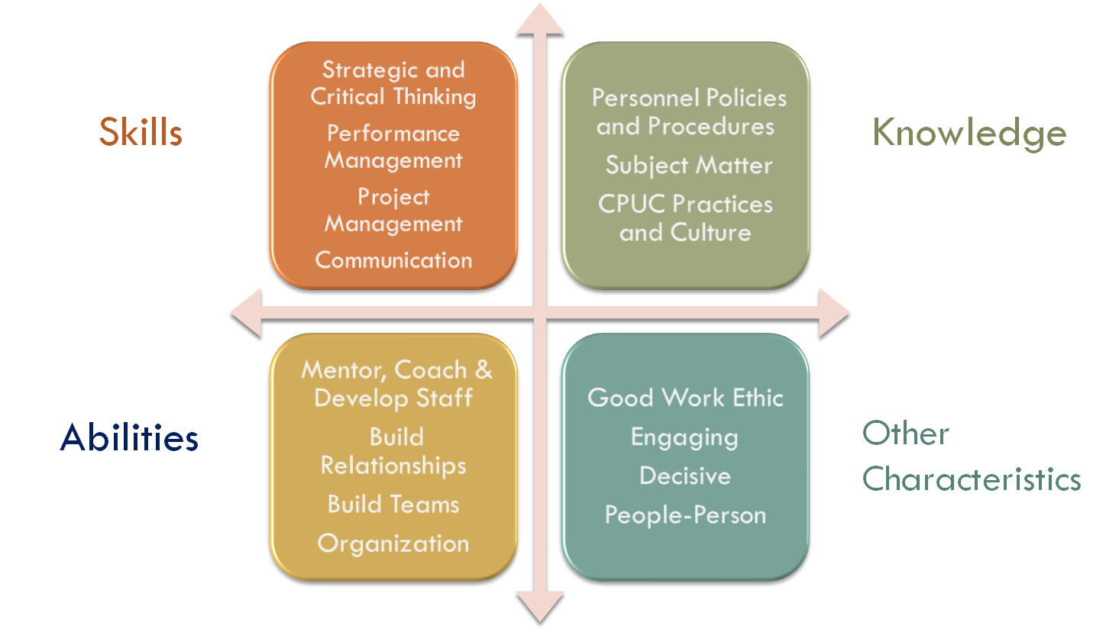

Slide 4

How to get started?
Microsoft Word document (.doc)
One page long
Consistent formatting/style
Font
Margins
  Bold key information
  Relevant information; no fluff

Slide 5
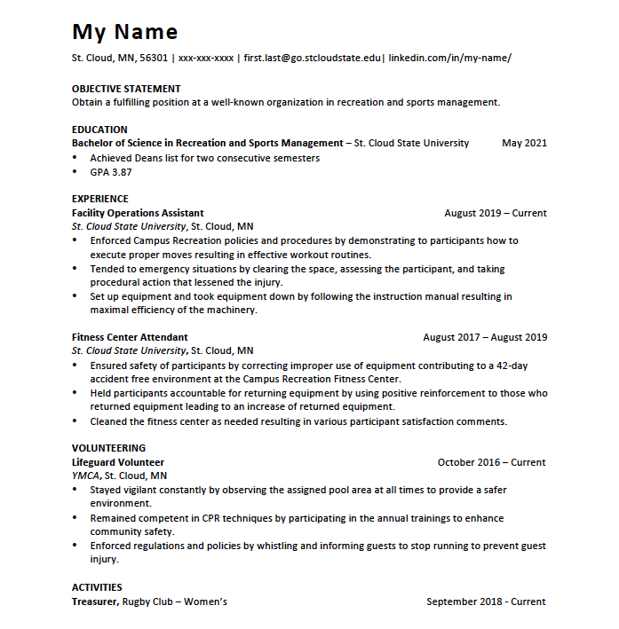

Slide 6
Additional / optional headings
Technical / Computer skills
Key training & skills
Languages
Study abroad / international experiences
Military experience
Volunteering

Slide 7
Education | Experience | Other
GPA (if 3.2 or higher) | Summer/Part-time Jobs | Awards
Minor | Internships (credit and not for credit) | Volunteer
Academic honors/awards | Campus involvement | Training Completions
Related certificates | Self-Employment / Freelance | Any Leadership Experience
Scholarships | Volunteer work | Memberships/Organizations
International experience | Clinical work | Related Experience and Skills
Licensures | Practicum work
Related training and skills
Thesis or Senior Project

Slide 8
Skills
Clerical Job ad:
Answer multi-line phone system, route calls to appropriate person/department, greet customers at reception desk, typing as needed, copying, filing, occasional errands on campus, other clerical tasks as assigned. Must have prior clerical experience and be dependable and punctual.
What kind of transferable skills can we pull out of this job ad?
Multi-task
Time management
Organizational skills
Effective communication skills
Meet deadlines
Work efficiently

Slide 9

Writing effective bullet points
Use WHO logic to describe experience
What did you do?
How did you do it?
What was the outcome?
  Team Leader
  “I managed a team of 10 direct report professionals by using organization and time management that led to 90% of performance feedback satisfaction rates.”

Slide 10
You try!
Create a WHO statement for a resume in the below scenarios with your group.
Example 1: You are applying for a middle school teaching position. Your most recent experience has been as a swim instructor.
Example 2: You are applying for a nursing position. Your most recent experience has been volunteering in a nursing home.
What did you do?
How did you do it?
What was the Outcome?

Slide 12
Thank you!
St. Cloud State University
Career Center
215 Centennial Hall
careercenter@stcloudstate.edu
(320) 308 – 2151
www.stcloudstate.edu/careercenter

