Slide 1
Non Faculty Overrides

Slide 2
Staff who are not faculty members are able to provide overrides to students through the Administrative application (ARSA), using the option Override Edits. Override Edits is used to override one or more edits for a student in a particular or unique situation if the need arises. It can also be used to view the history of edits that have been applied to the student’s registration. https://eservices.minnstate.edu/employee/public/secure

Slide 3
Override Edits with ARSA
Add and Delete Override Edits
The Student Information screen allows adding or deleting Override Edit(s) for an individual student.
Override Edits Tab
The system will default to the Registration tab. Click on the [Override Edits] Tab.
Adding an Edit
To add an edit to a student schedule for the selected Year Term, click on the [Add] button.

Slide 4
Override Edits with ARSA (continued)

Slide 5
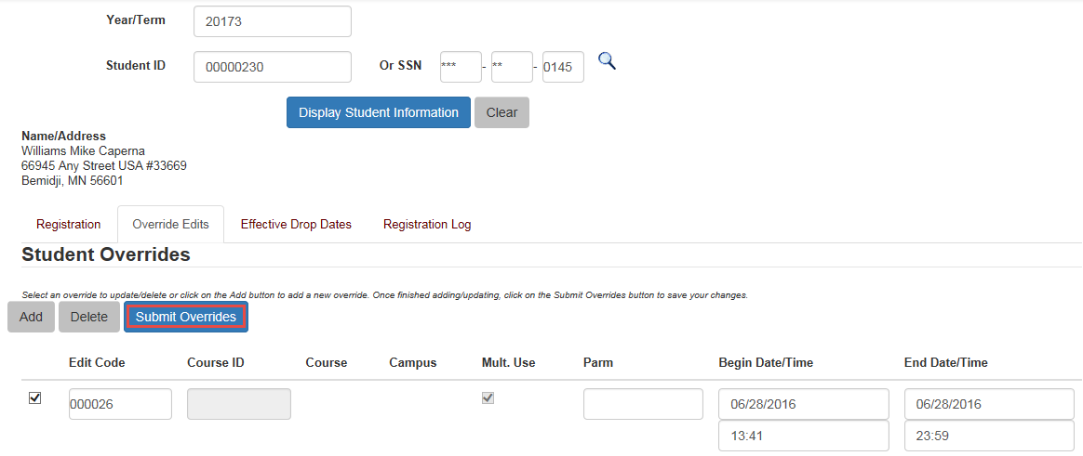
Override Edits with ARSA (continued)
After clicking the [Add] button, the system will default with a check mark [] beside the blank Edit Code and Course ID. Enter the Edit Code and Course ID. If the Begin Date and End Date need to be adjusted then enter the corrected date(s) in the fields. If the selected edit is correct, then select the [Submit Overrides] button to attempt to override the course.

Slide 6
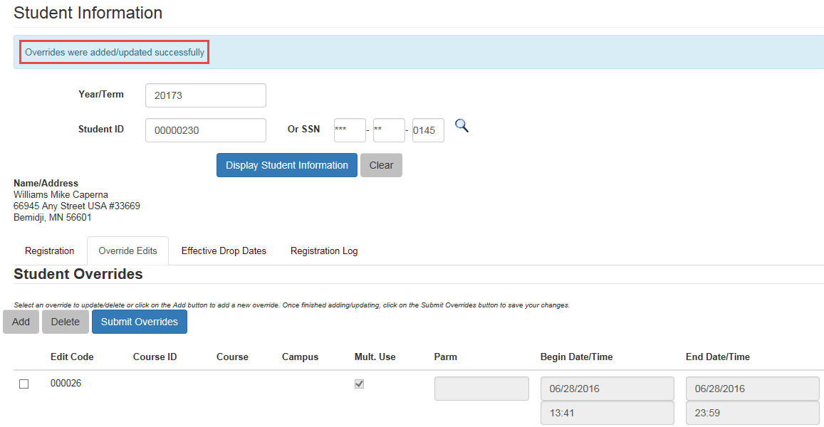
Override Edits with ARSA (continued)
If the student passes the edit(s) that are active for the institution, a message stating Overrides were added/updated successfully will display on the top of the page.

Slide 7
Questions?
Contact us at 320/308-2168 or 320/308-2111 or Email registrar@stcloudstate.edu.

