Slide 1
Masters of Sports Management: Athletic Coaching Concentration

Slide 2
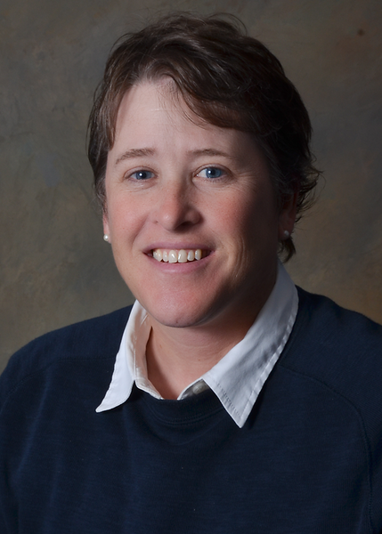
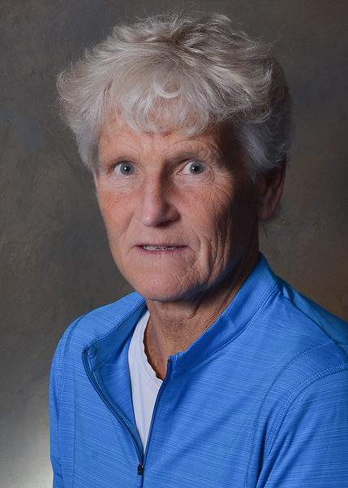
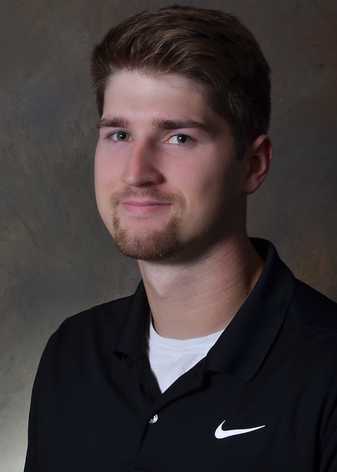
Today’s Hosts
Dr. Paula U’Ren
Dr. Lori Ulferts
Kyle Voss
Kinesiology Department Chairperson
Rec & Sport Management Professor
Kinesiology Graduate Program Director
Rec & Sport Management Professor
Student in the SM: Coaching Concentration M.S.
GA for Kinesiology Department

Slide 3
Program Highlights
Accomplished and experienced professionals comprise the graduate faculty from a multitude of sports-related fields with a high-level of experience.
Classes focus on theoretical foundations, practical situations and applied learning.
Assistantships are offered through Athletics, Campus Recreation, and Kinesiology.
You will enjoy an engaging and interactive learning experience that accommodates a working professional.
Ability to gain continuing education units(CEU) credits.
One of two colleges that offer a Coaching Concentration online!

Slide 4
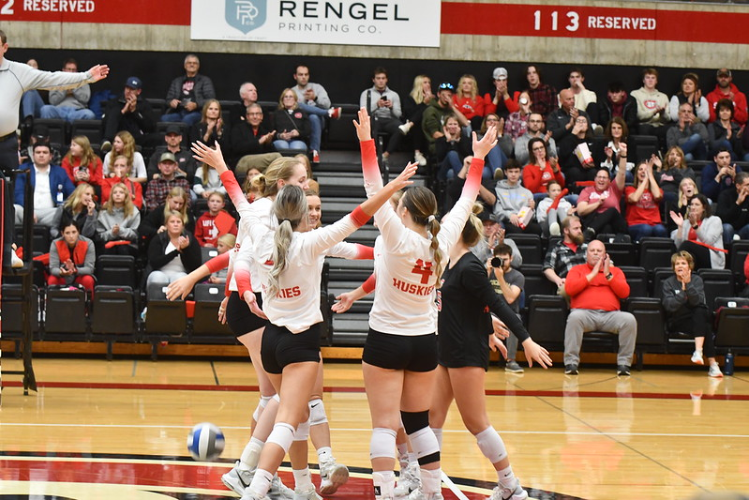
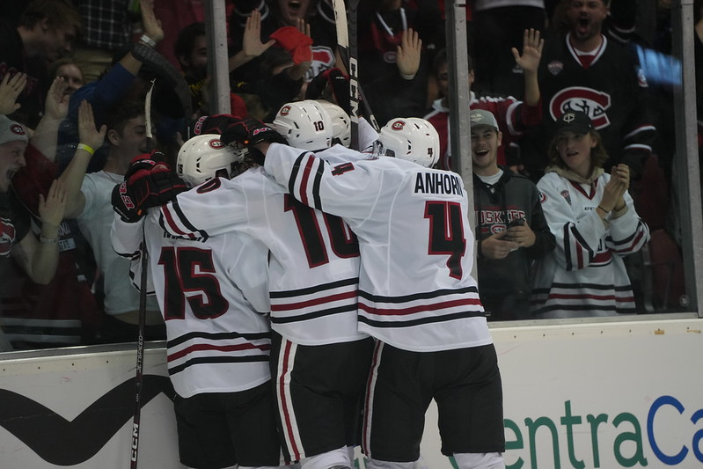
Program Distinctions
Access to collegiate and high school coaching mentors and administrations
Academic Quality
Affordability
Flexibility in course selection to meet your professional goals
Alumni network in professional and collegiate sports
8-week and 16-week course options

Slide 5
Course Options
Core Courses
Elective Options
Planning PE & Sports Facilities
Finance & Marketing
Law & Sport
Organization & Administration
Social Cultural Issues in Sports
Internship
Sport & Exercise Nutrition
Strength & Conditioning
Mental Training Techniques
Sports Psychology
Advanced Theory of Competitive Athletics

Slide 6
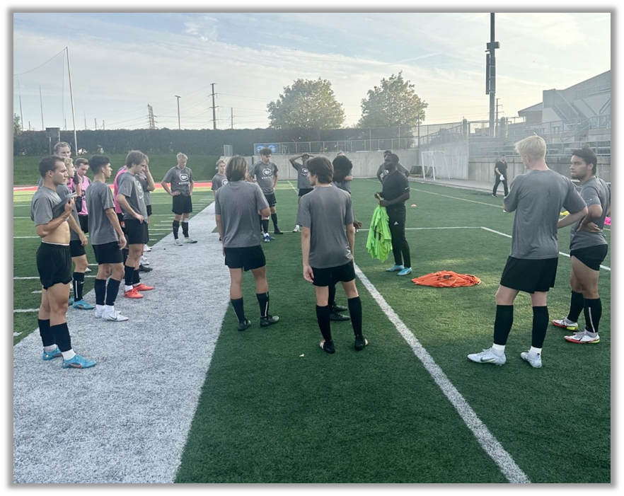
Coaching Internship Opportunities
Coach with a DI, DII, DIII or a NJCAA Coach.
Coach at the high school or professional level.
Coach with an athletics' team strength & conditioning coach.
Athletic Administration: working in compliance, directing, or special projects.
Learn in-depth recruiting strategies, experience real scouting and/or film breakdown.
Involve your self with coaching communications, social media, and sport analytics.
Be mentored by highly successful coaches.

Slide 7
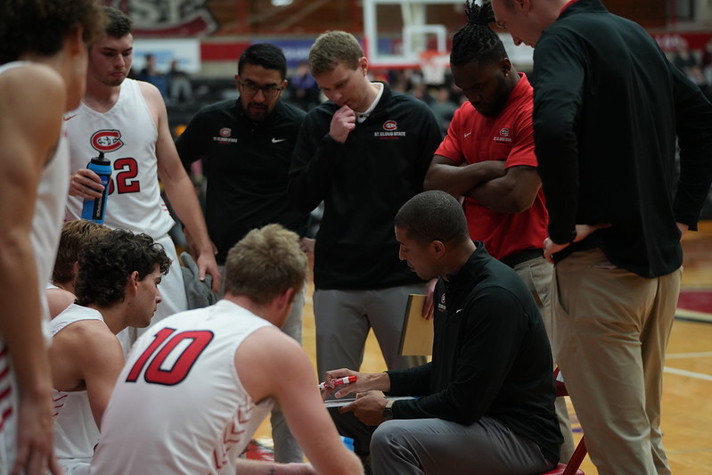
Career Options
Athletic coaching positions, every level
Professional sports major and minor leagues
Athletic administration - college and high school
Financial and fundraising operations
Sports marketing and promotions
Facilities operations and event management
Sports advertising and sponsorship
Athletic academic compliance
Athletic media relations
Youth sports administration

Slide 8
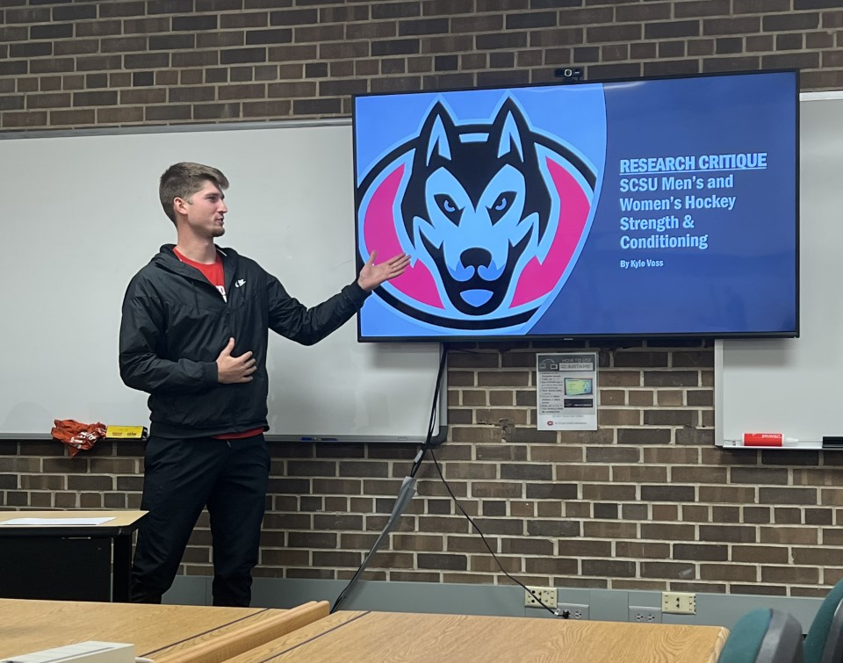
Application Process
Apply at SCSU Graduate Admissions
GradCAS
3-Letters of Recommendation
Statement of Intent
Resume
Unofficial Transcripts
Pay Fees ($40)
No GRE Required
Due Dates:
Spring Semester 2023
October 15th for International Citizens
December 1st for U.S. Citizens
Fall Semester 2023
June 15th for International Citizens
May 1st for Coaching Concentration
August 1st For U.S. Citizens

Slide 9
FAQs
What choices do I have in my internship and what’s next?
We have a lot of different opportunities to coach here, and at different levels. Whether it is working with our 16-Division 2 teams, our 2-Division 1 teams, or working with local high schools and youth programs. We are also close by to the College of Saint Benedicts and Saint John’s University to work with programs at the Division 3 level. Find your passion of what you like to coach, and we will help you reach out to perform your internship at that program.
What are opportunities that your students have received post-graduation?
Post-graduation, students will be capable of continuing their coaching careers, but also have the opportunity to find other jobs with their degree. Whether it is a facility manager, events coordinator, external operations, we have different opportunities that this degree can lead you.
What is Sport Management: Athletic Coaching Concentration?
The coaching concentration allows for students to gain their Masters in our Sports Management program, it allows for students to focus on coaching for the sport of their preference. Rather than writing a thesis, the program allows for the hands-on experience in being in the field.
Why choose St. Cloud State University for your Sport Management: Athletic Coaching Concentration Degree?
St. Cloud State offers a lot of great mentors as coaches. We have teams that are nationally ranked and are constantly competing for conference championships and national championships. St. Cloud State is also home to 16-Division 2 teams, and 2-Division 1 teams and both divisions compete in some of the toughest conferences of their respected division.
What makes the Athletic Coaching Concentration unique from other programs?
St. Cloud State is one of two colleges that offers this program online. It allows students to be able to coach and learn from home. Teachers who are coaches as well for their school, allows them to use the program to gain CEU credits.

Slide 10
Follow Us!
Instagram - @scsukinesiology
Facebook – SCSU Department of Kinesiology
TikTok - @scsukinesiology

Slide 11
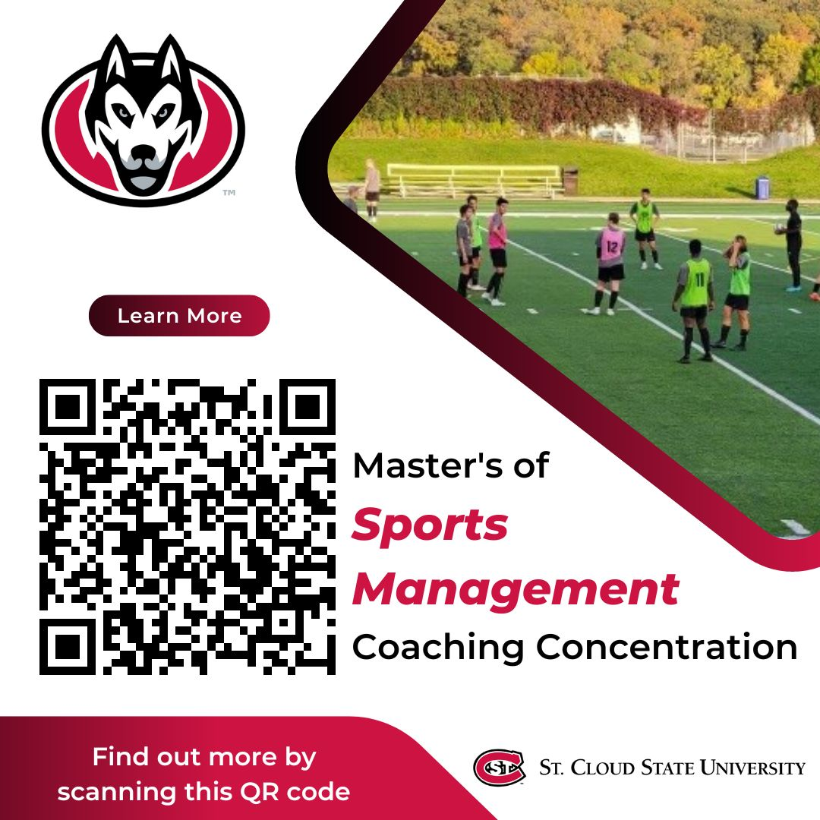
Contact Information
Office Phone
320-308-4251
Email
Office
kinesiology@stcloudstate.edu
Dr. Paula U’Ren
pjuren@stcloudstate.edu
Dr. Lori Ulferts
lkulferts@stcloudstate.edu
Website
www.stcloudstate.edu/graduate/sports-mgmt/default.aspx

