Slide 1
US NATIONAL ECONOMIC OUTLOOK
Nimantha Manamperi
Associate professor of economics
St. cloud state university

Slide 2
GOLDILOCK’s Economy
US economic outlook looks healthy.
GDP growth rate around 2%.
Unemployment rate below its natural levels.
No too much inflation or deflation.
NOT TOO COLD , NOT TOO HOT ,
JUST RIGHT
source: prospect.org

Slide 3
Enjoying the Long Run ?
Source: Congressional Budget Office (CBO)

Slide 4
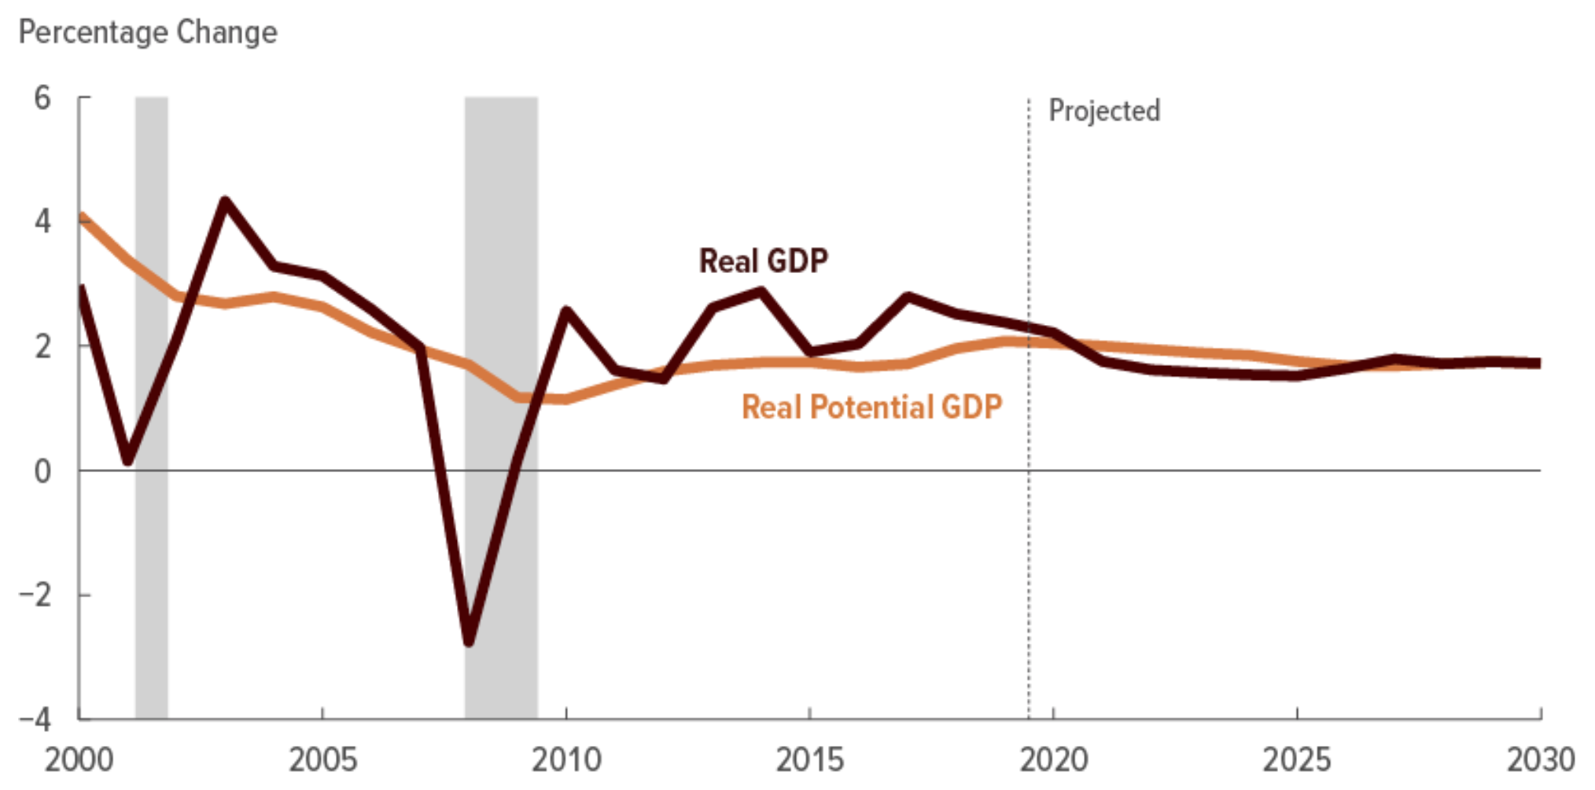
REAL GDP GROWTH RATE
2.2 % in 2020
1.7% between 2021-2030
Source: Congressional Budget Office (CBO)

Slide 5
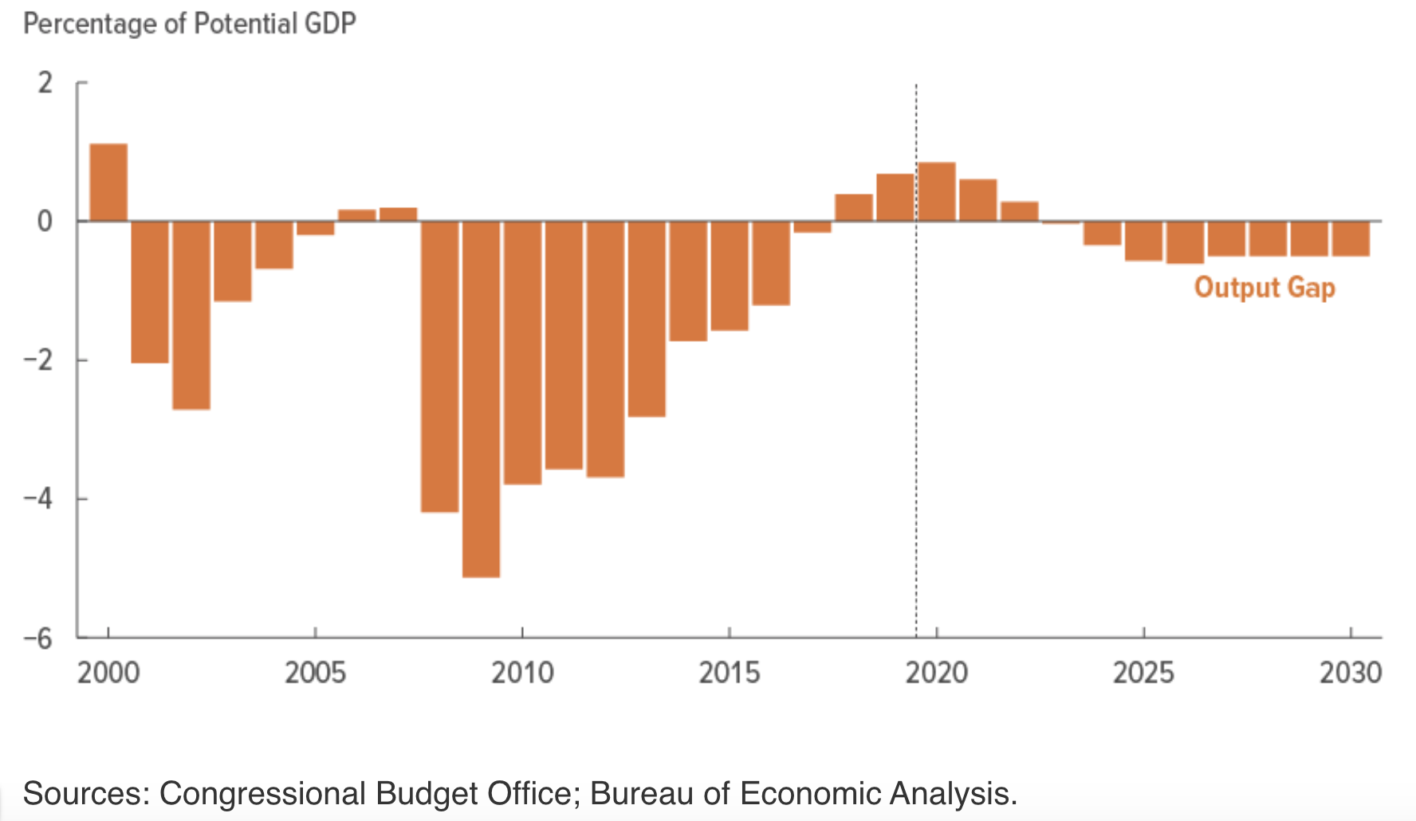
OUTPUT GAP
Strong demand for labor and services pushes output gap to a cyclical peak in 2020
Over the next few years, the output gap narrows, reducing the upward pressure on inflation and interest rates.

Slide 6
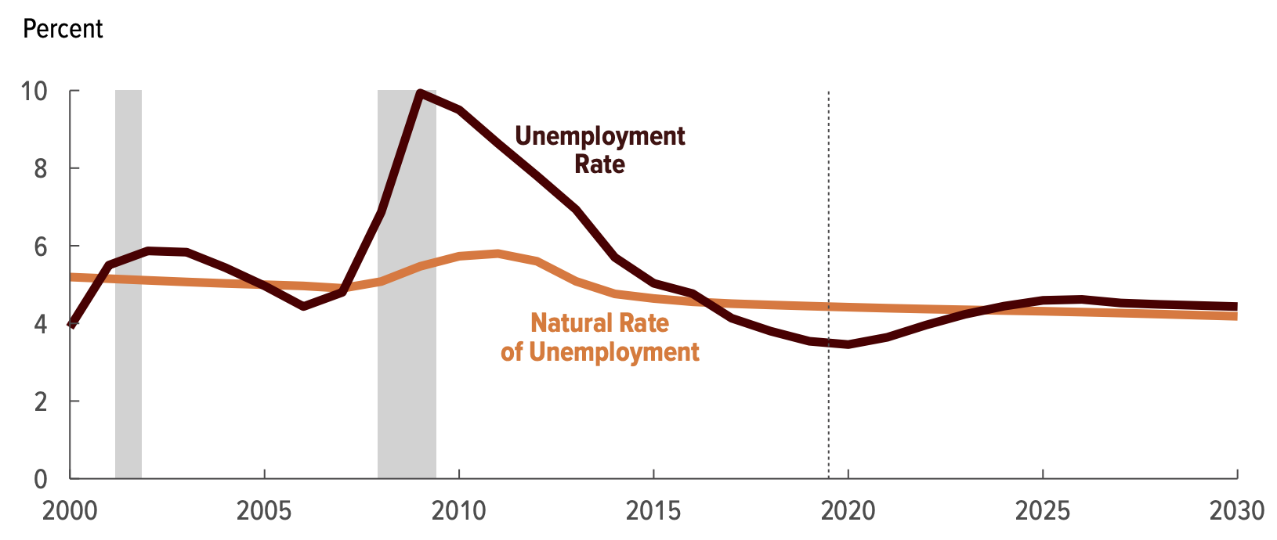
Unemployment rate
3.5% at end of 2020
4.3% by end of 2024
Source: Congressional Budget Office (CBO)

Slide 7
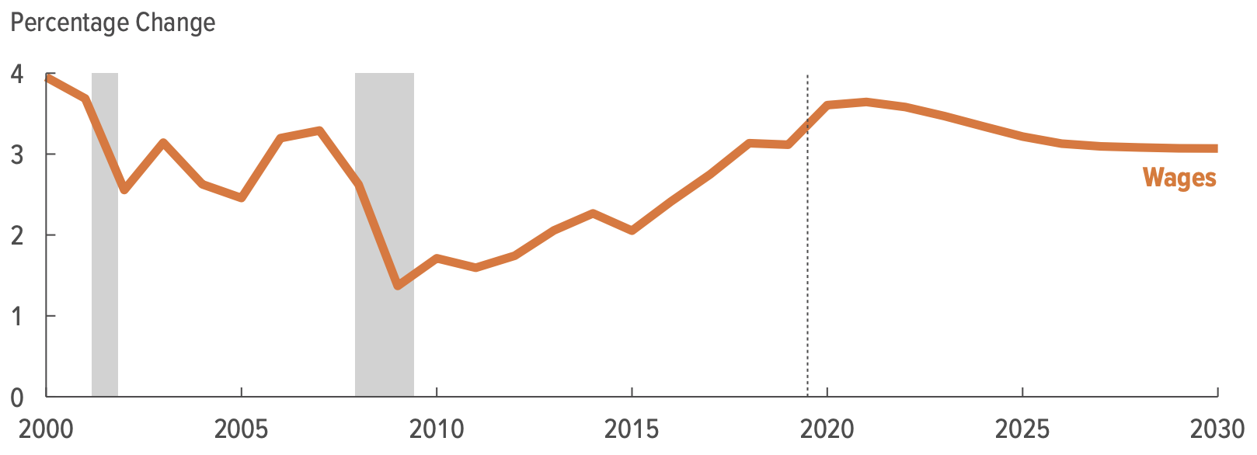
WAGES
3.6% in 2020
Strong wage growth as employers continue to bid up the price of labor to recruit and retain workers (Specially Low and Middle wage earners).
Wage Growth rises from 3.1% (2019) to 3.6% (2020), its highest rate since the early 2000s, and then averages 3.5% (2021 to 2024).
Source: Congressional Budget Office (CBO)

Slide 8
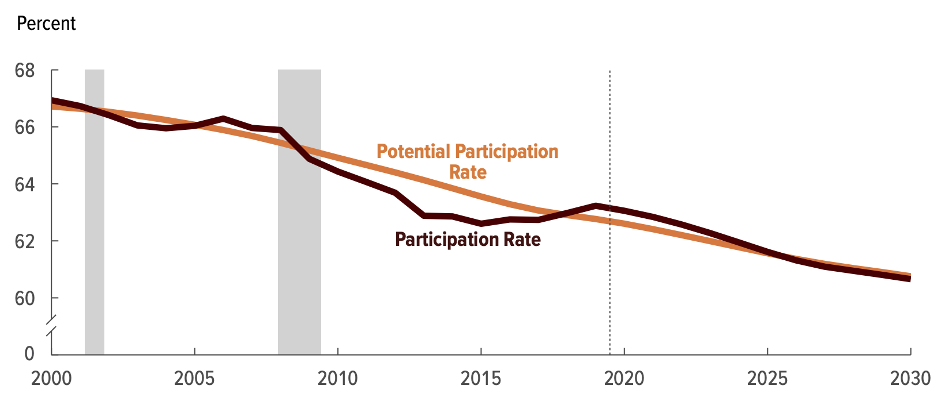
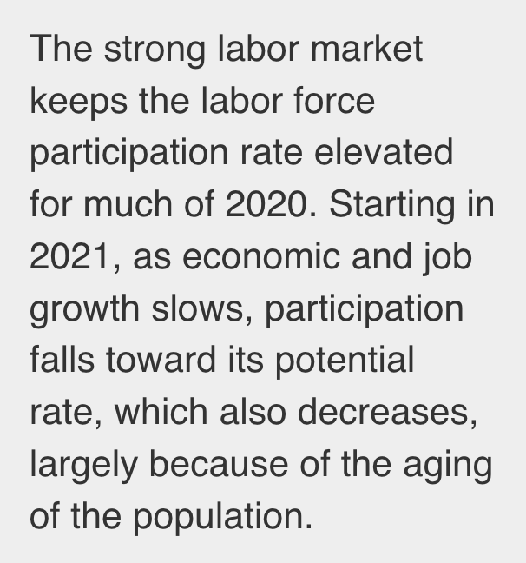
LABOR FORCE Participation RATE
Cyclical strength keeps the overall LFPR above 63 % (2020).
Starting in 2021, as economic and job growth slows, LFPR falls toward its potential.
Overall LFPR falls from 63% in early 2021 to 61.9% by late 2024.
Source: Congressional Budget Office (CBO)

Slide 9
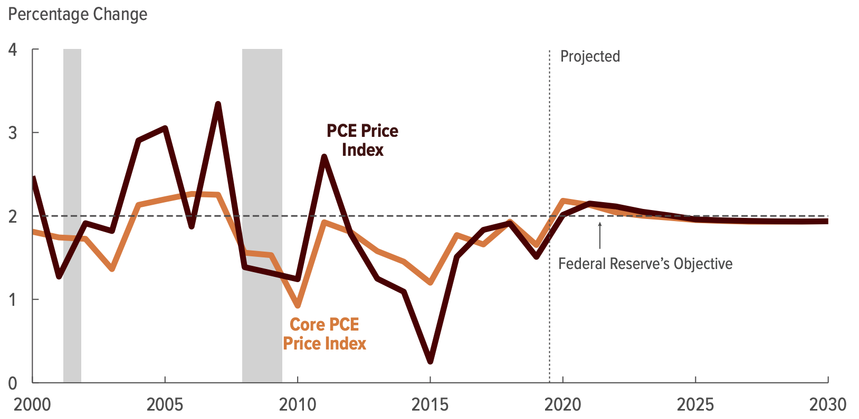
inflation
Core Inflation
2.2 % in 2020
2.1 % in 2021
Overall Inflation;
2.0 % in 2020
2.1% in 2021
Source: Congressional Budget Office (CBO)

Slide 10
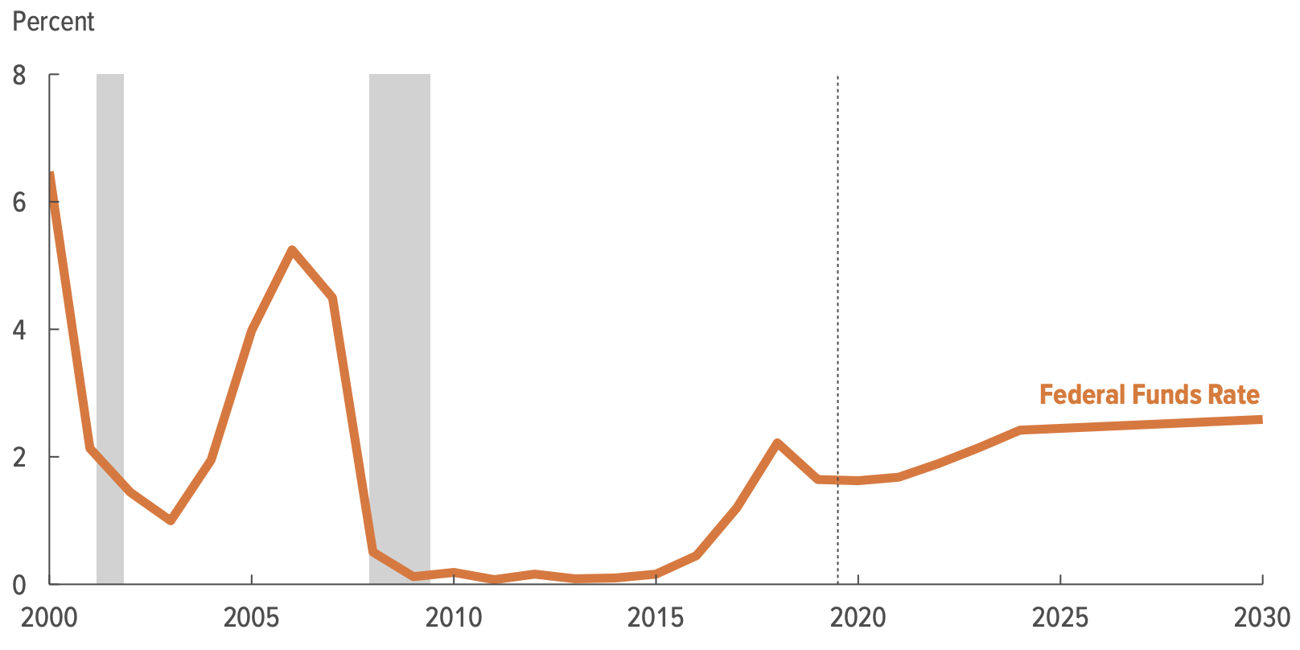
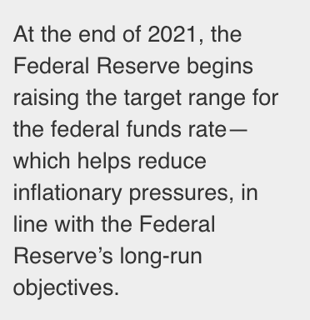
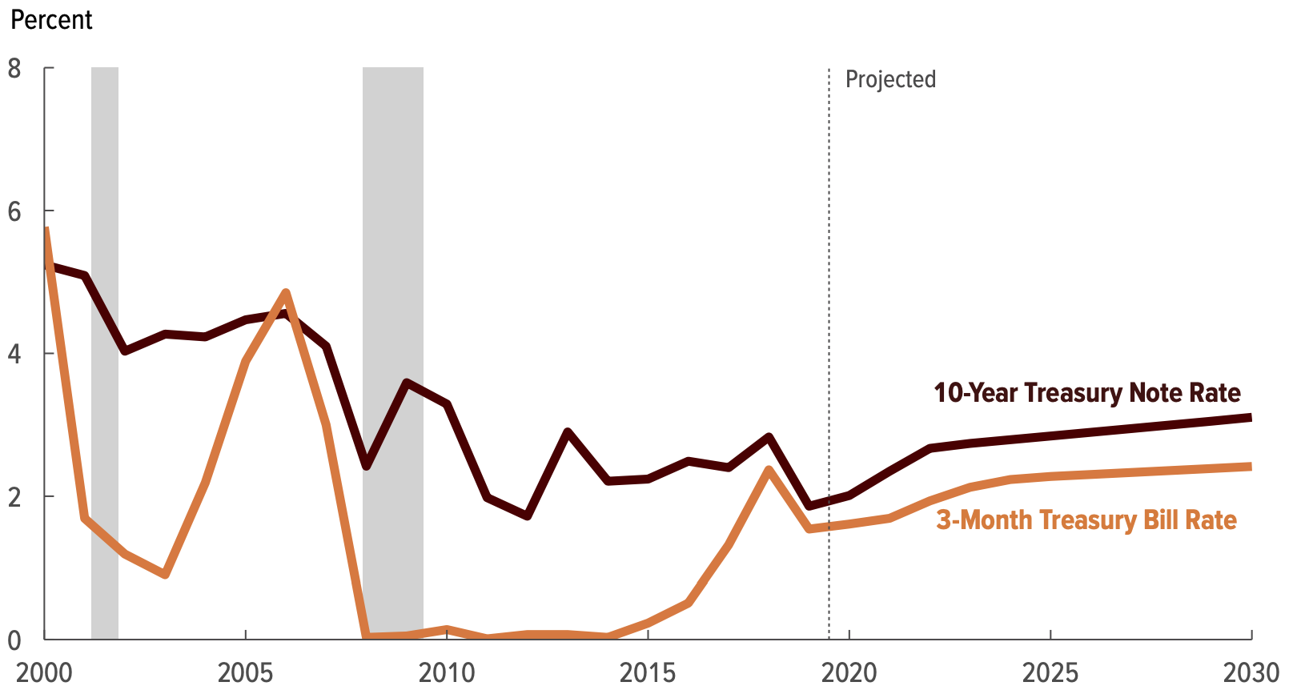
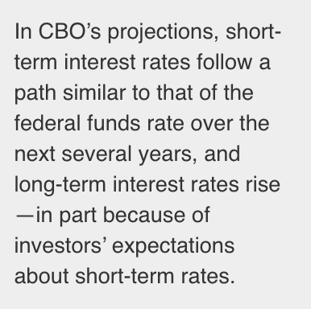
INTEREST RATES
Source: Congressional Budget Office (CBO)

Slide 11
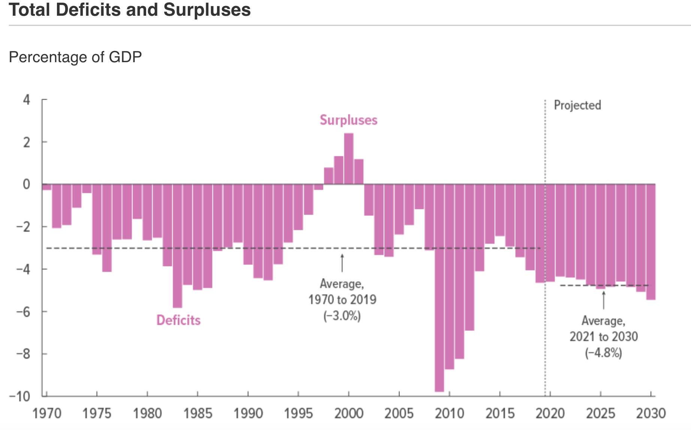
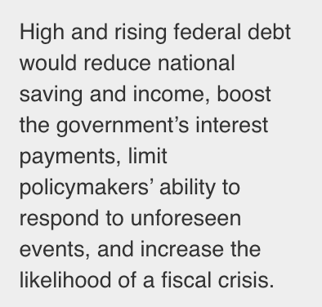
Federal debt held by public
Federal Debt held by Public,
81% of GDP (2020)
98% of GDP (2030)
180% of GDP (2050)
Source: Congressional Budget Office (CBO)

Slide 12
GLOBAL OUTLOOK
Source: IMF

Slide 13
Conclusion
Stronger Consumer spending and Business fixed investment.
Stronger Employment and Wages.
Unchanged FED Funds Rate target till end of 2021.
Inflation around 2% level .
However these projections are subjected to changes in;
Global market conditions. (Coronavirus, Global geo/political tensions)
Uncertainly around Trade Agreements
Sudden changes in domestic market conditions etc …
Global Growth: Trade disputes disrupted growth in 2019, but with tensions and monetary policy simultaneously easing > path to recovery in 2020.

Slide 14
Thank you
source: dailybusinessreview.com

Slide 15
SCSU Winter Institute Minnesota Employment Trends and Outlook
Luke Greiner
Regional Labor Market Analyst
Department of Employment and Economic Development
Labor Market Information Office
http://mn.gov/deed/data/

Slide 16
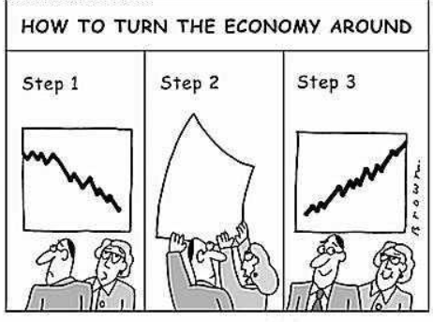
It’s a Beautiful Day in The Economy
, or is it?
2018- to- 2019
Seasonal adjusted unemployment rate ticked up to 3.2% from 2.9% in 2018
More than 3 million Minnesotans are working (record #)
Labor Force grew by +1.2%, the fastest growth since 2000
Notes:
Minnesota is still a half point lower than U.S.
U.S. Labor Force Growth was +0.9%

Slide 17
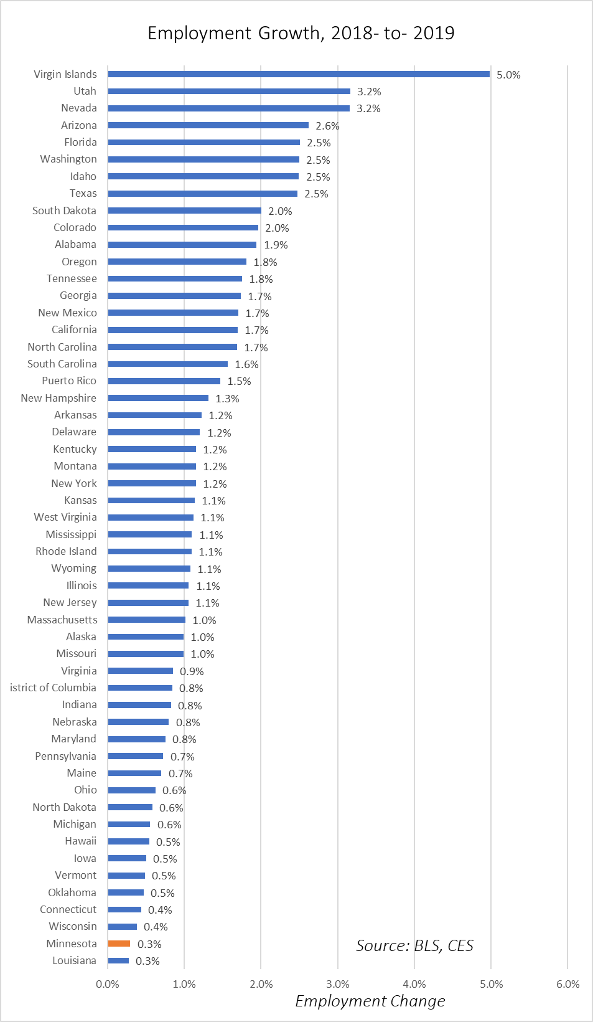
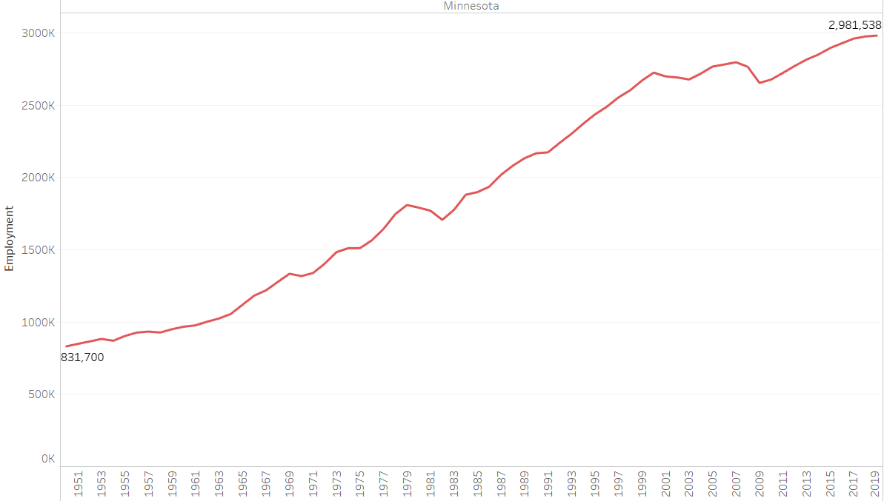
Or is it?
CES data for 2019 will be revised
Annual Employment grew +0.3%, 2018-2019

Slide 18
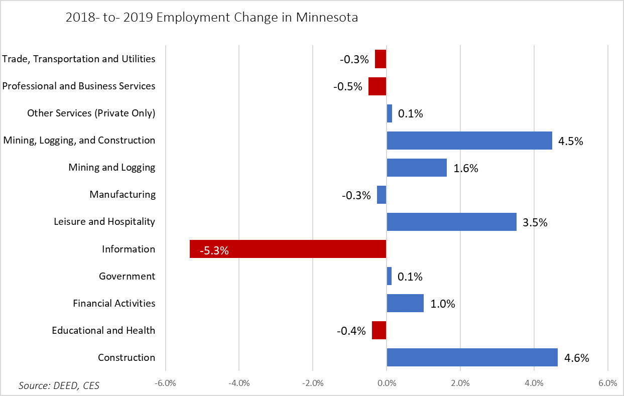

Slide 19
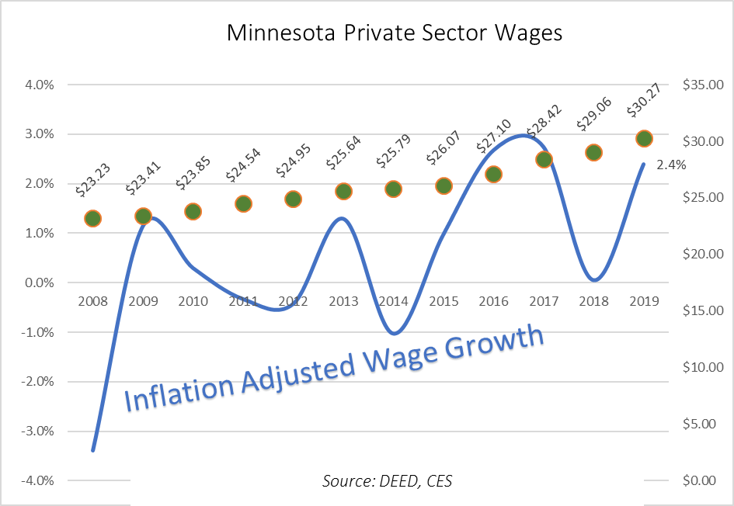

Slide 20
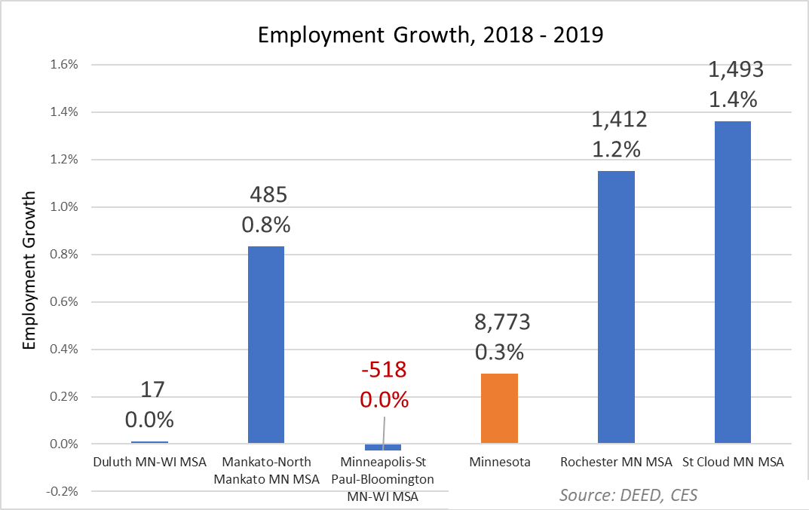

Slide 21
Demographic Trends
Minnesota’s population is still growing – up to 5.6 million in 2018
Now the 22nd largest state in the U.S. (just behind Colorado)
Twin Cities grew +8.8%; Greater Minnesota grew +2.4%
The Baby Boom generation (53-71 years) is causing a significant shift over time
Generation Z = 1,298,657 people
(23.3%)
Millennials = 1,412,429
(25.3%)
Generation X = 1,109,083
(19.9%)
Baby Boomers = 1,265,278
(22.7%)
Silent & Greatest = 491,158
(8.8%)

Slide 22
Labor Force Trends
Minnesota’s labor force is still growing as well
Up from 2,812,947 workers in 2000 (+257,276 workers; +9.1%)
From 1990 to 2000, Minnesota gained +414,049 workers (+17.3%)
From 2000 to 2010, Minnesota added +125,848 workers (+4.5%)
From 2010 to 2018, Minnesota added +131,428 workers (+4.5%)
Labor force growth is projected to slow even more in the next decade
Huge loss in 55-64 year olds (-70,979 workers)
Big gains in 20-44 year olds (+92,528 workers)
Big gains in 65 years & older (+46,034 workers)

Slide 23
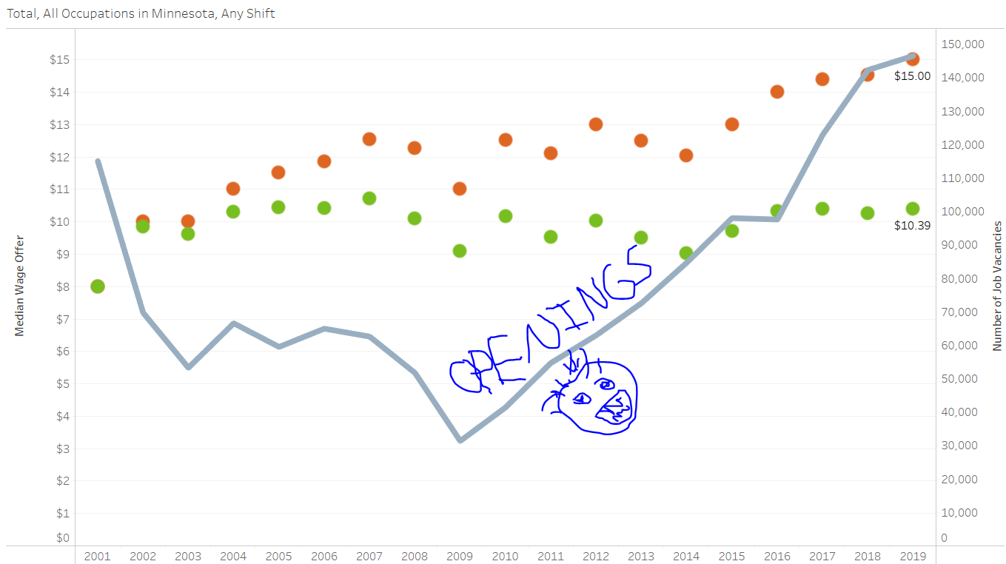

Slide 24
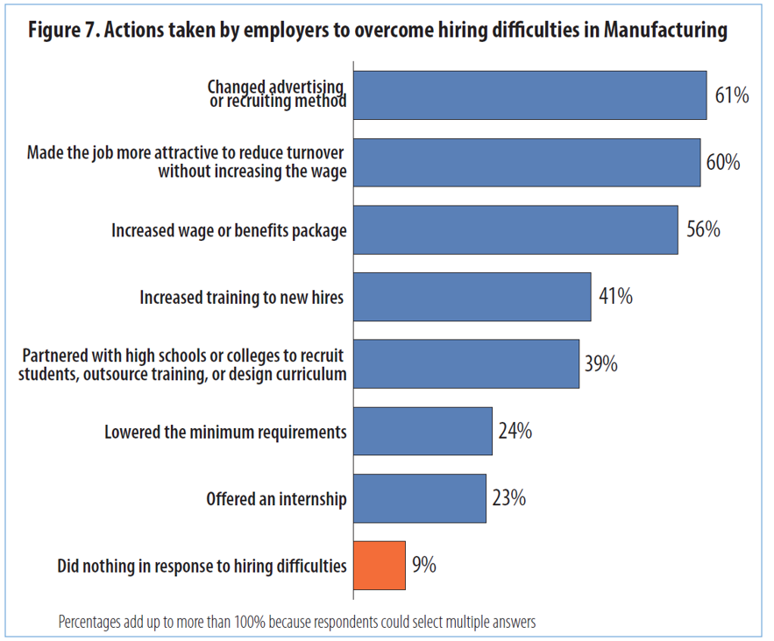

Slide 25
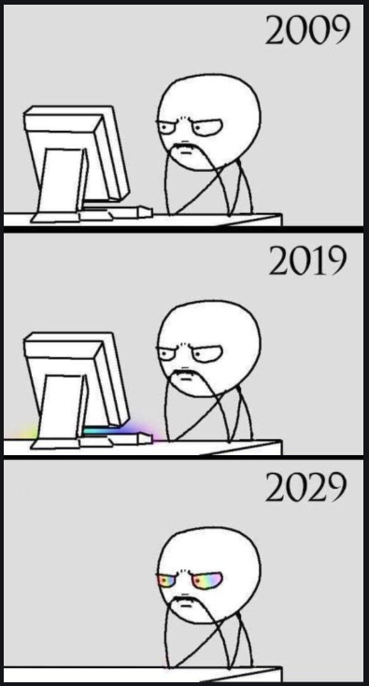
Preparing for the Future
Job Openings reflect future and current needs
What type of openings do we have?
What skills are needed to fill them?
Can you increase labor without increasing people? People or productivity?

Slide 26
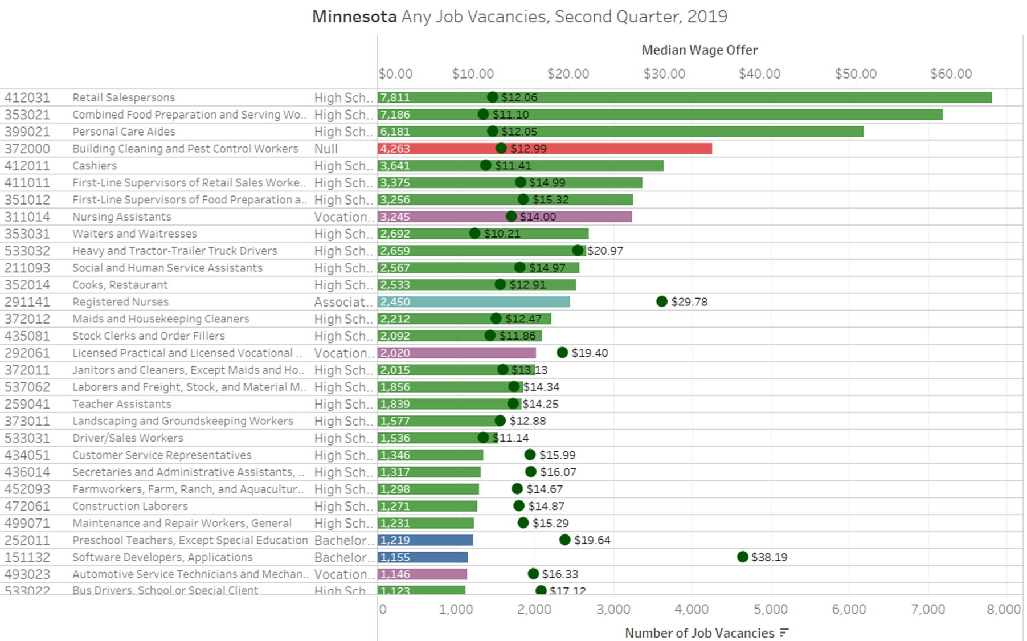

Slide 27
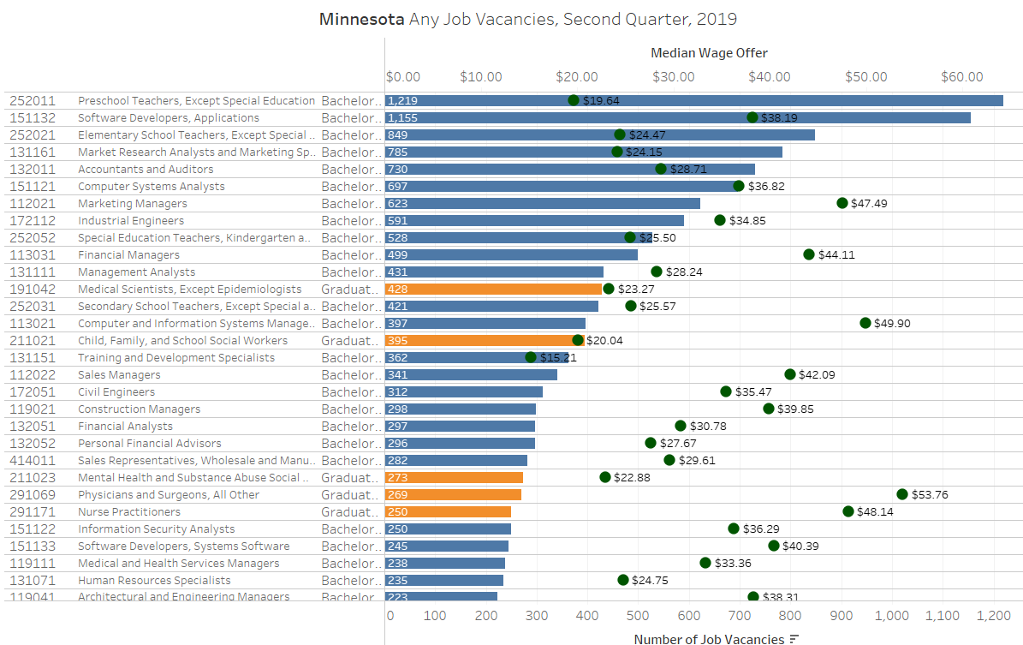
For any Students That are in Attendance…

Slide 28
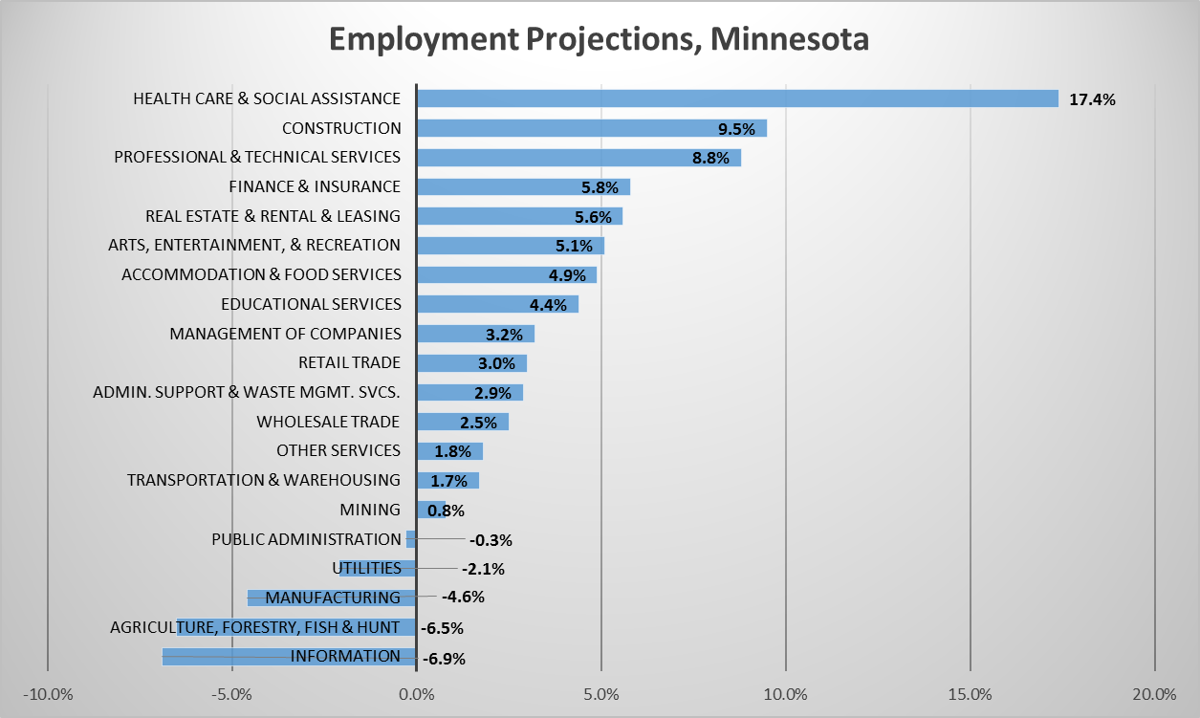
“Its tough to make predictions, especially about the future”

Slide 29
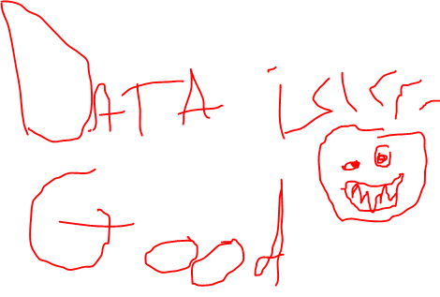

Slide 30
Thank You!
Luke Greiner
Regional Labor Market Analyst
Central and Southwest Minnesota
Labor Market Information Office
Phone: (320)-308-5378
Luke.greiner@state.mn.us

Slide 31
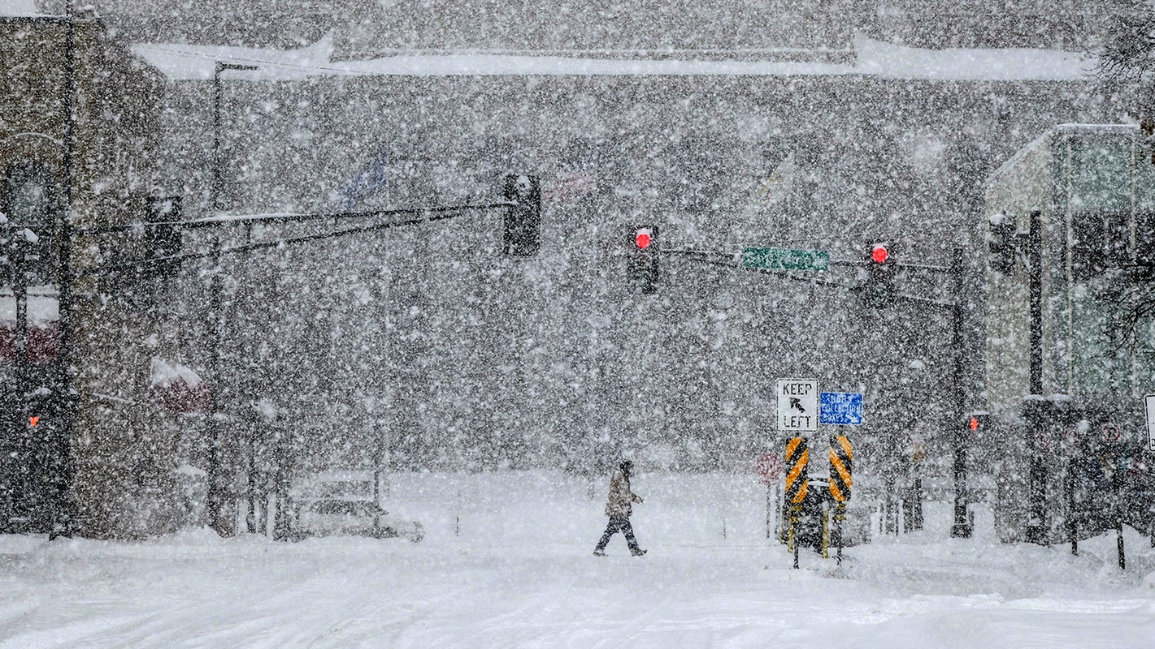
The Future of the Minnesota Economy
Dean King Banaian
St. Cloud State University

Slide 32
How Long Will This Go On?

Slide 33
7% of the economy; 75% of the gain
Construction has been very strong, almost entirely due to commercial.
Notes:
DEED as of Feb 1, 2020.

Slide 34
Local stocks gained 17.2%, vs 30.4% for S&P 500.
Top gainer PPC +117%
Top loser NFYEF -16%
Stocks out: ELUXY, BGRP
Stock in: ECPG

Slide 35
Value of commercial permits up 26%, residential mostly flat
Notes:
Commercial building permit information covers St. Cloud, Sartell, Waite Park, St. Joseph and St. Augusta from city data. Sauk Rapids data not available. Residential data courtesy Central MN Builders Assn.

Slide 36
Major area commercial projects, 2019
TECH HS ($88m)
COSTCO ($32m)
MN Ref’tory ($20m)
Toppan- Merrill ($6m)
State Armory ($6m)
Cathedral HS ($14m)
JAN
FEB
MAR
APR
MAY
JUN
JUL
AUG
SEP
OCT
NOV
DEC
Add’l $6m 1/20
4/20
8/20

Slide 37
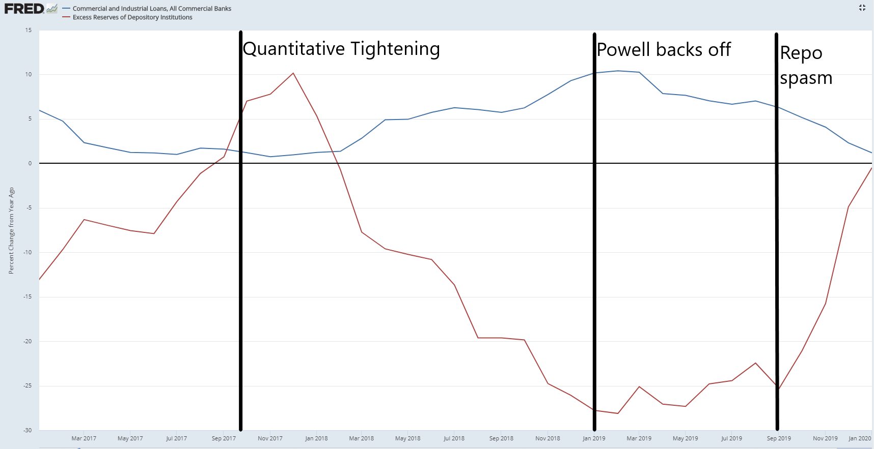
One moment on monetary policy
Two major events in 2019:
Powell speech at AEA reversing course (acknowledged and agreed by Jim Bullard here last February). Future rate increases spiked.
A seize-up in repo markets in September that caused the Fed funds rate to shoot up to 10% and the Fed to add $400 billion to its balance sheet over the rest of the year.
The runoff of excess reserves only began to reverse with the second act.
Despite this, commercial and industrial lending in US has declined.
Creighton Univ. Rural Mainstreet survey of community bankers in January shows loan volume under 50 (55.8 1/19 to 50 Dec. to 48.5).

Slide 38
In the broader central MN area…
Indicators | 12/19 | 12/18 | %chg
MN Business Conditions Index, Creighton Univ. | 50.7 | 55.5 | -8.7%
Central MN initial claims for unemployment ins. | 6,212 | 5,288 | 17.5%
Central MN new filings of incorporation (4th quarter) | 1,094 | 1,017 | 7.6%
US new orders of durable goods (1984$) | 277.7 | 260.9 | 6.4%
Notes:
December 2019 data previous unpublished.

Slide 39
(dollars in millions) | 2010 | 2013 | 2015 | 2018
Total St. Cloud exports | $269.0 | $307.7 | $258.8 | $260.3
Total to Asia o/w | $27.5 | $62.0 | $58.2 | $77.2
not ASEAN* | $21.7 | $50.6 | $43.2 | $49.6
Memo: Private-sector GDP, o/w | $6,889.7 | $7,700.0 | $8,443.4 | $9,357.5
Goods production | n/a | $2,177.4 | $2,418.7 | $2,572.4
Should we worry about coronavirus?
Not really, from a local economy view.
Supply chain more than demand issues.
Ecolab 5 manufacturing facilities AND 40 sales offices, 3k employees
“More than 90% of the products we sell in China are manufactured in the country. We do not want to dismantle a business that took more than 30 years to build.”
Cargill $7.5 bn in China, 9k employees in 50 locations
"Cargill has not relocated any of our businesses or supply chains out of China, and at this time we don't have any plans to.“
Both statements pre-date coronavirus.
Notes:
Source of quotes: Jim Spencer, “Minn. firms find ways to buffer tariffs' toll: Buyers juggle costs while sellers stick with China.” Minneapolis StarTribune, Oct. 7, 2019, p A1. Data from US International Trade Association except GDP, from BEA.

Slide 40
The latest LEI is not positive about first half
2
3
4
St. Cloud Index of Leading Economic Indicators as of October 2019, indicators that are positive.
1
5
0
6

Slide 41
2020 will be a slower year than 2019
Conclusions
POSITIVES:
Credit should get easier.
Firms are paying more
Less qualified?
Labor supply still growing
Washington and state legislature have elections to occupy them.
If China reopens soon, trade deal should have small impact.
USMCA puts that issue aside.
NEGATIVES:
Boost from construction most likely fades.
Negative external shocks still matter.
Germany and China were slowing before January.
Retail space, many other service sectors disrupted by tech.
THIS IS NOT A RECESSION FORECAST!!
But this reflects the vulnerabilities we face today.

