Slide 1
Immigration Economics and Immigration Policy
George J. Borjas
February 2019

Slide 2
2. The “economistic” perspective
Immigration is like trade.
Importing a widget is equivalent to importing a few skilled workers to do the design, and a few more low-skill workers to do the manufacturing. Immigration simply allows the production to be done domestically.
All the costs and benefits come from the immigrants’ time on the assembly line.
Immigrants have no other effects on the receiving country’s political, social, cultural, and economic infrastructure.
We’ve all been taught: “Trade is good.” Therefore, immigration is good.

Slide 3
3. A more realistic perspective
Max Frisch on guest workers entering Europe in the 1950s and 1960s:
“We wanted workers, but we got people instead.”
Calculating the impact of immigration requires taking into account that immigrants act in particular ways because some actions are more beneficial than others.
Those decisions have repercussions and unintended consequences that can magnify or shrink the beneficial impact of immigration that comes from their contribution to widget production.

Slide 4
4. Those choices include…
People choose to migrate. As Obi-Wan Kenobi might say: “Those weren’t the people we were looking for.”
Immigrants choose whether or not to assimilate.
Immigrants wear ethnic labels, and ethnicity can have a long-term social and cultural impact.
Immigrants have lives outside the factory gates, and there’s an important interaction between immigration and the welfare state.

Slide 5
5. The narrative
Paul Collier in Exodus: How Migration is Changing our World:
“A rabid collection of xenophobes and racists…lose no opportunity to argue that migration is bad for indigenous populations. Understandably, this has triggered a reaction: desperate not to give succor to these groups, social scientists have strained every muscle to show that migration is good for everyone.”
And how do social “scientists” do this? By:
Ignoring distinction between workers and people.
Making assumptions.
Overlooking inconvenient facts.

Slide 6
6. Examples of narrative building
“Open borders will solve the world’s poverty problem once and for all.”
”Immigrants have a small impact on the labor market opportunities of native workers.”
“Immigrants create huge benefits for the nation’s economy.”
“The fiscal impact of immigration, obtained by comparing the taxes they pay with the services they receive, is trivial. And may even be beneficial.”

Slide 7
7. Imagine there’s no countries…
The impact of open borders, 2013
Increase in world GDP | $40.1 trillion
Number of movers | 5.6 billion
Wage change in the North | −39.3 percent
Wage change in the South | +143.0 percent
Increase in world GDP after accounting for migration costs | $28.1 trillion
Source: George J. Borjas, ”Globalization and Immigration: A Review Essay,” Journal of Economic Literature 53 (2016), 965.

Slide 8
8. Imagine there’s no countries…
The impact of open borders, 2013
Increase in world GDP | $40.1 trillion
Number of movers | 5.6 billion
Wage change in the North | −39.3 percent
Wage change in the South | +143.0 percent
Increase in world GDP after accounting for migration costs | $28.1 trillion
Source: George J. Borjas, ”Globalization and Immigration: A Review Essay,” Journal of Economic Literature 53 (2016), 965.

Slide 9
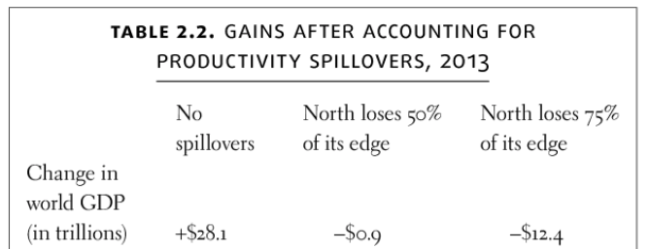
9. Externalities in Lennon’s Utopia

Slide 10
10. The laws of supply and demand
The supply of oil goes up; the price of gas goes down.
Paul Samuelson (1964): “After World War I, laws were passed severely limiting immigration. Only a trickle of immigrants has been admitted since then . . . By keeping labor supply down, immigration policy tends to keep wages high.”
This inference from the laws of supply and demand is highly disputed in the immigration context.

Slide 11
11. Supply and demand in real life
September 2006: Immigration agents raid Crider; a chicken-processing plant in Stillmoore, GA.
Crider suddenly loses 75% of its 900 workers.
Samuel Johnson: ”When a man knows he is to be hanged in a fortnight, it concentrates his mind wonderfully.”

Slide 12
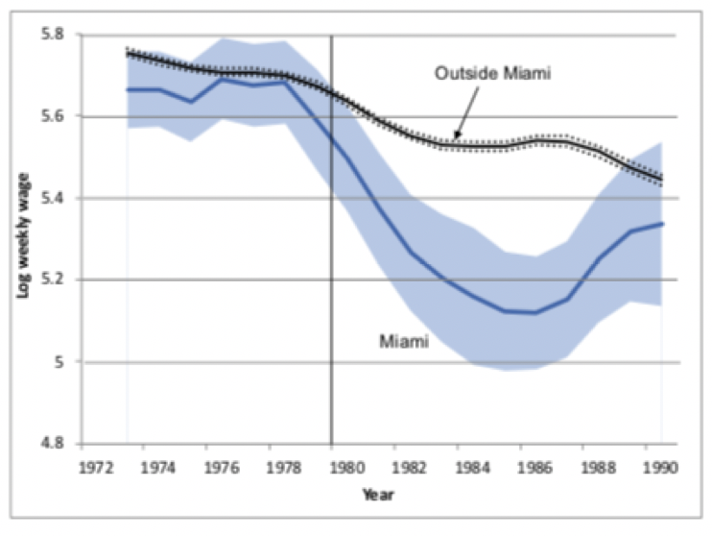
12. Supply and demand after Mariel (male, non-Hispanic, HS dropouts, 25-59)

Slide 13
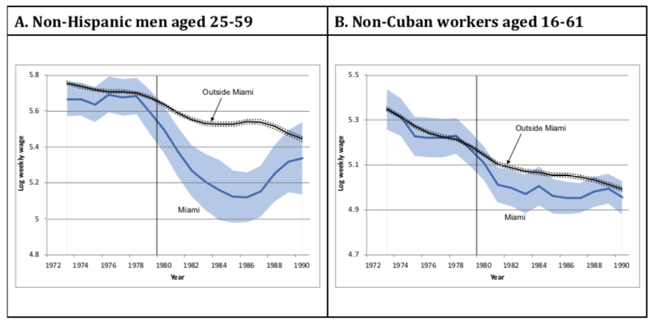
13. Fake news, part 1

Slide 14
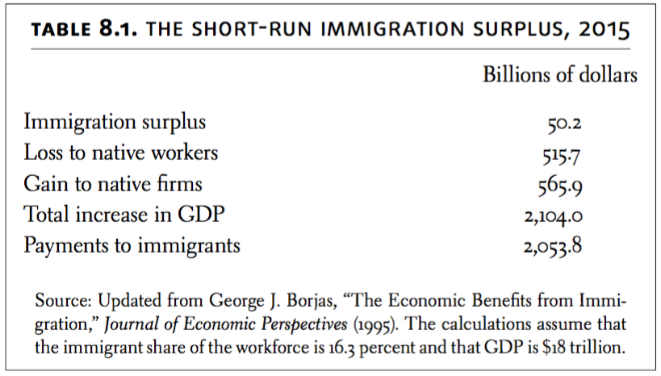
14. Estimate of the immigration surplus
Calculation of immigration surplus ignores externalities. Those externalities can be beneficial or harmful.

Slide 15
15. Fake news, part 2.

Slide 16
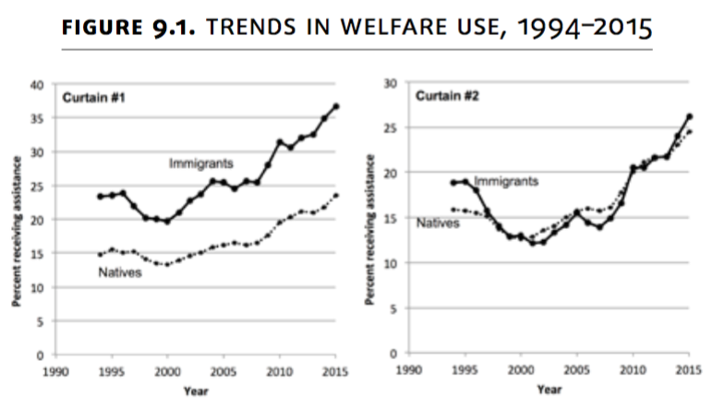
16. Fake news, part 3
Curtain #1: Households
Curtain #2: Persons

Slide 17
17. Fiscal impact in the short run
National Academy of Sciences, 2016: State and local expenditures on immigrants exceed taxes paid by immigrants by about $57 billion annually.
If we add in the federal government, the burden can increase substantially, perhaps up to $299 billion.
But short-run calculation misses a lot of the benefits (e.g., natives are getting older, and immigrants can help fund the liabilities).

Slide 18
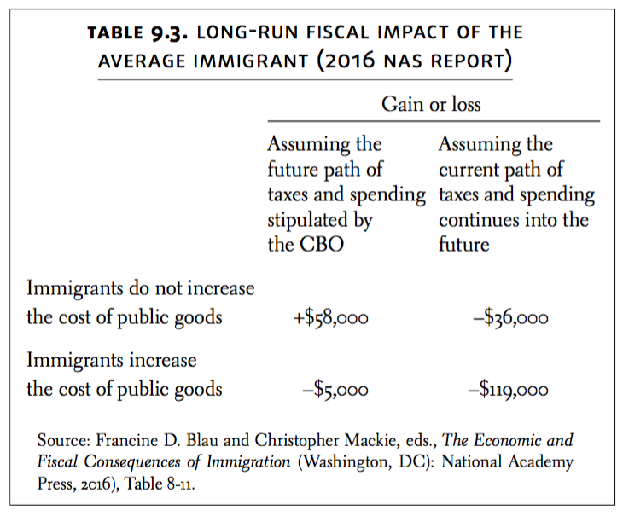
18. Fiscal impact in the long run

Slide 19
19. And in the end...
The most credible estimate of the immigration surplus is about $50 billion annually. Most credible estimates of the fiscal burden are at least $50 billion. Put bluntly, immigration is at best a net wash.
But there are winners and losers; and the losers compensate the winners to the tune of half-a-trillion dollars annually.
This helps to explain who is on which side of the immigration wars.

Slide 20
20. Who are you rooting for?
The adoption of any immigration policy implicitly makes a statement not only about how much we care about immigrants as compared to natives, but also about how much we care about this particular group of natives versus that particular group of natives.

